Slide 1
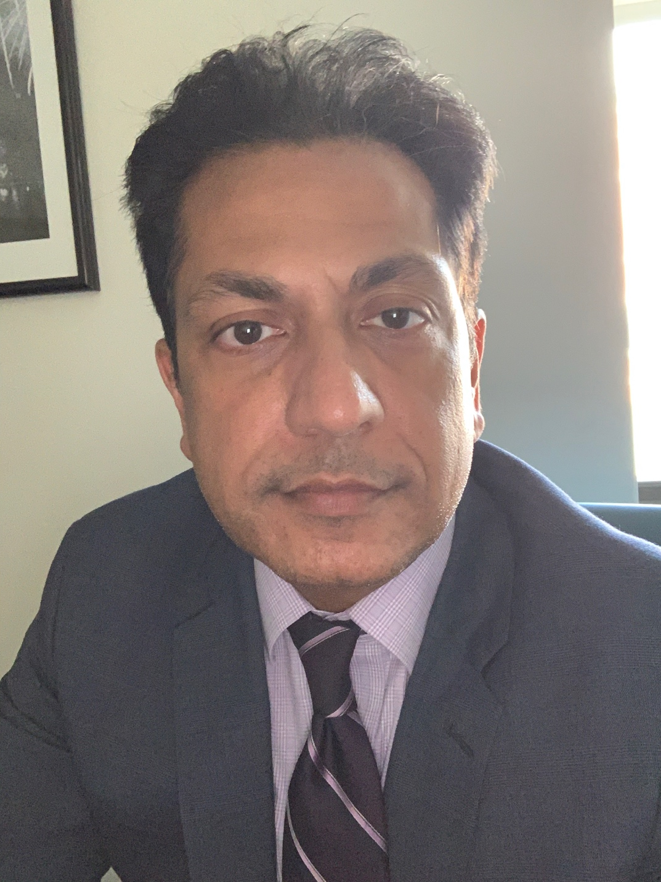
Manish Sharma, DO, MBA, FACEP
Chairman
Department of Emergency Medicine
NewYork-Presbyterian Queens
Dr. Manish Sharma is the Chief of Emergency Medicine at NewYork-Presbyterian Queens (NYP Queens). Dr. Sharma holds an MBA and has served in numerous administrative leadership roles. He is a seasoned emergency physician with a proven record as a medical educator, having held multiple residency leadership positions. In addition to being selected as an American Board of Emergency Medicine (ABEM) Oral Board Examiner and as Chief Resident, Dr. Sharma has been honored with numerous teaching awards. Dr. Sharma’s leadership style is focused on collaboration with the goal of providing high-quality, compassionate medical care. His mission is to standardize practices across the NYP system and follow best practices in delivering care to our patients.

