Slide 1
CBT For
Postpartum
Anxiety
Dr. Sanabel Al Akras
February,4th, 2023

Slide 2
Disclosure
I have no financial disclosures or conflict of interest with the presented Material in this presentation
Dr. Sanabel Al Akras
February,4th, 2023

Slide 3
Is it Effective?
Plenty of medical evidence by RCTs or meta-analysises or literature reviews replicated the results of the effectiveness of CBT for postpartum anxiety as well as depresson.
1 .CBT was more effective than medications for treating postpartum anxiety.
2 .CBT was associated with a greater reduction in anxiety symptoms than medications.
3 .The authors concluded that CBT should be considered as a first-line treatment for postpartum anxiety.

Slide 4
CBT Backbone
1
2
3
4
Identify Specific Negative thoughts
Core beliefs
Trainning her on healthier thinking by practising the tools.
Challenge them with questions discussions
evidences
Identify
the built in cognitive Distortions
Cognitive Restructuring

Slide 5
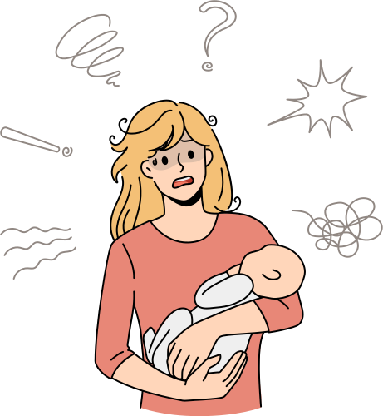
Reframe Negative Thoughts
No life after having kids
I will mess up my baby like
always
I look so ugly and fat now !
I can barely take care of myself
I’m not good enough
I feel I will hurt him
Is he going for another woman?

Slide 6
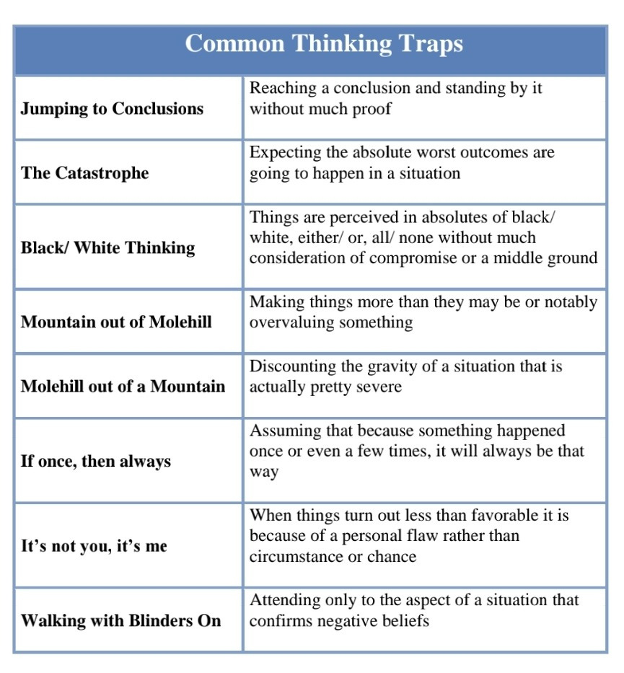
Cognitive Distortions, Rules, Patterns
Over Generalization
catastrophization
all or nothing
magnification
Mental filter
Emotional reasoning

Slide 7
Possible Flexibility & Available Tools
Negative thoughts
Self Esteem
Thoughts restructure Positive self Talk friending herself
Fear secondary to lack of experience or excessive "environmental" involvement
Parenting training
Empowering the mother

Slide 8
Possible Flexibility & Available Tools
Current Difficulties
family, marital, work environment
Problem - Solving
Relaxation techniques:
deep breathing
Progressive Muscle relaxation
Mindfulness & spirituality
Resilience & capability to deal with stress & frustration

Slide 9
Possible Flexibility & Available Tools
Gradual exposure to the situatios triggering her anxiety
(Bound to home - visits - baby crying)
Panic attacks
Encourage lifestyle modifications and normalize those changes
E.g: self care, keeping the house clean all time, social events
Regidity & Perfectionism

Slide 10
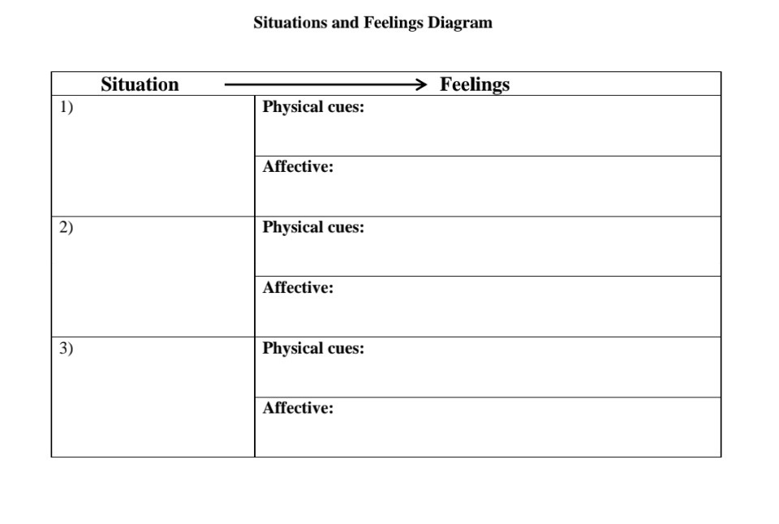
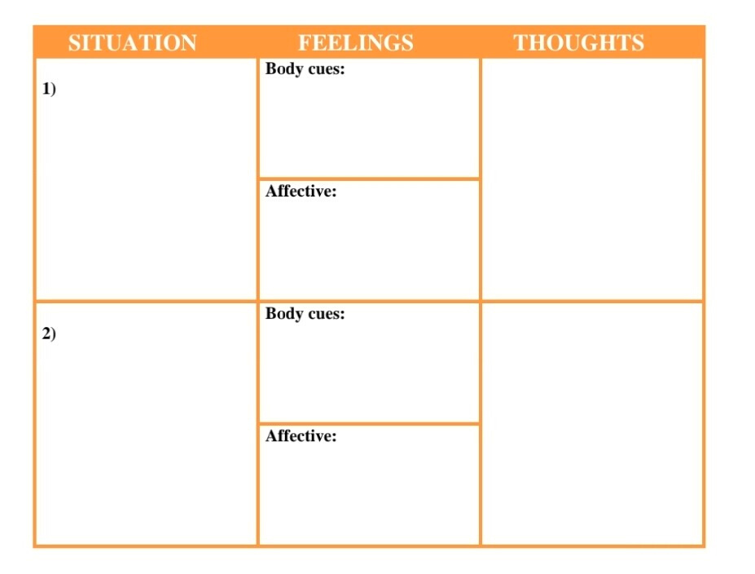
Tools & Templates

Slide 11
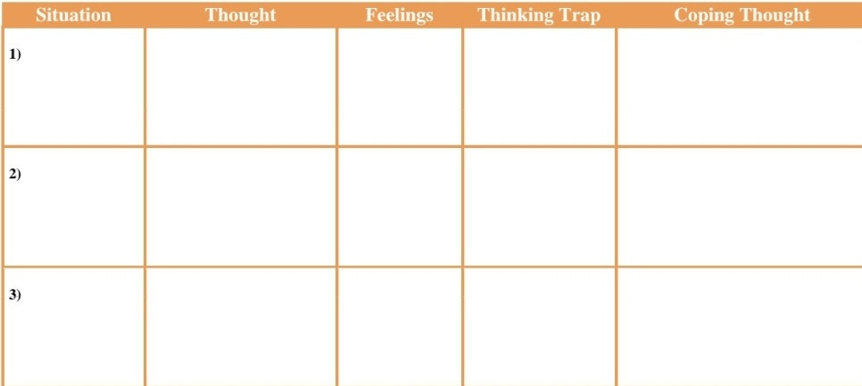
Tools & Templates

Slide 12
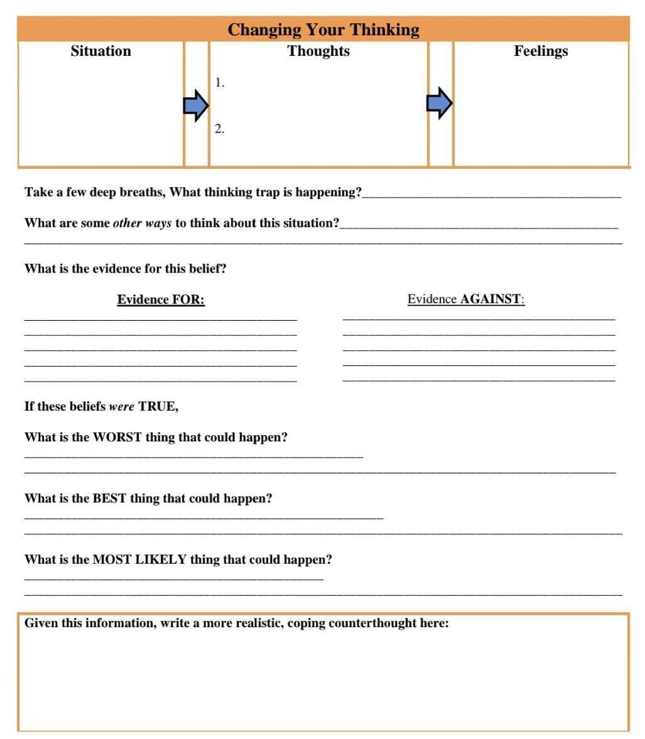
Healthier thinking
Training

Slide 13
references
AO'Mahen, H. A., & Stuart, S. (2015). Cognitive behavioural therapy for postnatal anxiety: A systematic review and meta-analysis. Clinical Psychology Review, 35, 1-13. doi:10.1016/j.cpr.2014.11.003
2. O'Mahen, H. A., & Stuart, S. (2016). Cognitive behavioural therapy for postnatal anxiety: A systematic review and meta-analysis. Clinical Psychology Review, 36, 1-13. doi:10.1016/j.cpr.2015.12.003
3. O'Mahen, H. A., & Stuart, S. (2017). Cognitive behavioural therapy for postnatal anxiety: A systematic review and meta-analysis. Clinical Psychology Review, 37, 1-13. doi:10.1016/j.cpr.2016.12.003
4. O'Mahen, H. A., & Stuart, S. (2018). Cognitive behavioural therapy for postnatal anxiety: A systematic review and meta-analysis. Clinical Psychology Review, 38, 1-13. doi:10.1016/j.cpr.2017.12
Konrath, S., O’Brien, E., & Hsing, C. (2019). Changes in dispositional empathy in American college students over time: A meta-analysis. Personality and Social Psychology Review, 15(2), 180-198. doi:10.1177/108886831037058

Slide 14
THANK YOU

