Slide 1
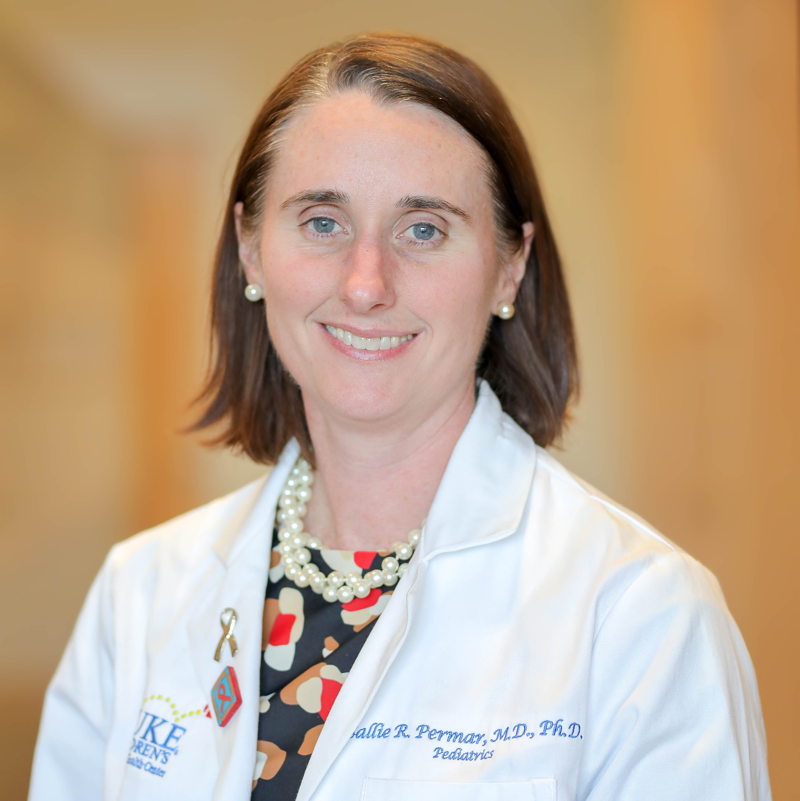
Sallie R. Permar, MD, PhD
Wilburt C. Davison Distinguished Professor of Pediatrics
Professor in Pediatrics, Immunology, and Molecular Genetics and Microbiology
Associate Dean, Office for Physician-Scientist Development
Director, Children’s Discovery Institute
Duke Human Vaccine Institute
Duke University Medical Center
Dr. Sallie Permar is a physician-scientist focusing on the prevention and treatment of neonatal viral infections. She leads a research laboratory investigating immune protection against vertical transmission of neonatal viral pathogens, namely HIV and cytomegalovirus (CMV), using human cohorts and nonhuman primate models. Dr. Permar has made important contributions to the development of vaccines for prevention of vertical HIV transmission, defining both innate and adaptive immune responses that are associated with protection against infant HIV acquisition. Moreover, Dr. Permar is leading the development of HIV vaccine strategies in preclinical maternal/infant nonhuman primate models and translation of this work for clinical vaccine trials in infants. Dr. Permar has also worked to understand the determinants of congenital and perinatal CMV transmission, developing the first nonhuman primate model of congenital CMV infection and designing human cohort studies that have been used to define the immune correlates of protection necessary to guide vaccine development.
Dr. Permar has a PhD in Microbiology/Immunology from Johns Hopkins Bloomberg School of Public Health in Baltimore, an MD from Harvard Medical School and completed her clinical training in pediatric infectious diseases at Boston Children’s Hospital. She has received several prestigious awards for her work as an investigator, including the Presidential Early Career Award in Science and Engineering (PECASE) and the E. Mead Johnson Award from the Society of Pediatric Research; she has also been inducted into the American Society of Clinical Investigation (ASCI), is a Fellow of the American Academy of Microbiology (AAM) and serves on the board of the National CMV Foundation. Dr. Permar is an institutional and national leader in physician-scientist training, serving as the Associate Dean of Physician-Scientist Development at Duke University Medical School, and she was selected by the Association of Medical School Pediatric Department Chairs (AMSPDC) as the next Director of the national Pediatric Scientist Development Program in 2019.

