Slide 1
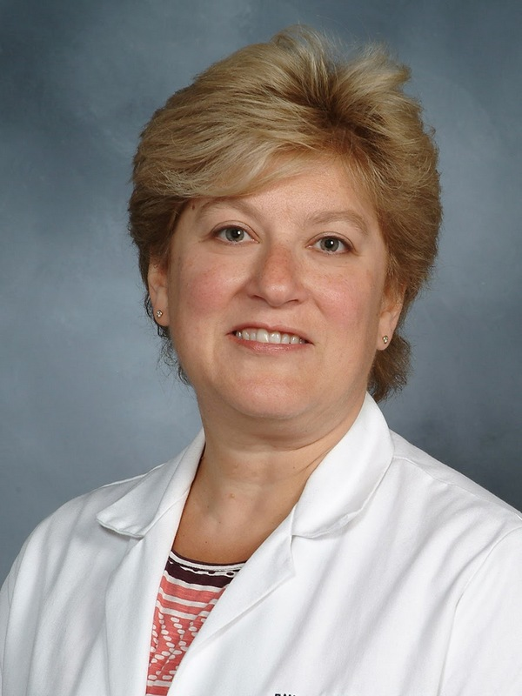
Randi R. Diamond, MD
Assistant Professor of Clinical Medicine
Division of Geriatrics and Palliative Medicine
Director, Liz Claiborne Center for Humanism in Medicine
Weill Cornell Medicine
Dr. Diamond is an Assistant Professor of Clinical Medicine in the Division of Geriatrics and Palliative Medicine at New York-Presbyterian Hospital/Weill Cornell Medical Center (NYPH/WCMC). She is involved the development of creative educational programs as the founding Director of the Liz Claiborne Center for Humanism in Medicine, and is an active clinician educator working with medical students, residents and fellows in palliative care, reflective practice and medical humanities. She serves on the NYPH Ethics Committee and is a faculty advisor to the WCMC student humanities journal, Ascensus. In addition, she is committed to her work in global health, traveling annually to rural Uganda to provide and teach palliative medicine.

