Slide 1
Biased ChatBots & Health Disparity Populations
Jessica L. Roberts, University of Houston Law Center

Slide 2
Disclosure Statement
Speaker:
Prof. Jessica Roberts
Has no relevant financial relationships to disclose.
Will not be discussing unlabeled/unapproved use of drugs or products.

Slide 3
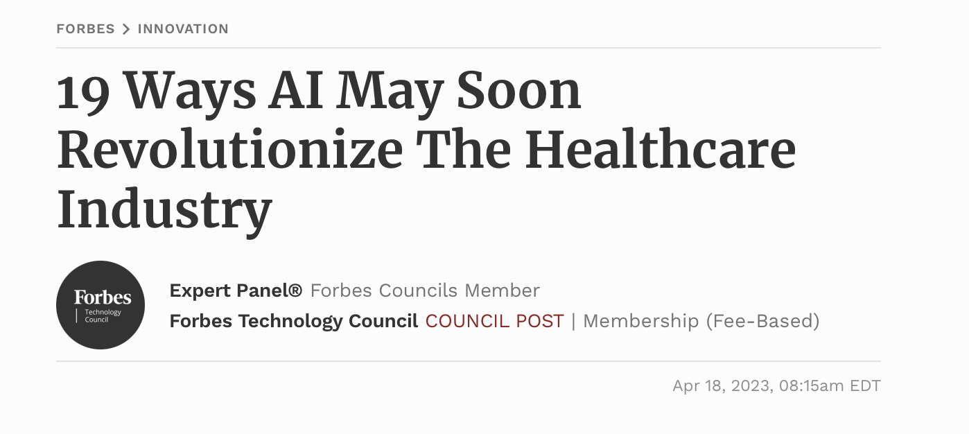
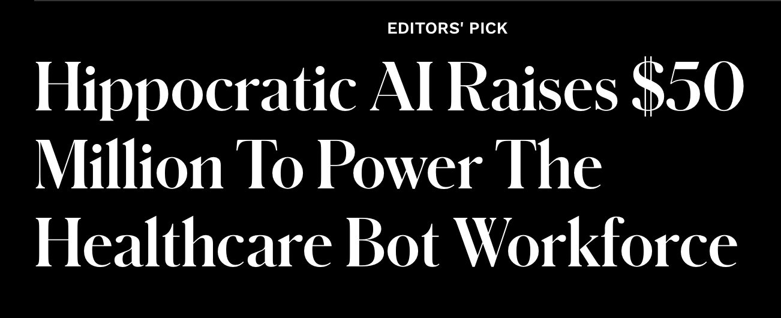
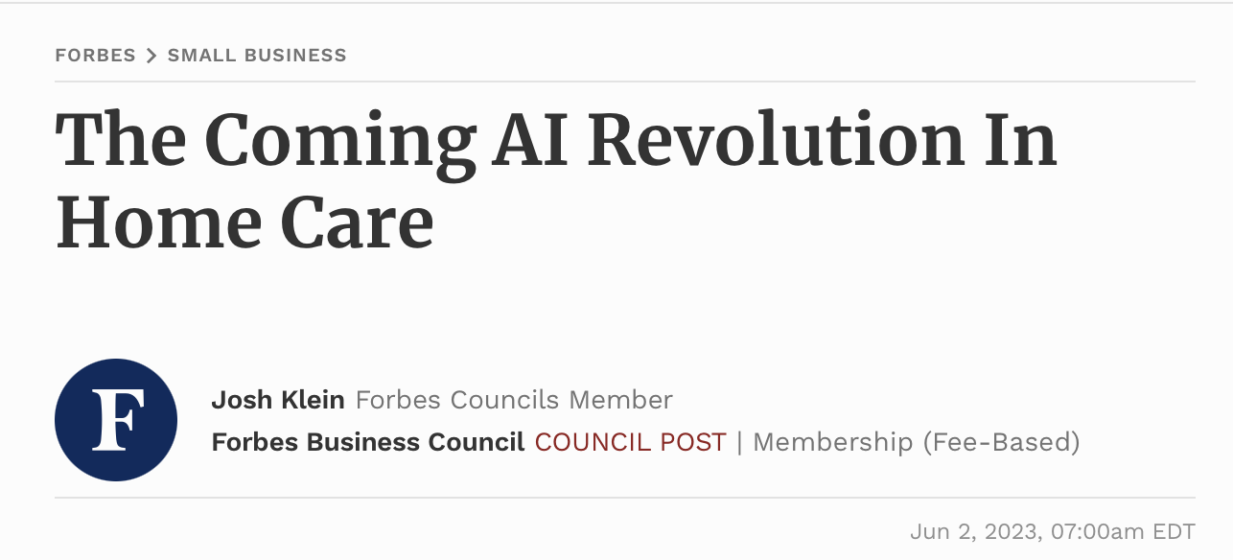

Slide 4
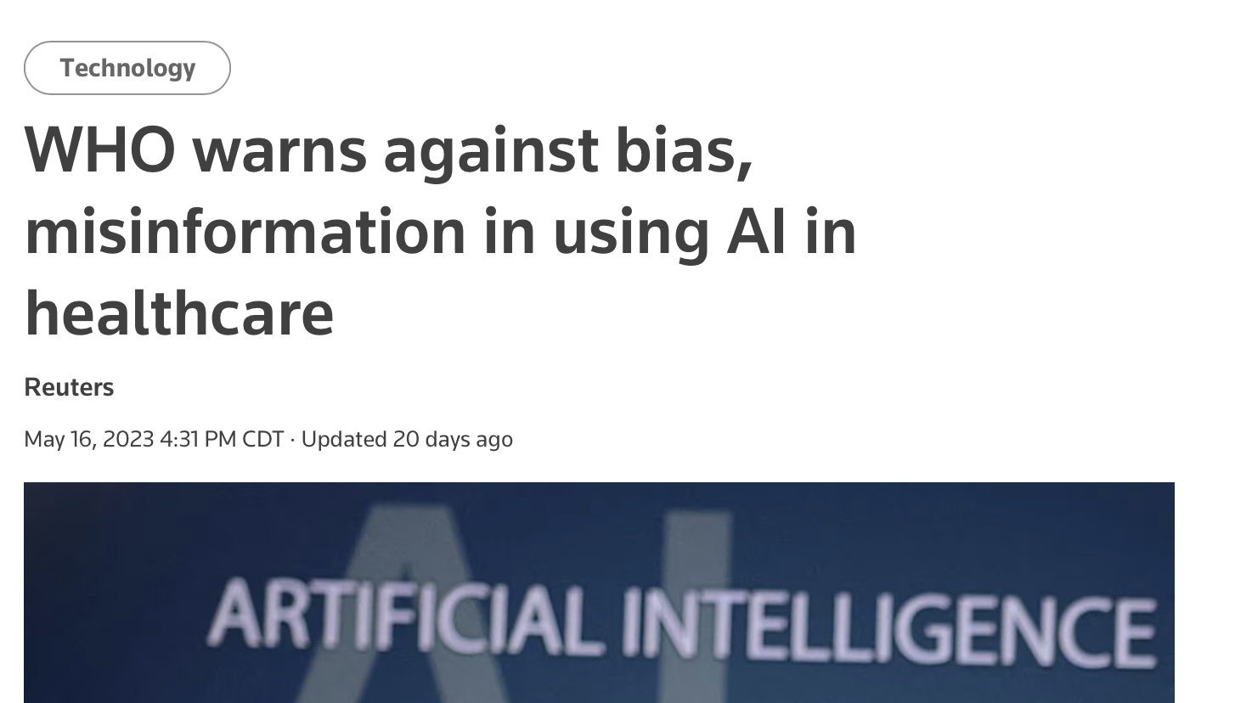
Integrating health AI equitably

Slide 5
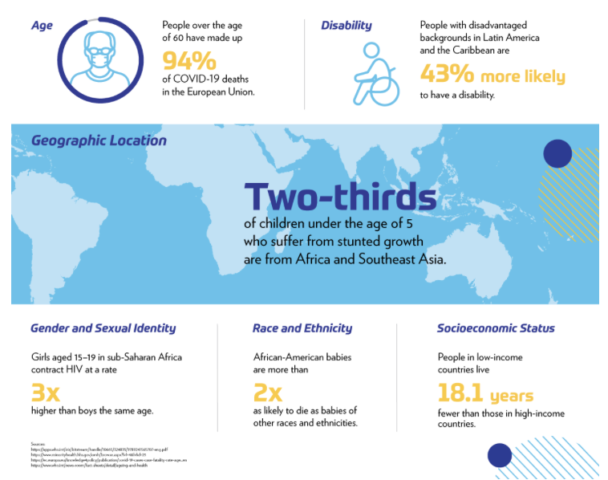

Slide 6
Goals
Identify what biased data is in healthcare.
Examine how biased data is incorporated into chatbot development.
Outline the risks in healthcare from data biases.
Appraise the legal protections for data biases in health care and their shortcomings.

Slide 10
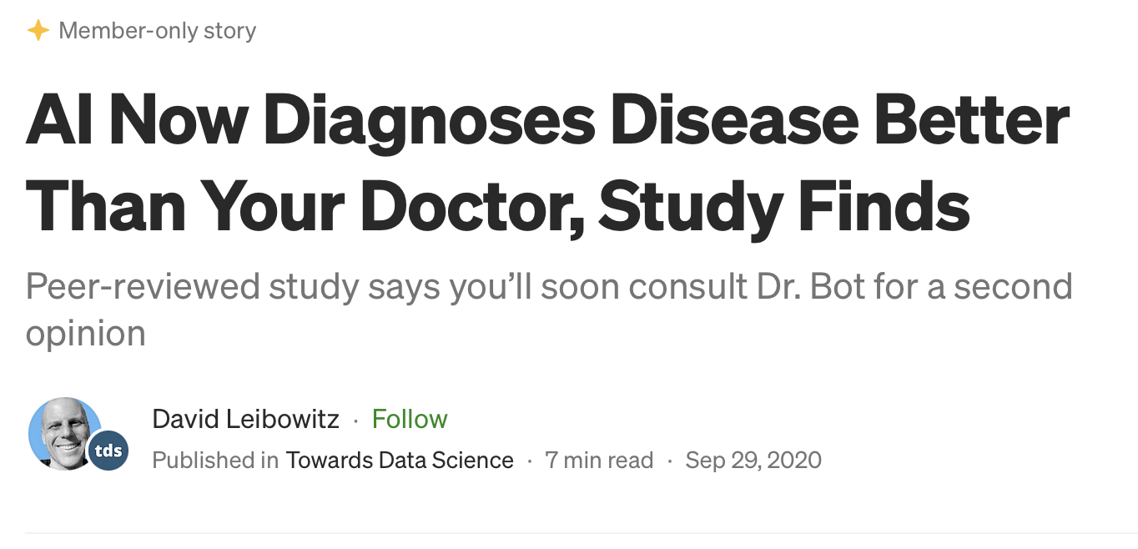

Slide 11
Ways data can lead to disparities
Inaccurate data
Incomplete data
Statistically accurate data that can create or perpetuate disparities.
Goal Misspecification
Disparate Impact

Slide 12
Inaccurate data

Slide 13
Incomplete Data

Slide 14
Accurate data (goal misspecification)

Slide 15
Accurate data (disparate impact)

Slide 17
Effect of data on results
Inaccurate data | Incomplete data | Misspecification | Disparate impact
Outputs replicate the bias in the inputs. | Outputs are less reliable for underrepresented populations. | Outputs accurately reflect the proxy but the proxy generates a socially undesirable result. | Outputs accurately reflect the desired variable but lead to a socially undesirable result.
E.g., under-diagnosis of cardiovascular disease in women. | E.g., polygenic risk scores. | E.g., amount spent on health care as a proxy for need. | E.g., double-booking for likely no-shows.
E.g., AI will under-diagnose cardiovascular disease in women at the same rates as the training data. | E.g., AI will not correctly predict genetic risk in non-European populations. | E.g., AI will not allocate additional care to people who need it but spend less (perhaps because they cannot afford health care). | E.g., AI will accurately double-book people who are more likely to no show but those people may face structural barriers.

Slide 19
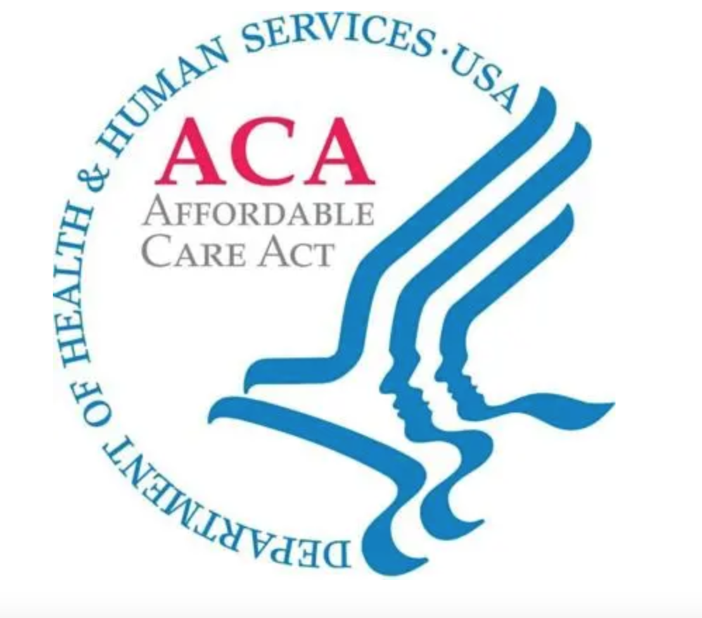
Does antidiscrimination law apply?
Multiple federal statutes forbid discrimination in health care in the United States on several bases, such as race, gender, disability, and age.

Slide 20
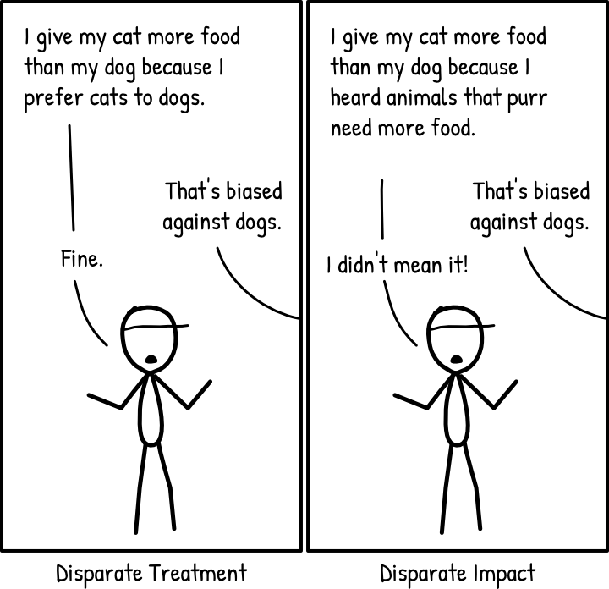

Slide 21
So what can we do?
Pass/amend a law—unlikely in U.S.
Disparate treatment
Disparate impact
Big data affirmative action
Funding and policy interventions to incentivize representative biomedical research

Slide 22
Thank you for your time!
Email: jrobert6@central.uh.edu
Twitter: @jrobertsuhlc
Jessica L. Roberts
Leonard H. Childs Chair in Law
Director, Health Law & Policy Institute
Professor of Medicine (by courtesy)
University of Houston

