Slide 1
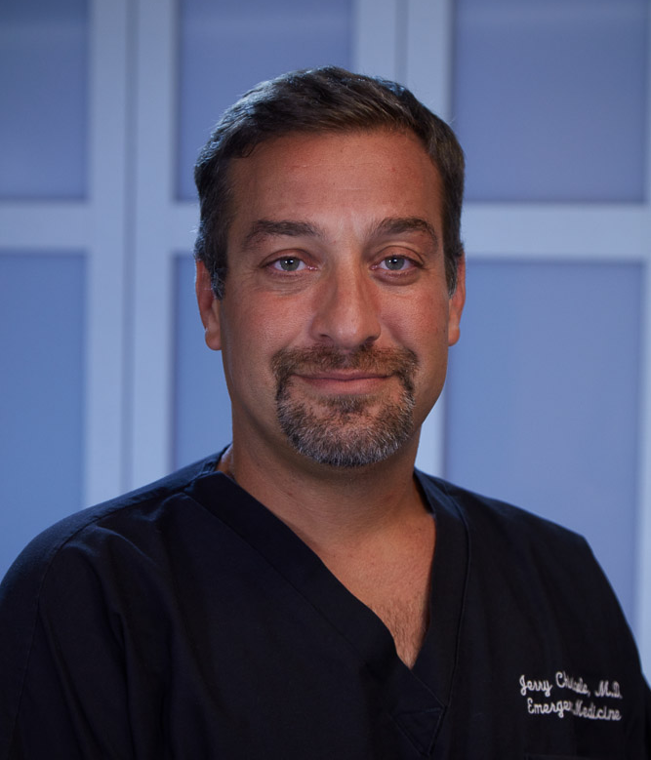
Gerardo Chiricolo, MD
Vice Chairman and Director, Division of Emergency Medicine Ultrasound
Department of Emergency Medicine
New-York Presbyterian/Brooklyn Methodist Hospital
Dr. Gerardo Chiricolo serves as Vice Chief of Emergency Medicine and Chief of the Division of Clinical Ultrasound for NewYork-Presbyterian Brooklyn Methodist Hospital, a position he has held since 2014. Dr. Chiricolo directs the operations of the Emergency Department, which receives more than 110,000 visits each year. He also oversees faculty affairs, with a special a focus on faculty development and professional practice evaluations. Dr. Chiricolo completed his residency and emergency ultrasound fellowship at North Shore University Hospital in Manhasset, New York. While at the North Shore-LIJ health system, he advanced his career from Chief Resident to Associate Director of the Division of Emergency Ultrasound and ultimately to Division Director. In 2009, he was elected Chair of the Emergency Ultrasound section of the American College of Emergency Physicians. He was also the Chair of the Clinical Ultrasound Accreditation Program for the American College of Emergency Physicians Board of Governors from 2016-2018. Dr. Chiricolo is on several hospital committees, including the credentialing committee, and is the clinical lead in the hospital flow leadership council. He also an invited lecturer at international healthcare conferences and events, most recently at the congress of the European Society of Emergency Medicine, held in Vienna, Austria.

