Slide 1
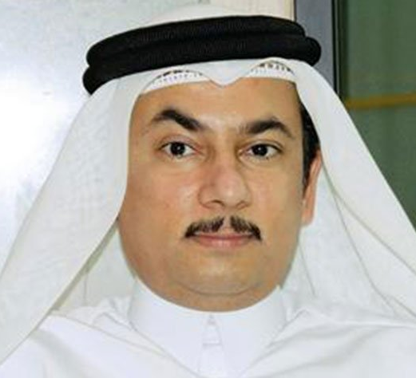
Abdullatif Al-Khal, MD
Deputy Chief Medical Officer
Director of the Department of Medical Education
Senior Consultant in Infectious Diseases
Hamad Medical Corporation
Dr. Abdullatif Mohamed Al Khal is the Deputy Chief Medical Officer and Director of the Department of Medical Education at Hamad Medical Corporation (HMC) in Doha, Qatar. He also serves as a Senior Consultant in Infectious Diseases and is the Head of the Infectious Diseases Division, Manager of Qatar’s National Tuberculosis Program, and Director of Qatar’s Clinical AIDS Program.
Dr. Al-Khal earned his MBBCh from the Royal College of Surgeons in Ireland, completed his residency and fellowship training in Connecticut (USA), and is American Board certified in both Internal Medicine and Infectious Diseases.
In addition to his clinical roles, Dr. Al-Khal also serves in an advisory role to several public health programs under the umbrella of the Qatar Ministry of Public Health. He has held a faculty appointment as Associate Professor of Clinical Medicine at Weill Cornell Medicine - Qatar since 2007 and also holds the title of Clinical Professor of Medicine at Qatar University’s College of Medicine. He is also the college’s founding Associate Dean for Clinical Affairs.
Dr. Al-Khal remains active in research and publishes regularly, with his interests spanning the fields of internal medicine, infectious disease, pharmacology and medical education.

