Slide 1
Dietary Interventions for the Management of Adults with Obesity: Meal Replacements as a Strategy for Weight Loss
A Chronic Disease that Requires Long-Term Management
Cosette Fakih El Khoury, PhD, LD

Slide 2
Disclosure Statement
Speaker:
Dr. Cosette Fakih El Khoury
Has no relevant financial relationships to disclose
Will not be discussing unlabeled/unapproved use of drugs or products

Slide 3
Learning Outcomes
Evaluate the effectiveness of meal replacement as a strategy for weight management based on the analysis and comparison of the evidence and arguments presented
1
Identify potential candidates for meal replacement in weight management
2
Assess the potential benefits and limitations of using meal replacements for long-term weight management.
3

Slide 4
Meal Replacements
Processed and preprepared Liquid or bar meal replacements
Intented for use as a substitute of one or more meals or snacks during the day
Controlled calories and nutrients
Utilized partially as part of overweight and obesity management

Slide 5
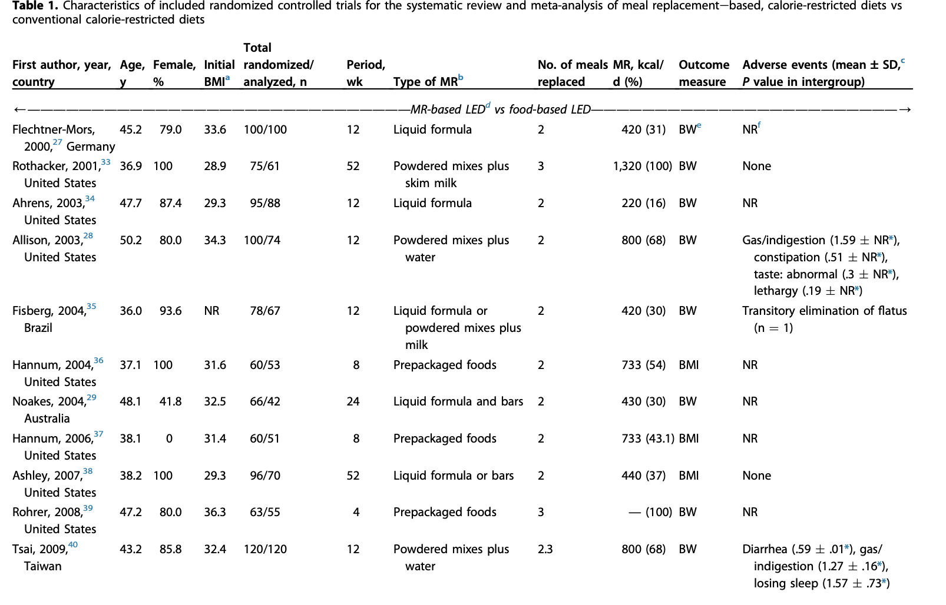
Different Types of Meal Replacements
Min, J., Kim, S. Y., Shin, I. S., Park, Y. B., & Lim, Y. W. (2021). The effect of meal replacement on weight loss according to calorie-restriction type and proportion of energy intake: A systematic review and meta-analysis of randomized controlled trials. Journal of the Academy of Nutrition and Dietetics, 121(8), 1551-1564.

Slide 6
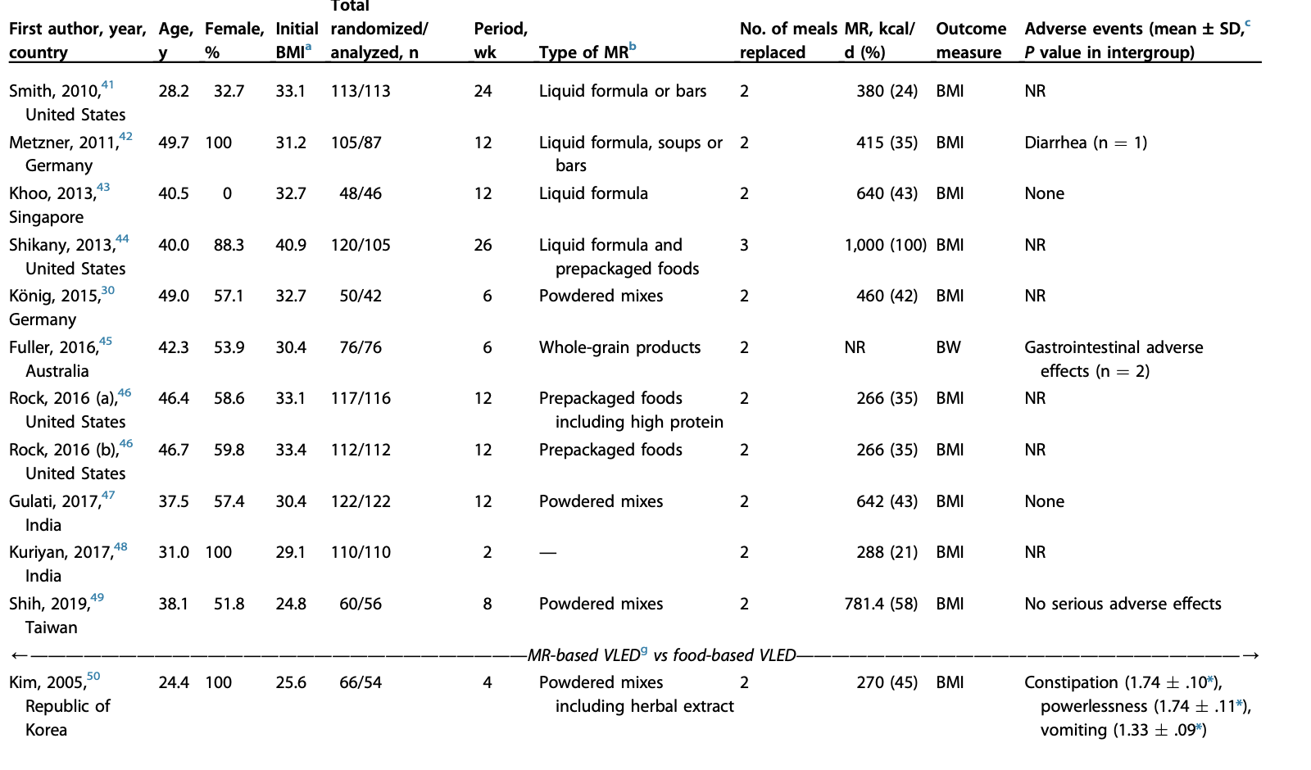
Different Types of Meal Replacements
Min, J., Kim, S. Y., Shin, I. S., Park, Y. B., & Lim, Y. W. (2021). The effect of meal replacement on weight loss according to calorie-restriction type and proportion of energy intake: A systematic review and meta-analysis of randomized controlled trials. Journal of the Academy of Nutrition and Dietetics, 121(8), 1551-1564.

Slide 7
Meal Replacements- Evidence Analysis Library
Recommendation
For people who have difficulty with self selection and/or portion control, meal replacements (e.g., liquid meals, meal bars, calorie-controlled packaged meals) may be used as part of the diet component of a comprehensive weight management program. Substituting one or two daily meals or snacks with meal replacements is a successful weight loss and weight maintenance strategy. (Evidence: Grade 1-Strong and Conditional)
Evidence Analysis Library. Academy of Nutrition and Dietetics. Retrieved from https://www.andeal.org/template.cfm?template=guide_summary&key=625

Slide 8
European Association for the Study of Obesity Position Statement on Medical Nutrition Therapy for the Management of Overweight and Obesity in Adults
Hassapidou, M., Vlassopoulos, A., Kalliostra, M., Govers, E., Mulrooney, H., Ells, L., ... & Brown, T. (2023). European Association for the study of obesity position statement on medical nutrition therapy for the management of overweight and obesity in adults developed in collaboration with the European federation of the associations of dietitians. Obesity Facts, 16(1), 11-28.
Notes:
The newest evidence for partial meal replacements further supports their role in MNT as elements with a positive impact on measures of BW, WC, and BP (Table ​(Table5).5). On the other hand, for IF the evidence highlights that although helpful, it does not provide significant advantages compared to CER. In more detail, the previous guidelines stated that “partial meal replacements (replacing one to two meals/day as part of a calorie-restricted intervention) could be used to reduce BW, WC, BP and improve glycaemic control,” but evidence was graded as level 1a, grade B. The addition of new evidence from literature reviews and meta-analyses indicates that meal replacements could be linked with modest to significant higher weight loss even at 1 year [38, 40], may indicate a greater role of meal replacements in adult obesity.

Slide 9
Main Candidates for Intervention
EAL: Recommendation applies to people who have difficulty with self selection and/or portion control.
Evidence incorporated in the “European Association for the Study of Obesity Position Statement on Medical Nutrition Therapy for the Management of Overweight and Obesity in Adults” includes:
Adults with BMI 27–35 kg/m² and w/> 1 component of metabolic syndrome
Adults with T2DM (insulin) and obesity
Women at 9–16 weeks gestation with pregestation BMI ≥25 kg/m²
Adults with BMI >24 kg/m²

Slide 10
Efficacy of Meal Replacement
The ACOORH trial
Meal replacement by formula diet reduces weight more than a lifestyle intervention alone in patients with overweight or obesity and accompanied cardiovascular risk factors
Halle, M., Röhling, M., Banzer, W., Braumann, K. M., Kempf, K., McCarthy, D., ... & ACOORH study group Martin Stephan 3 12 Tan Susanne 9 Koohkan Sadaf 13 Pinget Michel 14. (2021). Meal replacement by formula diet reduces weight more than a lifestyle intervention alone in patients with overweight or obesity and accompanied cardiovascular risk factors—the ACOORH trial. European journal of clinical nutrition, 75(4), 661-669.
Notes:
Meal replacement by formula diet reduces weight more than a lifestyle intervention alone in patients with overweight or obesity and accompanied cardiovascular risk factors—the ACOORH trial
In this multicenter RCT 463 participants with overweight or obesity (BMI: 27–35 kg/m²; at least one additional comorbidity of the metabolic syndrome) were randomised (1:2) into either a control group with lifestyle intervention only (CON, n = 155) or a lifestyle intervention group including a liquid meal replacement (INT, n = 308).
Conclusions A low-intensity lifestyle intervention combined with a liquid meal replacement is superior regarding weight reduction and improvement of cardiovascular risk factors than lifestyle intervention alone.
Figures: Weight reduction was accompanied with changes in WC, FM, FBG, SBP, DBP, total cholesterol, TG and LDL-C in both groups following the intervention, with a particularly pronounced effect within the first 12 weeks

Slide 11
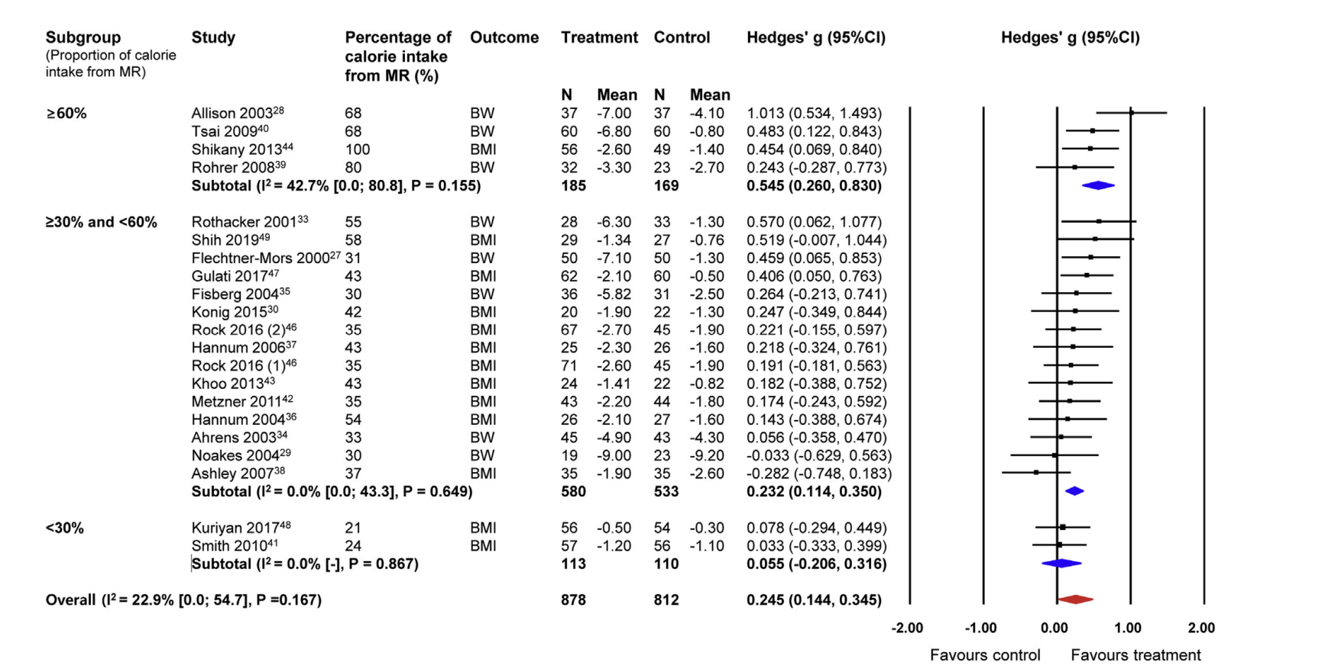
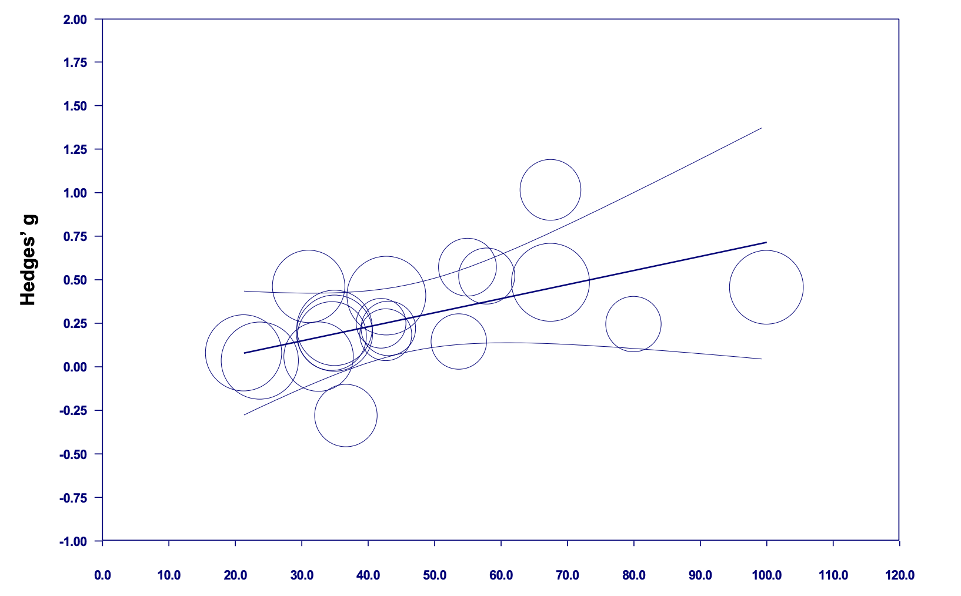
The Effect of Meal Replacement on Weight Loss According to Calorie-Restriction Type and Proportion of Energy Intake: A Systematic Review and Meta-Analysis of Randomized Controlled Trials
Min, J., Kim, S. Y., Shin, I. S., Park, Y. B., & Lim, Y. W. (2021). The effect of meal replacement on weight loss according to calorie-restriction type and proportion of energy intake: A systematic review and meta-analysis of randomized controlled trials. Journal of the Academy of Nutrition and Dietetics, 121(8), 1551-1564.
Notes:
High risk of bias for almost all studies included in the article
Results: Twenty-two studies involving 24 interventions and 1,982 patients who were overweight or obese were included. The effect size in which MR-based LED was compared with food-based LED for weight loss was small, favoring MR (Hedges’ g ¼ 0.261; 95% CI 0.156 to 0.365; I 2 ¼ 21.9; 95% CI 0.0 to 53.6). Diets including 60% of total daily energy intake from MR had a medium effect size favoring MR with regard to weight loss among the groups (Hedges’ g ¼ 0.545; 95% CI 0.260 to 0.830; I 2 ¼ 42.7; 95% CI 0.0 to 80.8).
Conclusions The effect of MR-based LED on weight loss was superior to the effect of food-based LED, and receiving 60% of total daily energy intake from MR had the greatest effect on weight loss.
1st figure: Effects of MR-Based LED Compared with Food-Based LED on Weight Loss According to Percentage of Total Daily Energy Intake from MR. Figure 4 depicts the Hedges’ g values and the forest plots for MR-based LED compared with food-based LED. To examine whether the overall effects of MR-based LED differed according to the percentage of total daily energy intake from MR, 3 subgroups (< 30%, > or equal 30% and < 60%, and > or equal 60%) were created according to caloric intake percentage. The meta-ANOVA test showed that in those receiving 60% calories from MR, the effect size was medium and had the greatest effect size on weight loss (Hedges’ g ¼ 0.545; 95% CI 0.260 to 0.830; I 2 ¼ 42.7; 95% CI 0.0 to 80.8); this was followed by the group receiving 30% and <60% (Hedges’ g ¼ 0.232; 95% CI 0.114 to 0.350; I 2 ¼ 0). The group with <30% calories from MR was not statistically different (Hedges’ g ¼ 0.055; 95% CI e0.206 to 0.316; I 2 ¼ 0); there was a significant difference between groups (Q ¼ 9.226; degrees of freedom ¼ 2; P ¼.010).
2nd figure: depicts the results of the meta-regression on the percentage of total daily energy intake from MR (model 5).
Regression of Hedges’ g for meal replacement-based low-energy vs conventional low-energy diets according to the percentage of total daily energy intake from meal replacement (model 5).
Title of figure: The percentage of total daily energy intake from meal replacement

Slide 12
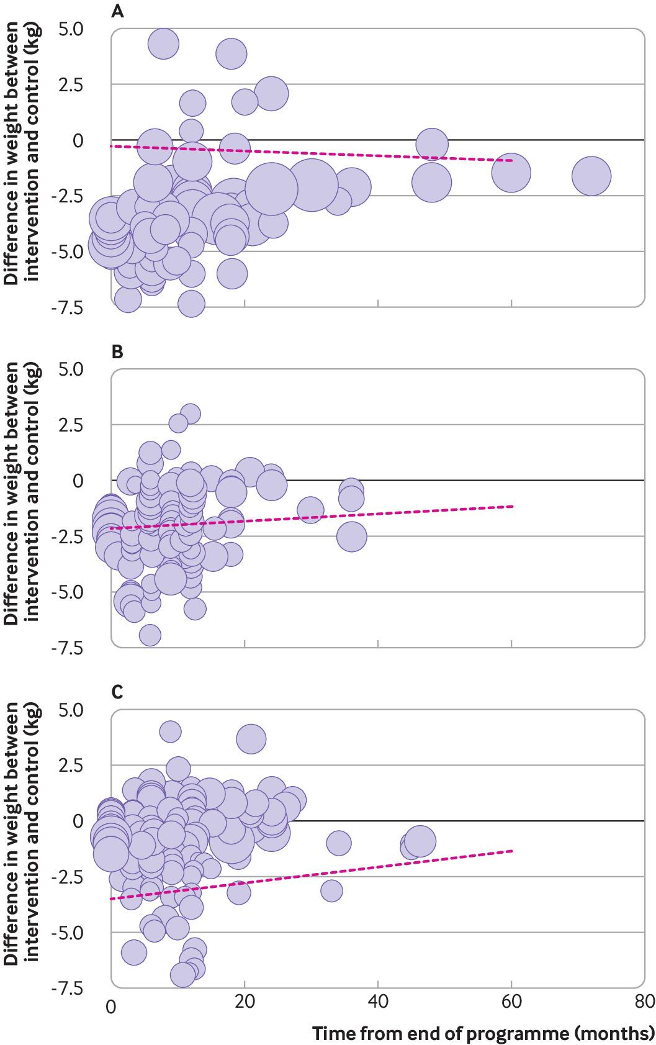
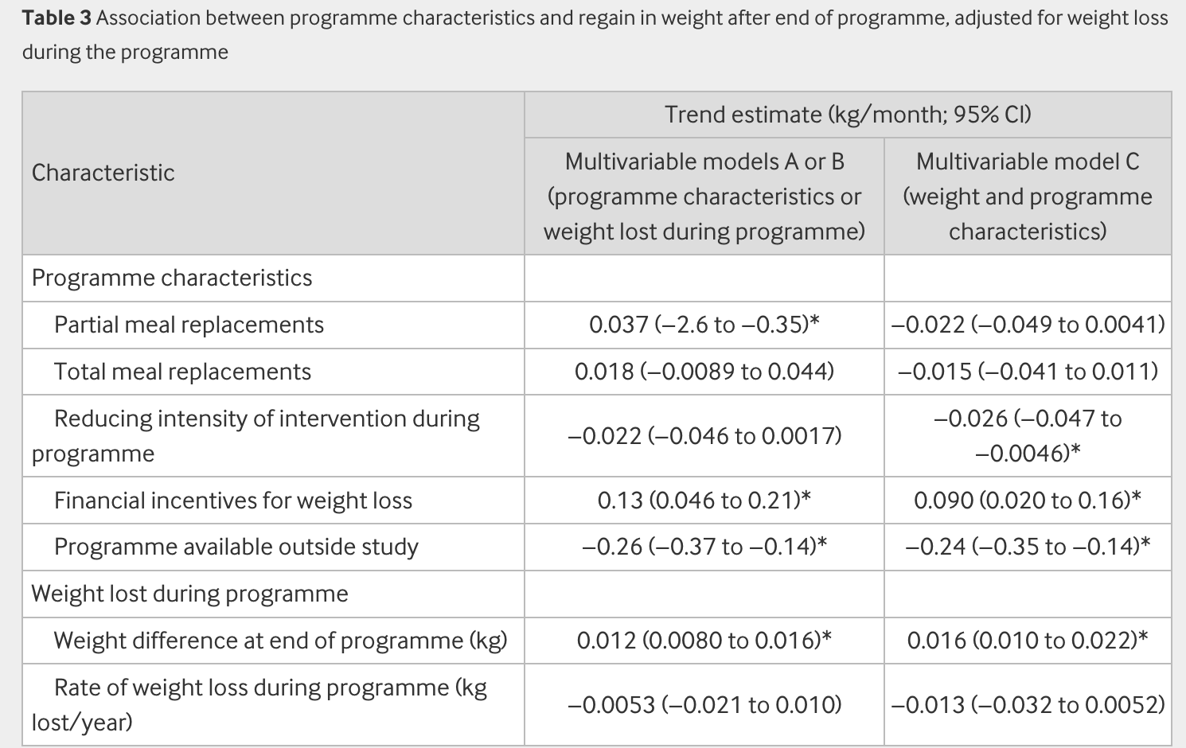
Interventions involving partial meal replacements were associated with faster regain in weight but not after adjustment for weight loss
Long Term Limitations
Hartmann-Boyce, J., Theodoulou, A., Oke, J. L., Butler, A. R., Scarborough, P., Bastounis, A., ... & Aveyard, P. (2021). Association between characteristics of behavioural weight loss programmes and weight change after programme end: systematic review and meta-analysis. bmj, 374
Notes:
Programmes providing partial meal replacement products were associated with faster regain in weight; in our main model, this finding was explained by weight loss achieved in the programme, but in sensitivity analyses where studies at high risk of bias were removed, partial meal replacements remained independently associated with greater regain in weight.
Figure: Rate of change in weight after end of behavioural weight management programme, by weight loss during the programme. Difference in weight at end of programme between intervention and control groups: A, up to −1.5 kg; B, −1.4 to −3 kg; C, −3.1 to −5 kg. Graphs are illustrative only and analyses are based on mixed models. Lines are based on changes within trials, and because the points mapped represent different trials, the lines will not necessarily be visually consistent with the mapped points. In sensitivity analyses, removing studies at high risk of bias (eTable 6), univariate analyses were not substantially different with the exception that the association between partial meal replacements and regain in weight was stronger, with confidence intervals excluding the original estimate (0.15 kg/month (95% confidence interval 0.087 to 0.21) v 0.035 kg/month). In a post hoc analysis, a similar pattern was found when only studies at low risk of bias were included; univariate analyses were significantly different only for partial meal replacements where the point estimate and confidence intervals were the same as in the sensitivity analysis including studies at low and unclear risk of bias
Table: Adjusting for the extent and rate of weight loss during the programme markedly changed the estimates for meal replacement programmes (table 3). After adjustment, the point estimates suggested that meal replacement programmes were associated with slower regain in weight but were close to the null and not significant.
Programmes where the intensity of the interaction declined gradually over time were statistically significantly associated with slower regain in weight in the multivariable analysis (table 3), which was not the case in the univariable analysis

Slide 13
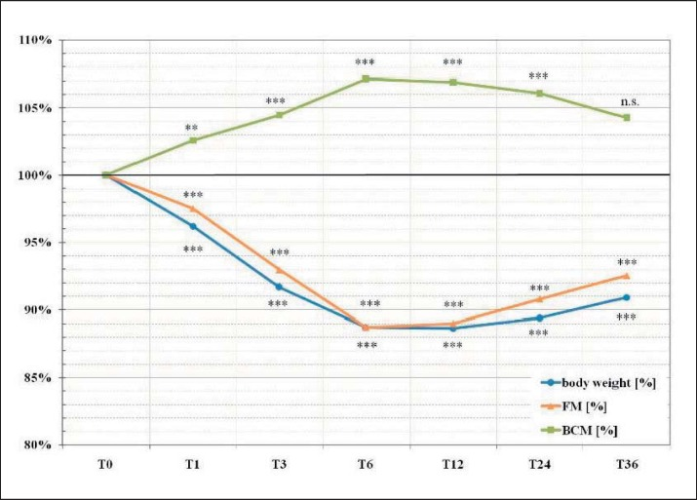
Long Term Weight Loss Maintenance by Meal Replacements
Kruschitz, R., Wallner-Liebmann, S., Lothaller, H., Luger, M., & Ludvik, B. (2017). Long-term weight-loss maintenance by a meal replacement based weight management program in primary care. Obesity Facts, 10(2), 76-84.
Notes:
Figure: Representing relative BCM development in males and females from baseline (T0) to 36 months (T36) (mean ± SD). * * * p < 0.001
The greatest mean reduction of absolute and relative weight (T0–T6: 10.5 ± 6.2 kg, p < 0.001; 11.1 ± 5.9%, p < 0.001), BMI, FM, and absolute BCM could be observed at T6
ll evaluated parameters remained stable until T12. Out of the original sample (n = 1,237), those who attended the program at least 12 months (n = 1,167) showed a lower weight loss at T12 in comparison with participants attending at least 36 months (n = 70) (8.6 ± 7.5 kg vs. 10.5 ± 7.7 kg, p < 0.05; 8.2 ± 7.8% vs.11.0 ± 7.0%, p = 0.01). At T12, 61% of all participants achieved a minimal weight loss of 5%, 36% of 10%, and 19% of more than 15% of their initial weight, which is comparable with the previously published data of the 12-month sample [17] . A slight weight and FM increase and a BCM decrease was seen at the subsequent 24- and 36-month follow-ups. Nevertheless, at T24 and T36, weight and FM were significantly lower and absolute BCM significantly higher compared to T0. At T36, relative BCM was not longer significantly higher compared to T0 ( fig. 1 ).

Slide 14
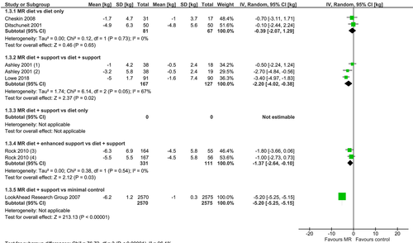
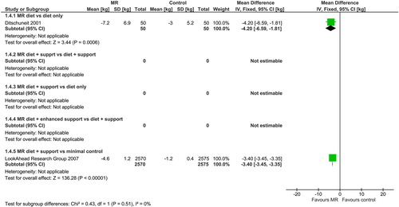
Mean weight change (kg) from baseline at 2 and 4 years between interventions incorporating meal replacements (MR) and control interventions
Astbury, N. M., Piernas, C., Hartmann‐Boyce, J., Lapworth, S., Aveyard, P., & Jebb, S. A. (2019). A systematic review and meta‐analysis of the effectiveness of meal replacements for weight loss. Obesity reviews, 20(4), 569-587.
Notes:
Figure 1 (at 2 years): Forest plot of mean weight change (kg) from baseline at 2 years between interventions incorporating meal replacements (MR) and control interventions by comparison group [Colour figure can be viewed at wileyonlinelibrary.com]
Figure 2 (at 4 years):Forest plot of mean weight change (kg) from baseline at 4 years between interventions incorporating meal replacements (MR) and control interventions by comparison group [Colour figure can be viewed at wileyonlinelibrary.com]
Study conclusion: Programmes incorporating meal replacements led to greater weight loss at 1 year than comparator weight loss programmes and should be considered as a valid option for management of overweight and obesity in community and health care settings.

Slide 15
Safety
Recommendation
“Qualified meal replacement combined with multivitamin and mineral supplements should be chosen to ensure adequate nutrition intake during weight loss (Level of evidence C, weak recommendation; 94.5% agreement).”
Short Term Application
“Meal replacement for weight loss is safe, with few serious adverse effects and favorable tolerability”
Long Term Application
Safety needs further investigation (Level of evidence B, weak recommendation; 95.4% agreement).
Chen, W. (2022). Guidelines for medical nutrition treatment of overweight/obesity in China (2021). Asia Pacific Journal of Clinical Nutrition, 31(3), 450-482.

Slide 16
Safety
Flechtner-Mors et al. 2000:
(4-year intervention): MR + vitamin and mineral supplementation: safe and effective
Coleman et al 2015:
(24 weeks intervention): mild side effects (gastrointestinal disorders, hunger, fatigure, stress and anxiety) and rarely any severe side effects (stroke, heart attack, cholecystectomy, and hospitalization for coagulation, hemorrhoids, and hyperthermia)
Astbury et al. (systematic review): limited adverse effects
Chen, W. (2022). Guidelines for medical nutrition treatment of overweight/obesity in China (2021). Asia Pacific Journal of Clinical Nutrition, 31(3), 450-482.

Slide 17
Thank You

