Slide 1
Patient safety and medication errors
Presented by:
Dr Reham Negm Eldin
Assistant Executive Director Quality
Hamad Healthcare Quality Institute (HHQI)-HMC

Slide 2
Disclosure Statement
Speaker:
Dr Reham Negm Eldin
Has no relevant financial/non-financial relationships to disclose
Will not be discussing unlabeled/unapproved use of drugs or products

Slide 3
Objectives:
Understanding Human Fallibility
Application of Human Factors:
Implementing Error Reduction Strategies:
Notes:
Understanding Human Fallibility: Explore the concept that errors are inevitable aspects of human behavior,
as outlined in James Reason's Swiss Cheese Model, which illustrates how multiple layers of defense can fail to prevent errors from occurring.
Application of Human Factors: Investigate how human factors influence error occurrence in various contexts, and examine error reduction principles aimed at mitigating the impact of human fallibility on safety and performance.
Implementing Error Reduction Strategies: Learn about practical strategies derived from human factors research to reduce errors in diverse settings, including healthcare, aviation, and manufacturing, to enhance safety and reliability.

Slide 4
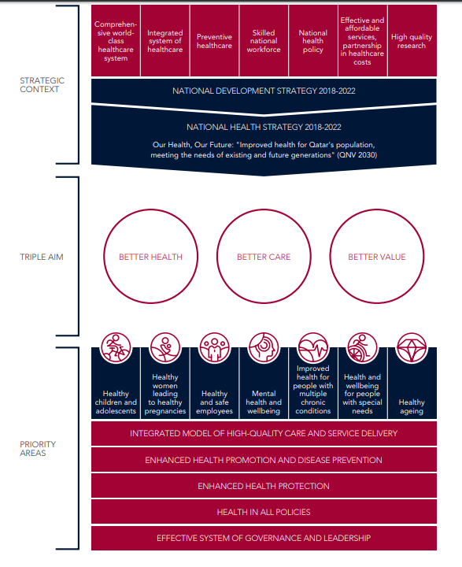
Qatar NHS
Notes:
And our Qatar NHS 2018-2022, main outcomes and identified targets of healthcare sector is/ “Improved health for Qatar’s population, / meeting the needs of existing and future generations / through an integrated health system / that aims to achieve better health,/ better care /and better value for all.”

Slide 5
First: Do NO Harm
460 – 370 B.C.
Notes:
Hippocrates the
“First, do no harm.” This phrase is one of the most familiar tenets of the health care profession. If you poll a group of health care professionals, it is likely all would say they strive to embrace this motto in their practice. And yet, patients are inadvertently harmed every day in the health care system, sometimes with severe consequencesfirst commandment of a doctor do no harm

Slide 6
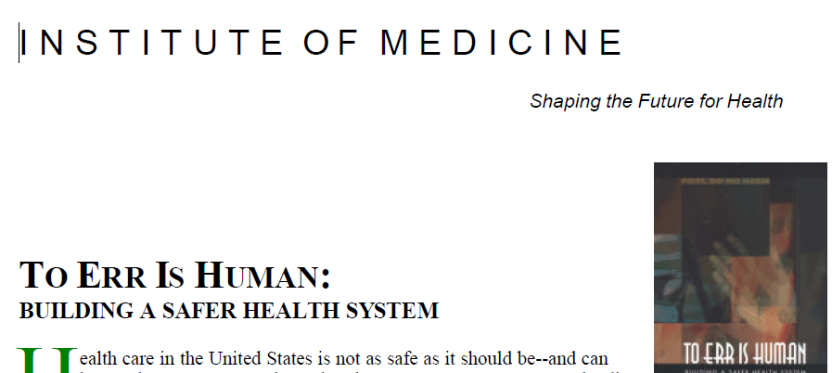
To Err is Human
Notes:
In 1999, the Institute of Medicine (IOM) released its landmark report, To Err Is Human, which revealed that between 44,000 and 98,000 died each year in United States hospitals due to medical errors and adverse events.¹ More recently, estimates of adverse event mortality reach approx. 250,000 patients annually.²
It did not identify the main cause of the problem to be reckless or incompetent providers. “Faulty systems, processes, and conditions that lead people to make mistakes or fail to prevent them” were usually to blame for patient harm, according to the IOM report.
Within days of the report, new legislation tasked the US Agency for Healthcare Research and Quality with studying health care quality. Over the next five years, the rate of English-language articles published on patient safety almost tripled.³ Over time, studies using the IHI Global Trigger Tool(opens in a new tab) for quantifying patient harm have suggested the original report underestimated the problem. One study reported about 400,000 deaths each year from harm in US hospitals.⁴

Slide 7
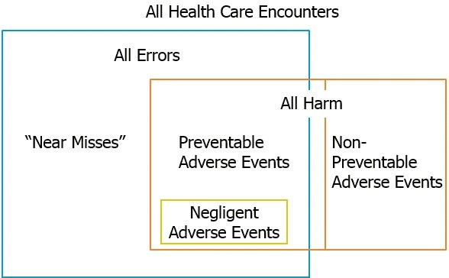
Relationship between harm and error

Slide 8
James Reason: Swiss Cheese Model
In the Swiss cheese model, the holes in the cheese represent both latent conditions and active failures.
Latent conditions are defects in the design and organization of processes and systems — things like poor equipment design, inadequate training, or insufficient resources. These errors are often unrecognized, or just become accepted aspects of the work, because their effects are delayed.
Active failures are events whose effects are seen and felt immediately: someone pushing an incorrect button, ignoring a warning light, or grabbing the wrong medication.
In health care, the person on the front line — e.g., the doctor, nurse, pharmacist, or technician — might be the proximal “cause” of the active error, but the real underlying causes of the error have often been present within the system for a long time.

Slide 9
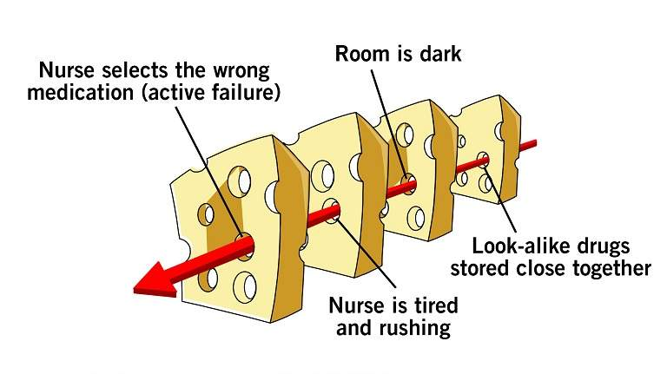
James Reason: Swiss Cheese Model
This example shows how a series of contributing factors, including both latent conditions and an active failure, could lead to a medication error.
Notes:
Serious adverse events are almost always the result of multiple failed opportunities to stop a hazard from causing harm. James Reason, a psychology professor and one of the seminal thinkers in the field of human error, has called this idea the Swiss cheese model of accident causation — meaning, the idea that harm is caused by a series of systemic failures in the presence of hazard.¹
In this model, the cheese represents successive layers of defense in your organization’s safety system. For example, to prevent CLABSIs, providers wear sterile gowns, wash their hands, follow checklists, and remove the catheter as soon as possible; in most cases, safety systems such as these prevent hazardous situations from leading to harm.²
Let’s consider the delivery of medicine to be the inherent hazard in our industry. Ingesting a medication, having surgery, being placed on bypass, undergoing dialysis, or receiving radiation for example, all come with significant health benefits, but they are not risk-free. In addition to the hazards inherent in medicine, accident analysis has revealed the human contribution to adverse outcomes predominates.
Taking a step back, Reason asserts that the setup for an accident to occur in a system begins with fallible decisions made by top level leaders. These decisions are then transmitted via line management and then ultimately to the point of production, or the point of care in our industry, where so called preconditions, or qualities of human behavior in production coexist including attributes like the level of skill and knowledge of the workforce, the work schedules, technology, equipment, and maintenance programs, along with the individual and collective attitudes and motivation of the workforce itself which creates its culture.
In summary, Reason conceptualized the trajectory of accident opportunity being one which begins with what he calls latent failures at managerial levels’ It proceeds with complex interactions as the impact of the management decisions get closer and closer to the point of care, and is neither stopped nor mitigated by one or more levels of defense that were designed to reduce the risk of harm associated with unsafe acts in the very first place. This is the Swiss Cheese Model of accident causation.
The Swiss Cheese analogy here is that all of the holes or defects in the various levels of the system align to turn a managerial deficiency into an adverse outcome, and the challenge for safety professionals is that because this alignment occurs so infrequently, it is difficult to get the organization to attend to the risks. Those that are active and present every day such as not washing ones hands, and those that are latent or lie dormant in system such as the choice of where to place hand hygiene dispensers in the first place.

Slide 10
Human Factors
Human beings by their very nature are hardwired in such a way that errors are inevitable, and given certain circumstances
Human Factors Engineering, , a discipline concerned with the design of tools, machines, and systems that take into account human capabilities, limitations, and characteristics.¹
Notes:
E.g. Administering the incorrect medication because of look-alike medication names and packaging
Human beings by their very nature are hardwired in such a way that errors are inevitable, and given certain circumstances — such as being fatigued, bored, distracted, task-overloaded, stressed, or frequently interrupted — the chance of making errors goes up exponentially.
to build awareness of the ways in which multiple factors in the workplace, involving both people and their surroundings (known as a sociotechnical system), can contribute to error.

Slide 11
Error reduction principles
This is simplifying the structure of tasks to help minimize the load on global cognitive processes like working memory, and to reduce waste.
Notes:
The list of error reduction principles you see here is not meant to be all inclusive. But it’s clearly a good start and they crosswalk nicely to the Hierarchy of Controls that we just looked at. Let’s go through all eleven.
Simplification.

Slide 12
Error reduction principles
This is about creating standard work, equipment, and materials, to better assess and improve outcomes.
Orient and train new staff, and improve ease of use. Clarify roles and responsibilities regarding both routine and infrequent tasks so that everyone is absolutely clear about who is accountable for what and how where and when we expect those accountabilities to occur.
Notes:
Standardization. This is about creating standard work, equipment, and materials, to better assess and improve outcomes. Orient and train new staff, and improve ease of use. Standardization also requires us to clarify roles and responsibilities regarding both routine and infrequent tasks so that everyone is absolutely clear about who is accountable for what and how where and when we expect those accountabilities to occur. If it’s good for nuclear power plants, commercial aviation, and other high reliability organizations, it should be good for us as well.

Slide 13
Error reduction principles
to minimize the risk of slips and lapses

Slide 14
Error reduction principles
Improving access to information and intelligent decision support to improve efficiencies, reduce reliance on memory, and minimize mistakes by improving decision making.

Slide 15
Error reduction principles
Taking advantage of habits and patterns to make it easy to do the right thing, and to minimize the risk associated with shortcuts, workarounds, and drift from safe practice that all humans take.

Slide 16
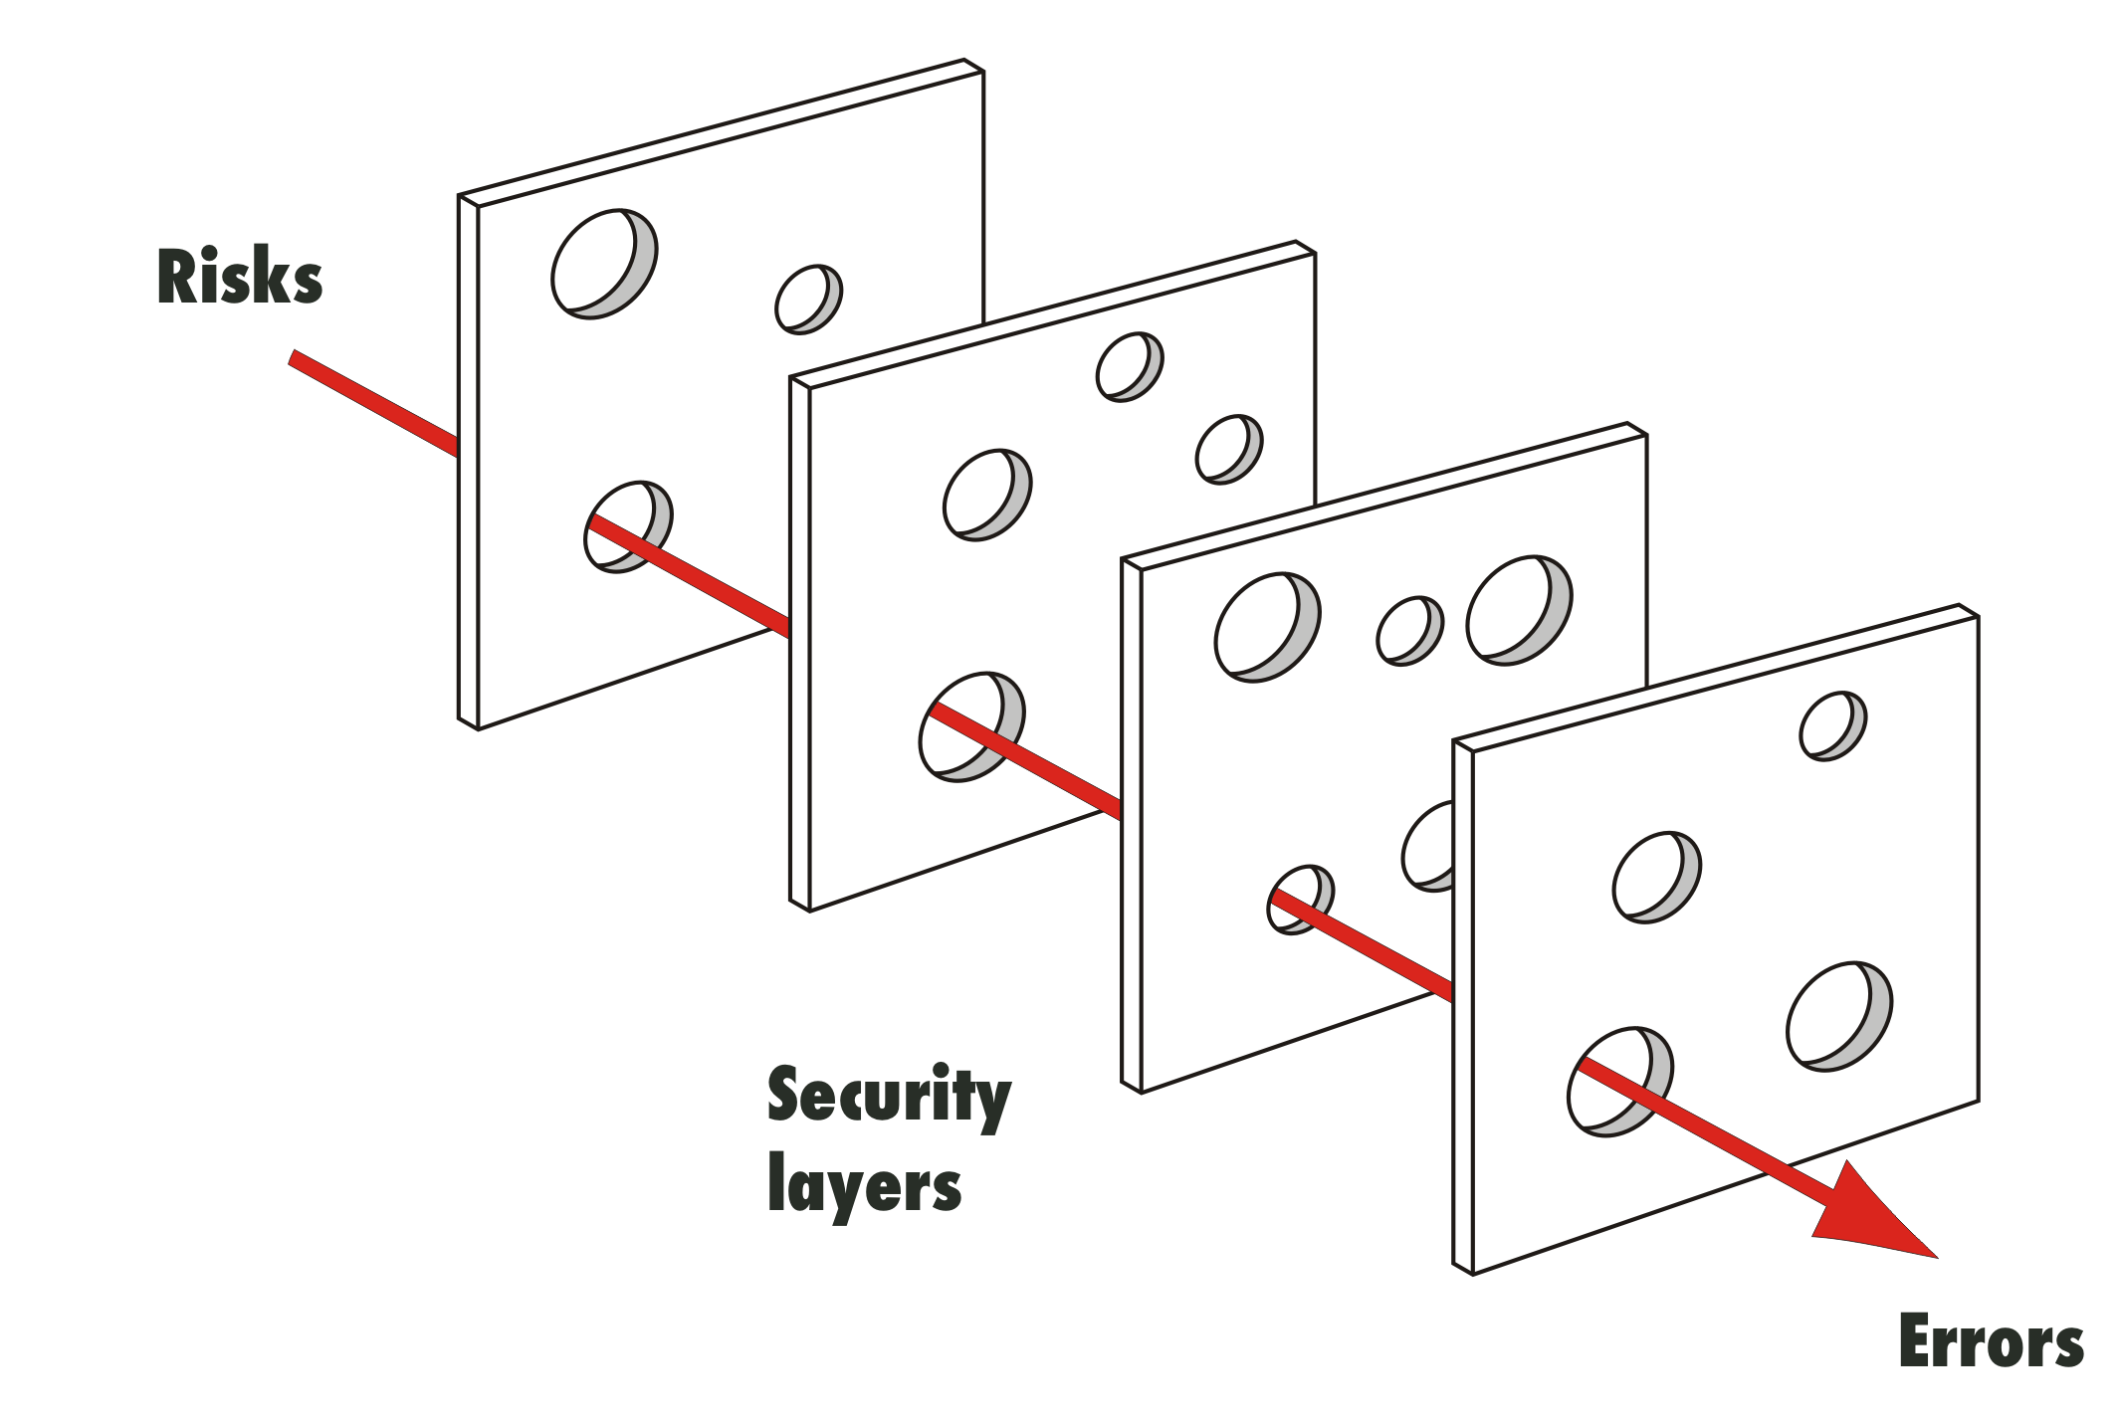
Error reduction principles
Exploiting the power of constraints forcing functions to make it harder to do the wrong thing.
.
Notes:
Exploiting the power of constraints forcing functions to make it harder to do the wrong thing.
Visual controls to shape desired behavior.
Promoting effective team functioning through enhanced strategies like simulation and development of communication skills to better leverage existing resources, minimize error, and recover from harm. High-performing teams also hold each other accountable and are more capable in confronting each other’s violations and drift in safe practice in the interest of patient safety.
Employing redundancies where appropriate to capture and mitigate an error before it has a chance to do significant harm.
Eliminating environmental factors that degrade performance such as clutter, inadequate lighting, excessive noise, and needless interruption and distraction.
Creating systems that are better able to tolerate the occurrence of errors and contain their damaging effects when they do occur. This includes actions and outcomes of practitioners, making them more visible through strategies like redundancies and substitution, and other mitigation strategies to minimize the impact of error.

Slide 17
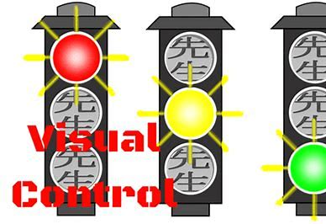
Error reduction principles

Slide 18
Error reduction principles
Promoting effective team functioning through enhanced strategies like simulation and development of communication skills to better leverage existing resources, minimize error, and recover from harm. High-performing teams also hold each other accountable and are more capable in confronting each other’s violations and drift in safe practice in the interest of patient safety.
Notes:
Employing redundancies where appropriate to capture and mitigate an error before it has a chance to do significant harm.
Eliminating environmental factors that degrade performance such as clutter, inadequate lighting, excessive noise, and needless interruption and distraction.
Creating systems that are better able to tolerate the occurrence of errors and contain their damaging effects when they do occur. This includes actions and outcomes of practitioners, making them more visible through strategies like redundancies and substitution, and other mitigation strategies to minimize the impact of error.

Slide 19
Error reduction principles
Employing redundancies where appropriate to capture and mitigate an error before it has a chance to do significant harm.

Slide 20
Error reduction principles
Eliminating environmental factors that degrade performance such as clutter, inadequate lighting, excessive noise, and needless interruption and distraction.

Slide 21
Error reduction principles
Creating systems that are better able to tolerate the occurrence of errors and contain their damaging effects when they do occur. This includes actions and outcomes of practitioners, making them more visible through strategies like redundancies and substitution, and other mitigation strategies to minimize the impact of error.

Slide 22
Building Safer Systems
Notes:
Culture: Is the product of individual and group values, attitudes, competencies, and behaviors related to safety.
Leaning system: Measures performance and help teams make improvements.
What will be the next way that health care prevents harm to patients?
You can be part of this work — even through small steps such as treating patients with kindness.
Most harm in today’s health system isn’t primarily caused by the unsafe acts of frontline clinicians, but by larger systems issues: latent unsafe conditions, too few layers of defense against hazards, and the presence of unnecessary hazards.
Harm can occur when there is no clearly identifiable error, but it does not change the impact to the patient.
The notion of “preventable” harm changes as scientific knowledge and health systems evolve, and experts encourage clinicians to take a broad view of what harm is.

Slide 23
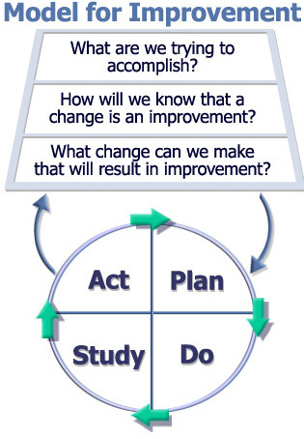
AIM
3 Questions
Measurement
Change concepts/ideas
PDSA cycle
Also known as
Shewhart Cycle
Deming Cycle
Learning and improvement cycle
Source: The Improvement Guide
by Langley, Moen, Nolan et al
Institute for Healthcare Improvement
Notes:
The Model for Improvement,* developed by Associates in Process Improvement, is a simple, yet powerful tool for accelerating improvement. IHI uses the Model for Improvement as the framework to guide improvement work.
The Model for Improvement is a simple, yet powerful approach to achieving rapid and significant improvements in care delivery and outcomes.
focusing on how three key questions can help drive your quality improvement work:
•What are we trying to accomplish?
•How will we know that a change is an improvement?
•What change can we make that will result in improvement?
When & Why we use PDSA?

Slide 24
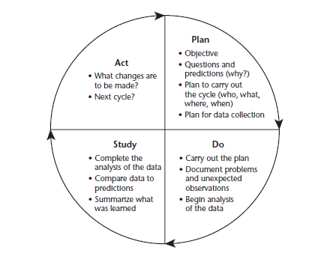
The PDSA Cycle for Learning & Improvement
What will happen if we try something different?
What’s next?
Did it work?
Let’s try it!
Notes:
Four parts of the cycle:
Plan:
Decide what change you will make, who will do it, and when it will be done. Formulate an hypothesis about what you think will happen when you try the change. What do you expect will happen?
Identify data that you can collect (either quantitative or qualitative) that will allow you to evaluate the result of the test.
Do:
Carry out the change.
Study:
Make sure that you leave time for reflection about your test. Use the data and the experience of those carrying out the test to discuss what happened. Did you get the results you expected? If not, why not? Did anything unexpected happen during the test?
Act:
Given what you learned during the test, what will your next test be? Will you make refinements to the change? Abandon it? Keep the change and try it on a larger scale?

Slide 25
PDSA Objective: Improve Patient Understanding Through Use of Teach-back
Improved patient understanding
D
S
Appt cycle time, ability to teach-back
DATA
P
A
A
P
S
D
Cycle 5: Pat (nurse expert) will conduct a workshop on teachback for all residents
D
S
P
A
A
Residents discovered nursing expertise in teachback – for one week, Pat will shadow 1 pt/day who is likely to need new meds and give them feedback on their teachback technique
S
P
A
P
D
Cycle 3:
S
D
Cycle 2/Day 2:
Residents decided to focus use of teachback on medication instructions – all patients with new meds Tuesday-Friday
Cycle 1/Day 1: residents on Monday will use teachback on the last patient of the day
Will asking patients to teachback uncover gaps in understanding that will improve patient adherence to care plans?

Slide 26
High Reliability Systems
Notes:
“Most organizational errors are made by well-intentioned human beings—most highly educated, well trained, well intentioned human beings—who become accustomed to small glitches, routine foul-ups, and a culture that suppresses doing much about them in the name of an overriding goal.”

Slide 27
References
Frankel A, Haraden C, Federico F, Lenoci-Edwards J. A Framework for Safe, Reliable, and Effective Care. White Paper. Cambridge, MA: Institute for Healthcare Improvement and Safe & Reliable Healthcare; 2017. (opens in a new tab)
National Patient Safety Foundation. Free from Harm: Accelerating Patient Safety Improvement Fifteen Years after To Err Is Human. Boston, MA: National Patient Safety Foundation; 2015. (opens in a new tab)
10 IHI Innovations to Improve Health and Health Care. Cambridge, Massachusetts: Institute for Healthcare Improvement; 2017.(opens in a new tab)
James JT. What happened to Alex? Case Study. IHI Open School website
Leape LL. Making Healthcare Safe: The Story of the Patient Safety Movement. Switzerland: Springer Nature; 2021.
Leape L. Error in medicine.(opens in a new tab) JAMA. December 1994;272(23):1851-1857.
Griffin FA, Resar RK. IHI Global Trigger Tool for Measuring Adverse Events (Second Edition)(opens in a new tab) [IHI Innovation Series white paper]. Boston, Massachusetts: Institute for Healthcare Improvement; 2009.
Free from Harm: Accelerating Patient Safety Improvement Fifteen Years after To Err Is Human(opens in a new tab). Boston, Massachusetts: Institute for Healthcare Improvement; 2015.
Safer Together: The National Action Plan to Advance Patient Safety. Boston, Massachusetts: Institute for Healthcare Improvement; 2020.

