Slide 1
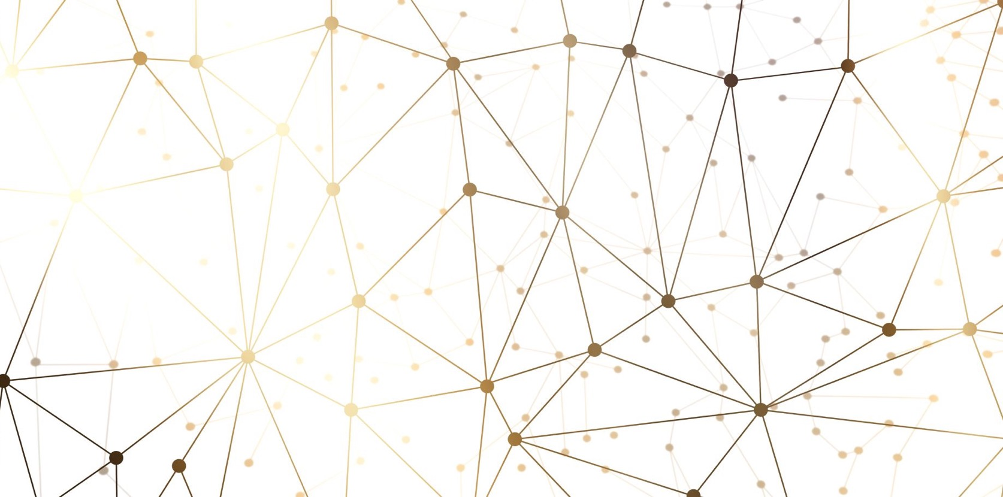
The Uses and Risks of Generative AI
Faisal Farooq, PhD

Slide 2
Disclosure Statement
Speaker:
Dr. Faisal Farooq
Has no relevant financial relationships to disclose.
Will not be discussing unlabeled/unapproved use of drugs or products.

Slide 3
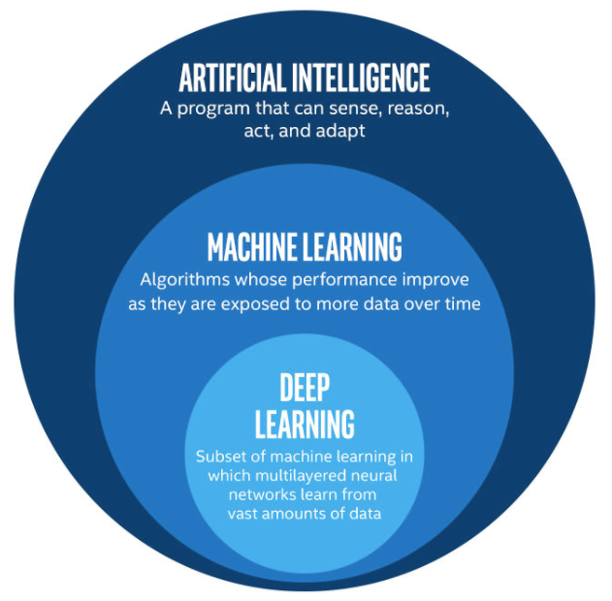
So What is this AI thing
Supervised Learning
Labeled data
Direct feedback
Predict outcome
Unsupervised Learning
No label
No feedback
Find hidden structure
Reinforcement Learning
Decision process
Reward system
Learn series of actions

Slide 4
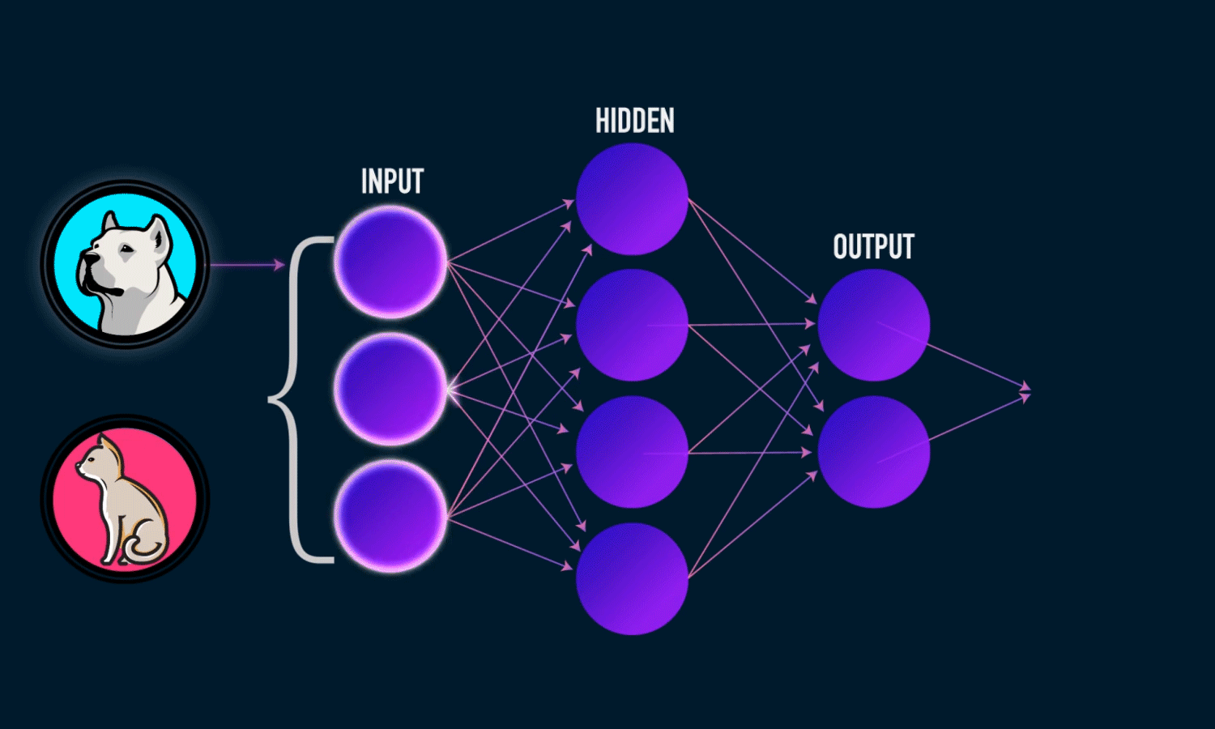
Supervised Learning
Training
Testing
Dog
Cat
Input = Image, Label (Image, “dog”)
Output = Model (White Box)
Input = Image, Model (White Box)
Output = Label (Dog)

Slide 5
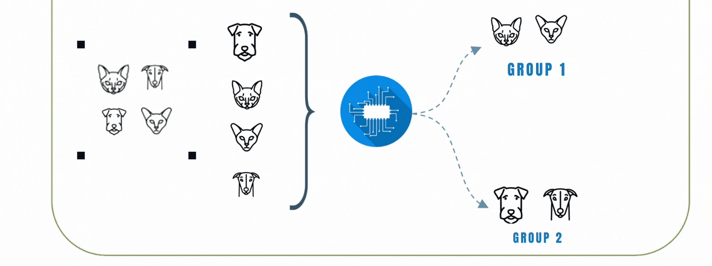
Unsupervised Learning
Output
Input

Slide 6
What is generative ai
 | Discriminative AI | Generative AI
Goal | Directly estimate P(y|x) | Estimate P(y,x)
Learns | Decision Boundary | Distribution of Data
Illustration
Example | Logistic Regression, SVM, Decision Trees | Bayesian Networks, GANs, Transformers

Slide 7
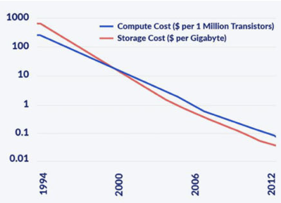
What Changed? Why the buzz now?
Generative Adversarial Networks
Variational Autoencoders
Autoregressive models
Transformers
Diffusion Models
COMPUTATION
ALGORITHMS
DATA EXPLOSION
1100 Terabytes
Generated per lifetime
60%
Exogenous Factors
30%
Genomics Factors
6 Terabytes
Per lifetime
10%
Clinical Factors
0.4 Terabytes
Per lifetime
1961
$18.7 billion
2018
$0.02

Slide 8
Types of generative ai
Text: Generative AI systems trained on words or word tokens include GPT-3, LaMDA, LLaMA, BLOOM, GPT-4
Code: Trained on programming language text allowing them to generate source code for new computer programs like OpenAI Codex
Sequences: Generative AI trained on complex sequences like amino acid molecules include AlphaFold
Images: Generative AI systems trained on sets of images include Imagen, DALL-E, Midjourney, Stable Diffusion.
Audio: Generative AI systems trained on sets of audio include MusicLM, COQUI, VALL-E
Video: Generative AI systems trained on video Gen1, Gen2 and Make-a-vid

Slide 9
Applications
Visual Generation
Image Generation and Enhancement
Video Creation and Editing
3D Shape Generation
Audio Generation
Creating music
Text to Speech
Speech to Speech
Text Generation
Conversational Agents
Translation
Summarization
Document Generation

Slide 10
Healthcare applications
Protein and Drug Design
Biomedical NLP
Patient Digital Twins
EHR Documentation
Wellness Tech
Synthetic Patient Data
Radiology Image Enhancement

Slide 11
DRUG Discovery
Generative AI can speed up the process by creating new drug molecules that have the potential to be developed into new drugs
The algorithm can learn from a large dataset of chemical structures and properties and generate new molecules similar to existing drugs.
Virtual compounds are generated by AI algorithms and tested in silico, which means in a computer simulation rather than a laboratory.
This decreases the time and cost involved in the discovery of new drugs.

Slide 12
Clinical decision support
BioGPT beat all previous human tests for tasks on PubMed data
Answering clinical and research questions
Passing board exams
Identifying literature and clinical trials related to a particular case
Generative AI as physician’s co-pilot can be a watershed moment in healthcare

Slide 13
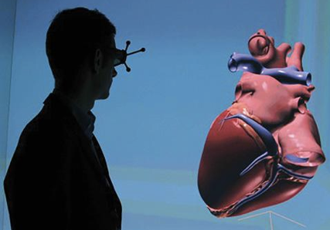
In Silico
Digital Twins – model outcomes without any intervention e.g. pacemakers in digital twin of heart.
Drug Discovery – model chemical composition to understand drug behavior without spending on wet lab experiments
Virtual Patients – Model disease progression, comorbidities, interventions and outcomes without conducting RCTs and no human subject involvement

Slide 14
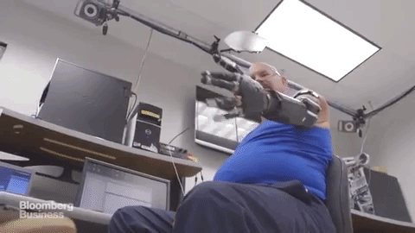
Treatment plans
HAL - Hybrid Assistive Limb

Slide 15
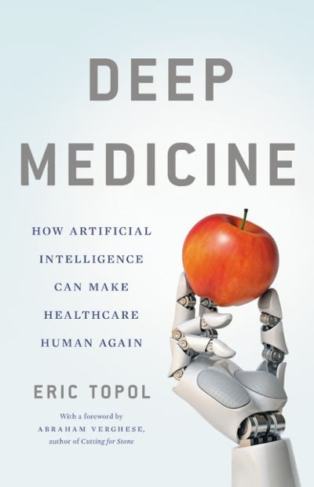
Clinical documentation
Creating a patient summary from the entire clinical record
Saves clinician’s time pre-encounter
Facilitates continuity of care
Generating correct documentation from pervasive data
Multi-modal data captured during patient encounter generates documentation
Automatically generates billing information

Slide 16
Advanced imaging
3D reconstruction technique, currently not approved for clinical use, that can produce photorealistic 3D images from
traditional CT and MRI data. Read More: https://www.ajronline.org/doi/full/10.2214/AJR.17.17850

Slide 17
risks
Privacy Risk
Lack of Trust
Safety
Low Interpretability
Problems with Reproducibility
Bias
Misuse and Over-reliance

Slide 18
Privacy
While using chatGPT – YOU may have trained it!
Adversarial attacks on producing training data
Imagine generative AI trained on patient data starts revealing it

Slide 19
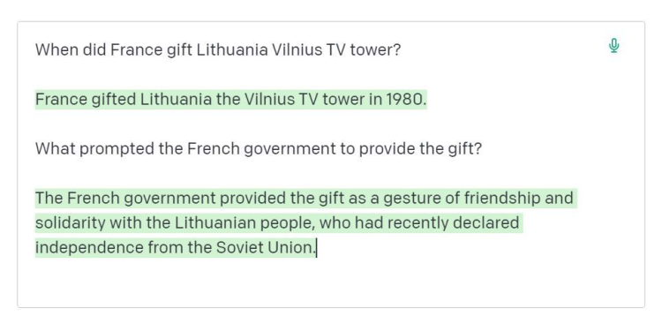
trust
Generative AI suffers from hallucination
when it produces something with high confidence and looks correct, but is actually wrong
Deepfakes
Fake pictures, fake profiles, fake identities, fake resumes etc.
Fraud : Fake cases and documentation for ease of pre-approval and higher reimbursement

Slide 20
safety
Incorrect diagnoses
Providing incorrect diagnoses in clinical decision support systems
Missed information
Patient summaries missing salient information such as drug allergies
Incorrect Treatment
a clinician in Africa using Gen AI to generate an outline for treatment options is actually focusing on outputs from a system trained in rich countries like USA

Slide 21
interpretability
Results are often not interpretable
Gen AI does not necessarily provide a rationale for producing a particular answer

Slide 22
reproducibility
Same outputs to different questions
WHO says Covid is no longer a health emergency
Who says Covid is no longer a health emergency?
Different outputs for same questions
Minor variations lead to drastically different answers
Prompt Engineering: Crafting prompts to get the best answers from the AI
Clinical guidelines and practices change: how can AI adjust

Slide 23
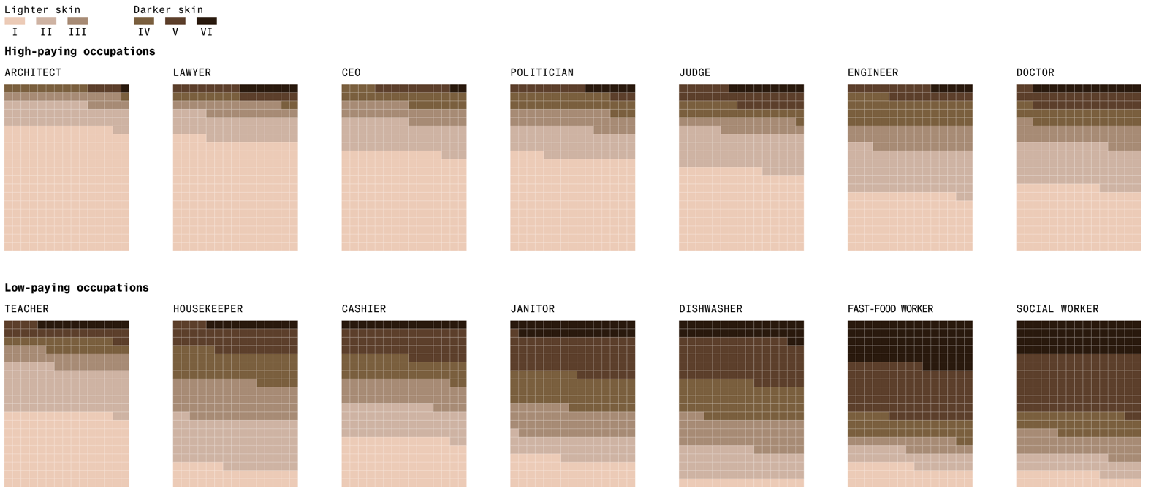
bias
Humans have biases – data has biases – Gen AI is just a reflection of that

Slide 24
Over-reliance
With advanced tools, humans lost scrappiness
In healthcare, art of diagnoses with limited resources is getting lost
Overly relying on Gen AI instead of bedside training
Generative AI for rare conditions?

Slide 25
Responsible AI Framework
Fairness
AI systems should treat all people fairly
Inclusiveness
AI systems should empower everyone and engage people
Reliability and Safety
AI systems should perform reliably and safely
Transparency
AI systems should be understandable
Privacy and Security
AI systems should be secure and respect privacy
Accountability
People should be accountable for AI systems

