Slide 1
Evaluate the Role of Interdisciplinary Collaboration in Medication Safety, Assessing How Effective Communication Among Healthcare Professionals Can Mitigate Errors
Ayat Kadhi
Lecturer, PhD Candidate, MSc, RN, BSN

Slide 2
Disclosure Statement
Speaker:
Ayat Kadhi
Has no relevant financial/non-financial relationships to disclose
Will not be discussing unlabeled/unapproved use of drugs or products

Slide 3
Outline
Role of Interdisciplinary Collaboration
Strategies for Interdisciplinary Collaboration
Introduction
1
3
5
2
4
6
Medication Errors: Scope and Impact
Case Study
Conclusion

Slide 4
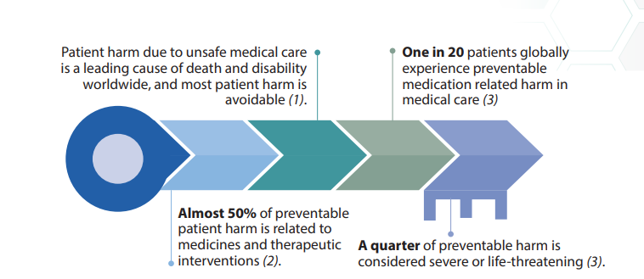
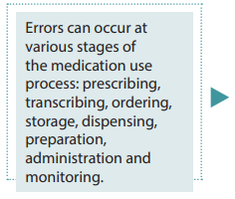
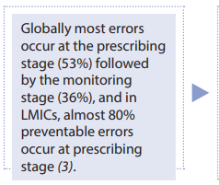
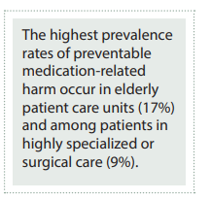
Introduction
(World Health Organization, 2017)
Notes:
Examples of medication errors include missed medications, administration of the wrong medication, administration to the wrong patient, excessive or insufficient doses, or the prescription of inappropriate medications to treat medical conditions. Medication errors can occur from. The most serious outcomes of medication errors involve the occurrence of sentinel events. Sentinel events with medications, which cause catastrophic harm, often feature in the top 10 types of reported sentinel events [2]. [3]. Therefore, by targeting strategies aimed at improving communication between health professionals, there is the potential for reducing medication errors, particularly those causing harm

Slide 5
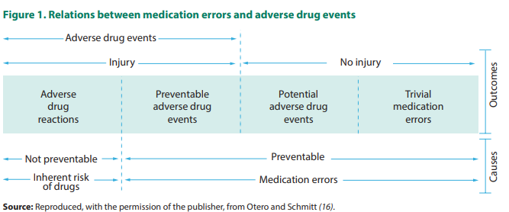
Medication Errors: Scope and Impact
Medication error: any preventable event that may cause or lead to inappropriate medication use or patient harm while the medication is in the control of the health care professional, patient, or consumer”
-Gaps in knowledge
-Failure to follow rules
-The use of inappropriate rules for managing medications,
-Technical errors and memory lapses in carrying out medication activities.
Breakdowns in communication are closely tied to sentinel events
Targeting strategies aimed at improving communication between health professionals, has a potential to reduce medication errors, particularly those causing harm.
(World Health Organization, 2017 and Manias, 2017)

Slide 6
Role of Interdisciplinary Collaboration
Interdisciplinary collaboration involves healthcare professionals from different disciplines working together to achieve common goals.
Effective communication and mutual respect among healthcare providers.
Shared decision-making by integrating diverse perspectives and expertise.
Collaboration improves medication safety through coordinated efforts and shared responsibilities.
(Manias, 2017)
Notes:
An important facet of communication involves interdisciplinary collaboration

Slide 7
Case Study
The physician prescribes a new medication regimen for Ahmad during morning rounds but did not communicate this change to the nursing staff due to time constraints.
There is a lack of electronic systems for real-time updates and access to patient medication records. The pharmacist was not available due to responding to a medical emergency (blue code)
The nurse assigned to Ahmad's care during the afternoon shift is unaware of the medication changes and administers Ahmad’s previous dose of diuretics and blood thinners.
The hospital lacks standardized protocols for medication reconciliation during shift changes, leading to confusion and errors in medication administration.
Ahmad is a 65-year-old male admitted to the hospital for heart failure exacerbation.
During his hospital stay, he is prescribed multiple medications, including diuretics and blood thinners.
Ahmad experiences an overdose of diuretics and blood thinners due to the double administration of medications. He develops symptoms of hypotension and dizziness, requiring urgent medical intervention
The medication error prolongs Ahamad's hospitalization and increases the risk of adverse outcomes, including renal dysfunction and bleeding complications.
Created with Biorender

Slide 8
Case Study
What were the critical gaps that contributed to the medication error described in the case study?
Communication Breakdown
Lack of Standardized Protocols
Lack of documentation and electronic system

Slide 9
Strategies for Interdisciplinary Collaboration
Clear Communication Protocols
Utilizing Technology
Continuous Education and Training
Monitoring and Feedback Mechanisms
Notes:
Team-based approaches involve healthcare professionals from different disciplines working together cohesively to achieve common goals related to patient care and safety.

Slide 10
Strategies for Interdisciplinary Collaboration
B
A
Establish Escalation Pathways
Standardized Communication
Define clear pathways for escalating medication-related concerns or issues to higher levels of care, ensuring prompt resolution of medication-related problems.
Implement tools like SBAR (Situation, Background, Assessment, Recommendation) for structured and concise communication during handoffs and patient consultations.
Medication review at patient admission and on discharge
A
B
D
C
Clear communication protocols outline standardized processes and procedures for sharing information among healthcare team members to ensure accurate and timely communication.
D
C
Encourage Two-way Communication
Foster an environment where all team members feel empowered to speak up, ask questions, and seek clarification regarding medication orders and treatment plans.
Document Communication Effectively
Ensure accurate documentation of medication-related discussions and decisions in patient records to facilitate continuity of care.
Manias, E. (2018)
Notes:
treatment plans, and resolving medication-related issues promptly.
Shared Goals and Values: Aligning interdisciplinary teams around common goals and patient-centered values promotes unity and collaboration in medication management.
Mutual Respect and Trust: Establishing mutual respect and trust among team members encourages open dialogue, constructive feedback, and collaborative problem-solving.

Slide 11
Strategies for Interdisciplinary Collaboration
Electronic Health Records (EHRs)
Use EHRs to maintain comprehensive and up-to-date medication lists, allergies, and treatment plans accessible to all healthcare providers involved in patient care.
Barcode Medication Administration (BCMA)
Implement BCMA systems to verify patient identity and medication administration accuracy at the point of care, reducing the risk of medication errors.
Telemedicine and secure messaging platforms
Enable remote consultations and communication between healthcare team members to facilitate real-time collaboration and decision-making.
Utilizing Technology involves leveraging digital tools and systems to enhance medication safety, streamline communication, and reduce medication errors.

Slide 12
Strategies for Interdisciplinary Collaboration
1)Scheduled Workshops and Online Learning
2) Interdisciplinary Grand Rounds
Encourage case presentations and discussions among healthcare professionals to promote shared learning and collaboration.
Offer regular workshops and develop interactive e-learning modules focusing on interdisciplinary collaboration and medication safety.
1
2
1
2
3
4
3) Team Training and Role Clarification
3
4
4) Promote Interprofessional Education
Integrate interprofessional education into healthcare training programs to foster mutual respect and enhance collaborative patient care
Conduct interdisciplinary training sessions to enhance teamwork, communication skills, and conflict resolution.
Example: TeamSTEPPS™
Define clear roles and responsibilities for each team member in medication management to ensure accountability and coordination.
Continuous Education and Training Ongoing education and training programs ensure that healthcare professionals are equipped with the necessary knowledge and skills to engage in effective interdisciplinary collaboration.
(Heier et al., 2024 and Irajpour et al., 2019 and Parker et al., 2019)
Notes:
Interprofessional communication skills training to improve medical students’ and nursing trainees’ error communication - quasi-experimental pilot study - PMC (nih.gov)
Effect of interprofessional education of medication safety program on the medication error of physicians and nurses in the intensive care units - PMC (nih.gov)

Slide 13
Strategies for Interdisciplinary Collaboration
Performance Metrics
Regular Audits and Reviews
Define measurable indicators (e.g., medication error rates, adherence to protocols) to assess the effectiveness of interdisciplinary collaboration in medication safety.
Conduct periodic audits and reviews of interdisciplinary team practices, communication protocols, and patient outcomes to identify trends, patterns, and areas needing improvement.
Feedback Loops
Establish feedback mechanisms to gather input from team members, patients, and stakeholders on their experiences with interdisciplinary collaboration and medication management.
Example of a Collaborative Committee Structure Report
Non-punitive
Anonymous
Responsive
Inclusiveness
Accountability
Supportive environment
Summary review
System-oriented
Expert analysis Psychological safety
Monitoring and Feedback Mechanisms
Ongoing evaluation of interdisciplinary collaboration processes and outcomes to identify areas for improvement and ensure quality assurance.
(Hanifin & Zielenski, C. , 2020)
Notes:
Non-punitiveNo punishment for the reporter as a result of error reporting.
AnonymousThe reporter is not identified by name.
Responsive Recommendations are disseminated and changes implemented when possible.
Inclusiveness Engaging everyone (prescriber, pharmacist, nurse, allied health professionals, patient, and family).
Accountability Holding an individual accountable for continuing unsafe practices.
Supportive environment Utilize preventive strategies (e.g. information technology) and increase comfort level by considering system design changes.
Summary review Analyze summary of medication error information on a quarterly, semi-annual, or annual basis.
System-oriented Focusing on the context and external environment in which an organization operates.
Expert analysis Understanding the circumstances under which incidents occur and recognizing defects.
Psychological safety

Slide 14
Conclusion
Clear Communication Protocols
Standardized Communication
Establish Escalation Pathways
Encourage Two-way Communication
Document Communication Effectively
Utilizing Technology
Electronic Health Records (EHRs)
Telemedicine and secure messaging platforms
Barcode Medication Administration (BCMA)
Continuous Education and Training
Scheduled Workshops and Online Learning
Interdisciplinary Grand Rounds
Team Training and Role Clarification
Promote Interprofessional Education
Monitoring and Feedback Mechanisms
Performance Metrics
Regular Audits and Reviews
Feedback Loops
Example of a Collaborative Committee Structure Report

Slide 15
References
World Health Organization. (2017). Medication without harm (No. WHO/HIS/SDS/2017.6). World Health Organization.
Manias, E. (2018). Effects of interdisciplinary collaboration in hospitals on medication errors: an integrative review. Expert Opinion on Drug Safety, 17(3), 259-275.
Hanifin, R., & Zielenski, C. (2020). Reducing medication error through a collaborative committee structure: an effort to implement change in a community-based health system. Quality Management in Healthcare, 29(1), 40-45.
Heier, L., Schellenberger, B., Schippers, A., Nies, S., Geiser, F., & Ernstmann, N. (2024). Interprofessional communication skills training to improve medical students’ and nursing trainees’ error communication-quasi-experimental pilot study. BMC Medical Education, 24(1), 10.
Irajpour, A., Farzi, S., Saghaei, M., & Ravaghi, H. (2019). Effect of interprofessional education of medication safety program on the medication error of physicians and nurses in the intensive care units. Journal of education and health promotion, 8(1), 196.
Parker, A. L., Forsythe, L. L., & Kohlmorgen, I. K. (2019). TeamSTEPPS®: An evidence‐based approach to reduce clinical errors threatening safety in outpatient settings: An integrative review. Journal of Healthcare Risk Management, 38(4), 19-31.

