Slide 1
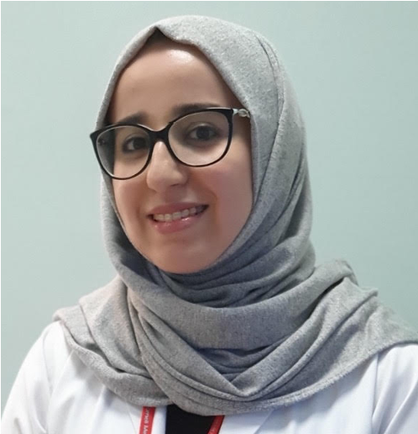
Karima Becetti, MD, MS
Rheumatology Consultant
Hamad Medical Corporation
Assistant Professor in Medicine Weill Cornell Medicine-Qatar
Dr. Karima Becetti is a rheumatology consultant at Hamad Medical Corporation and Assistant Professor of Clinical Medicine at Weill Cornell Medicine-Qatar (WCM-Q).
Dr. Becetti graduated from Weill Cornell Medicine–Qatar with academic distinction in 2011. Following graduation, Dr. Becetti pursued residency training in internal medicine at Vanderbilt University Medical Center in Nashville, Tennessee and a rheumatology fellowship at the Hospital for Special Surgery in New York. She is American Board certified in internal medicine and rheumatology.
Dr. Becetti has been involved in many research studies and has multiple peer-review publications and presentations at international conferences. She completed a Master of Science degree in epidemiology and health services research at the Weill Cornell Graduate School of Medical Sciences in New York. She received the 2013 Rheumatology Research Foundation Medical and Pediatric Resident Research Award for her work on cardiovascular disease in rheumatoid arthritis. Dr. Becetti was also the recipient of the 2019 Department of Medicine Grand Rounds Award at Hamad Medical Corporation.

