Slide 1
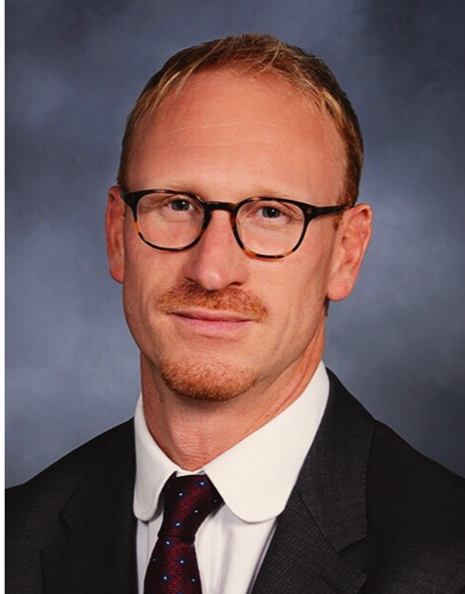
Peter A. D. Steel, MA, MBBS
Director of Clinical Services Assistant Professor of Clinical Emergency Medicine NewYork-Presbyterian/ Weill Cornell Medical Center
Dr. Peter Steel earned his pre-clinical MA (Hons) at Oxford University and his medical degree (MBBS) at University College London-Royal Free Medical School, England. He completed emergency medicine residency at New York-Presbyterian (NYP), serving as chief resident in 2010-11. Dr. Steel currently serves as the Director of Clinical Services for the Department of Emergency Medicine at NYP-Weill Cornell Medical Center, overseeing all clinical services and leading grant-funded research projects. Dr. Steel also serves on both national and regional American College of Emergency Physician committees. His research interests include the interface between operational innovation and quality outcomes, as well as post-ED transitions of care.

