Slide 1
Brugada Syndrome (BrS)
Amar Salam
Rasha Kaddoura
September 12, 2021

Slide 2
Disclosure Statement
Speakers
Dr. Amar Salam
Dr. Rasha Kaddoura
Have no relevant financial relationships to disclose
Will not be discussing unlabeled/unapproved use of drugs or products

Slide 3
Objectives
Identify Brugada ECG
Outline the diagnostic criteria and differential diagnosis of Brugada syndrome
Outline the typical presentation and evaluation of a patient with Brugada syndrome
Outline the pharmacological interactions in patients with Brugada Syndrome
A&E, Accident and Emergency; EMS, Emergency Medical Services

Slide 4
Outline
Case presentation
A&E, Accident and Emergency; EMS, Emergency Medical Services

Slide 5
Case 1
37-year old Nepalese gentleman
Abnormal sound while sleeping witnessed by room-mate
Unable to wake him up for few minutes
EMS
Fully conscious, oriented without complaint
A&E
Fully conscious, oriented
Not in distress or dyspneic, normal vital signs
A&E, Accident and Emergency; EMS, Emergency Medical Services
Notes:
A 37 year old Nepalese gentleman
His room mate noticed him while sleeping producing abnormal sound and unable to wake him up which took few minutes
By the rime EMS arrived, he was fully conscious oriented with out any complain.
A&E assessment fully conscious oriented, not in distress and not dyspneic, Vital signs with in normal

Slide 6
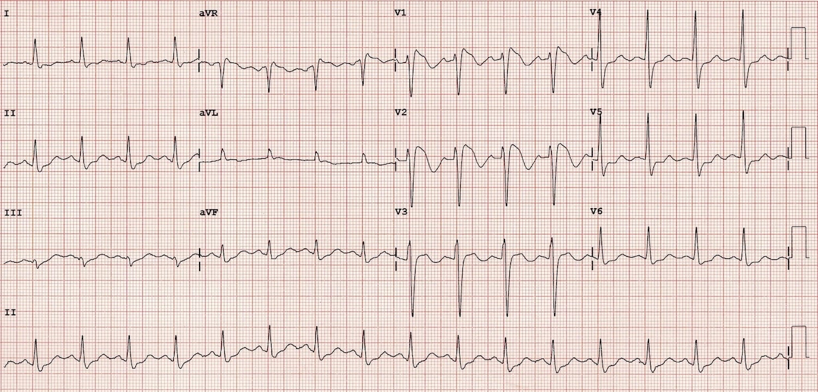
ECG - Case 1

Slide 7
Case 2
34-year old Nepalese gentleman, laborer
No previous medical history
A&E
Presented with complaint of transient LOC
Collapsed and found in cardiac arrest (VF)
CPR initiated and was resuscitated
CPR, cardiopulmonary resuscitation; LOC, loss of consciousness; VF, ventricular fibrillation
Notes:
34 year old Nepalese gentleman
laborer in construction company, no previous medical history
Presented to A&E with a complain of transient LOC
While in A&E, he collapsed and found to be in cardiac arrest
CPR initiated and his initial rhythm showed VF
Resuscitated

Slide 8
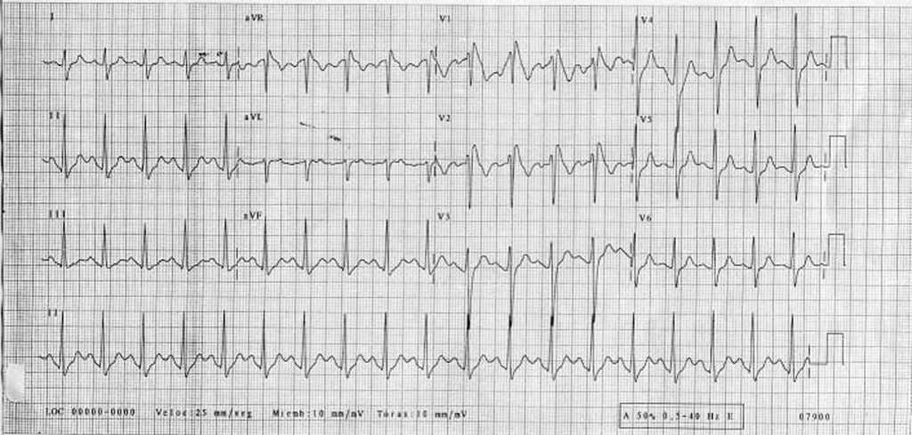
ECG - Case 2

Slide 9
Brugada Syndrome (BrS)
‘‘Pokkuri Death Syndrome’’ in Japan
‘‘Lai Tai’’ in Thailand
‘‘Bangungut’’ in the Philippines
‘‘Dream Disease’’ in Hawaii
‘‘Sudden Unexplained Nocturnal Death Syndrome (SUNDS)’’ among south Asian immigrants in USA
Notes:
VF usually occurs spontaneously at night, and the prevalence of BrS has been reported to be much higher in East/Southeast Asia [3,4]. ‘‘Pokkuri Death Syndrome’’ in Japan, ‘‘Lai Tai’’ in Thailand, ‘‘Bangungut’’ in the Philippines, ‘‘Dream Disease’’ in Hawaii, and ‘‘Sudden Unexplained Nocturnal Death Syndrome (SUNDS)’’ among south Asian immigrants in the United States of America (USA) are now thought to be the same disease as BrS.
Kengo F. Kusano. Brugada syndrome: Recent understanding of pathophysiological mechanism and treatment. Journal of Arrhythmia 2013; 29(2):77-82.

Slide 10
Definition
Inherited disease
Characterized by a coved-type STE in right precordial leads and increased risk of SCD
Absence of structural abnormalities
ECG pattern can be spontaneous or unmasked by drugs (sodium-channel blockers)
ECG, electrocardiograph; SCD, sudden cardiac death; STE, ST-segment elevation
Notes:
Brugada syndrome (BS) is an inherited disease characterized by a coved-type ST-segment elevation in the right precordial leads and increased risk of sudden cardiac death (SCD), in the absence of structural abnormalities. The cornerstone of BS diagnosis and definition, is its characteristic ECG pattern that can be present spontaneously or unmasked by drugs (The definition of the Brugada syndrome Juan Sieira, Pedro Brugada European Heart Journal, Volume 38, Issue 40, 21 October 2017, Pages 3029–3034,)

Slide 11
Disease Burden
Difficult to estimate (asymptomatic, dynamic)
Prevalence 1/5,000 - 1/2,000
Men > women (8 – 10 times)
Incidence of BrS pattern (ECG) 0.12% - 0.8%
4% - 12% of all sudden deaths
Up to 20% of sudden deaths in patients with structurally normal hearts
Prevalence is much higher in East/Southeast Asia
Notes:
It is difficult to estimate (asymptomatic, dynamic)
The prevalence 1/5,000 - 1/2,000.
The incidence of BrS pattern on ECG 0.12% - 0.8%.
4% to 12% of all sudden deaths.
Up to 20% of sudden deaths in patients with structurally normal hearts.
8 - 10 X more prevalent in men than women.

Slide 12
Clinical Presentation
Syncope, seizures, and nocturnal agonal breathing
SCD
Febrile episodes are frequent with symptoms
Syncope or SCD ranges from 17% to 42% (overestimated)
Recent report: SCD (4.6%) and recurrent arrhythmia (5%)
SCD, sudden cardiac death
Notes:
syncope, seizures, and nocturnal agonal breathing.
SCD.
Syncope or SCD ranges from 17% to 42% (overestimated).
Recent accounts report, SCD (4.6%) and recurrent arrhythmia during follow-up (5%).
Usually occur during resting or sleeping, suggesting an association with bradycardia or vagal events.
Febrile episodes have also been frequently associated with symptoms.
Typically first occur during adulthood, with a mean age of SCD presentation of 41 ± 15 years.
Hormonal influences (age and sex difference):
After castration in men with prostate cancer.
higher concentration of testosterone has been noted in men with BrS.
No male predominance in children younger than age 16 years.

Slide 13
Clinical Presentation
Occur during resting or sleeping
Association with bradycardia or vagal events
First occurrence during adulthood
Mean age of SCD presentation of 41 ± 15 years
Hormonal influences (age and sex difference)
After castration in men with prostate cancer
higher concentration of testosterone in men
No male predominance in children < 16 years
SCD, sudden cardiac death
Notes:
Usually occur during resting or sleeping, suggesting an association with bradycardia or vagal events.
Febrile episodes have also been frequently associated with symptoms.
Typically first occur during adulthood, with a mean age of SCD presentation of 41 ± 15 years.
Hormonal influences (age and sex difference):
After castration in men with prostate cancer.
higher concentration of testosterone has been noted in men with BrS.
No male predominance in children younger than age 16 years.

Slide 14
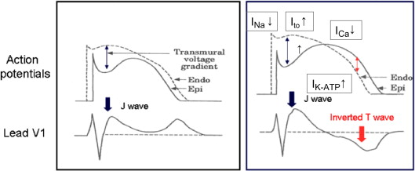
Pathophysiology
ST-T abnormality in right precordial leads
Outward shift of ionic currents during early repolarization (transmural voltage gradient)
Marked accentuation of action potential notch
Prolongation of repolarization in RV epicardial (spike-and-dome), but not endocardial, cells in the RVOT
RV, right ventricular; RVOT, right ventricular outflow tract
Notes:
Fig. 3. Mechanism of ST-T abnormality in Brugada syndrome. Note that a marked accentuation of the action potential notch and prolongation of repolarization in the right ventricular epicardial (Epi), but not endocardial (Endo), cells results in T-wave inversion in the surface electrocardiogram lead V1 (Modified from Ref. [20]).
Kengo F. Kusano. Brugada syndrome: Recent understanding of pathophysiological mechanism and treatment. Journal of Arrhythmia 2013; 29(2):77-82.

Slide 15
Pathophysiology
ST-T abnormality in right precordial leads
Increased transient outward current (Ito)
STE (J wave) and T wave inversion
RV, right ventricular; RVOT, right ventricular outflow tract
Notes:
Fig. 3. Mechanism of ST-T abnormality in Brugada syndrome. Note that a marked accentuation of the action potential notch and prolongation of repolarization in the right ventricular epicardial (Epi), but not endocardial (Endo), cells results in T-wave inversion in the surface electrocardiogram lead V1 (Modified from Ref. [20]).
Kengo F. Kusano. Brugada syndrome: Recent understanding of pathophysiological mechanism and treatment. Journal of Arrhythmia 2013; 29(2):77-82.

Slide 16
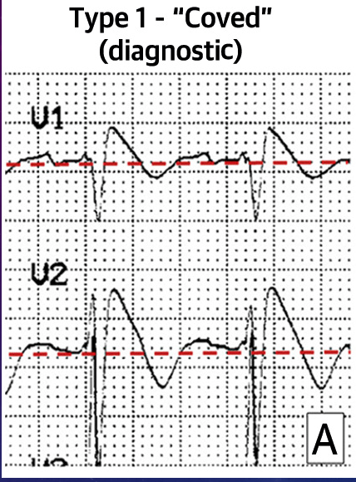
Type 1 BrS - ECG
STE ≥2 mm in ≥1 right precordial lead (V₁ to V₃), following an rʹ-wave and a concave or straight ST segment
Descending ST segment crosses isoelectric line and followed by negative and symmetric T-wave
STE, ST-segment elevation
Notes:
Type 1 (“coved type”) :
This alteration is the only diagnostic pattern for BrS. It is characterized by an ST-segment elevation ≥2 mm in ≥1 right precordial lead (V₁ to V₃), following an rʹ-wave and a concave or straight ST segment. The descending ST segment crosses the isoelectric line and is followed by a negative and symmetric T-wave.

Slide 17
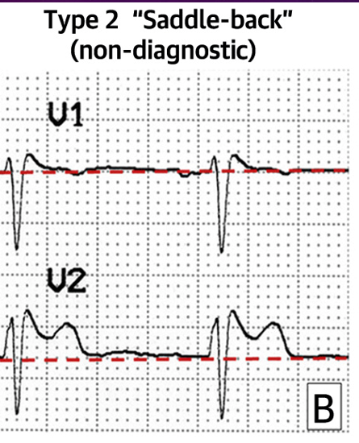
Type 2 BrS - ECG
Suggestive of BrS
STE ≥0.5 mm in ≥1 right precordial lead (V₁ to V₃), followed by a convex ST
rʹ-wave may or may not overlap the J point, but it has a slow downward slope
STE, ST-segment elevation
Notes:
Type 2 (“saddle-back type”):
Only suggestive of BrS.
It is characterized by an ST-segment elevation ≥0.5 mm (generally ≥2 mm in V₂) in ≥1 right precordial lead (V₁ to V₃), followed by a convex ST.
The rʹ-wave may or may not overlap the J point, but it has a slow downward slope.
The ST segment is followed by a positive T-wave in V₂ and is of variable morphology in V₁.

Slide 18
Type 2 BrS - ECG
STE ≥2 mm in V₂
ST segment is followed by a positive T-wave in V₂ and is of variable morphology in V₁
STE, ST-segment elevation
Notes:
Type 2 (“saddle-back type”):
Only suggestive of BrS.
It is characterized by an ST-segment elevation ≥0.5 mm (generally ≥2 mm in V₂) in ≥1 right precordial lead (V₁ to V₃), followed by a convex ST.
The rʹ-wave may or may not overlap the J point, but it has a slow downward slope.
The ST segment is followed by a positive T-wave in V₂ and is of variable morphology in V₁.

Slide 19
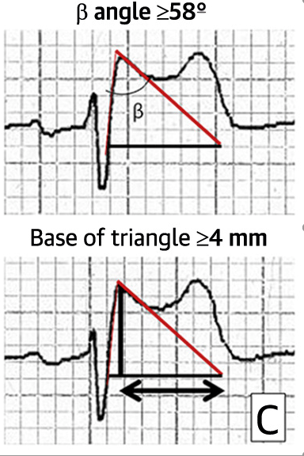
β angle
Cut-off value ≥58°
Best predictive values for conversion to a type 1 BrS pattern
73% PPV and 87% NPV
NPV, negative predictive value; PPV, positive predictive value
Notes:
○ β angle: A cut-off value ≥58° provided the best predictive values for conversion to a type 1 BrS pattern (73% PPV and 87% NPV).
○ Length of the base triangle of the rʹ-wave 5 mm below the maximum rise point: A cut-off value of 4 mm (≥4 mm in patients with BrS) demonstrated 96% specificity and 85% sensitivity (PPV 95% and NPV 88%).
○ Other criteria: The triangle base duration at the isoelectric line (>1.5 mm in patients with BrS) and the relationship between the triangle base at the isoelectric line and its height (>1.3 in BrS patients) may be distinguishing ECG patterns in BrS.

Slide 20
Base of Triangle
Length of base triangle of the rʹ-wave 5 mm below the maximum rise point
Cut-off value of 4 mm (≥4 mm in BrS) has:
Specificity 96%
Sensitivity 85%
PPV 95% and NPV 88%
NPV, negative predictive value; PPV, positive predictive value
Notes:
○ β angle: A cut-off value ≥58° provided the best predictive values for conversion to a type 1 BrS pattern (73% PPV and 87% NPV).
○ Length of the base triangle of the rʹ-wave 5 mm below the maximum rise point: A cut-off value of 4 mm (≥4 mm in patients with BrS) demonstrated 96% specificity and 85% sensitivity (PPV 95% and NPV 88%).
○ Other criteria: The triangle base duration at the isoelectric line (>1.5 mm in patients with BrS) and the relationship between the triangle base at the isoelectric line and its height (>1.3 in BrS patients) may be distinguishing ECG patterns in BrS.

Slide 21
Other Criteria
Triangle base duration at the isoelectric line (>1.5 mm in BrS)
Relationship between triangle base at isoelectric line and its height (>1.3 in BrS) may be distinguishing ECG patterns in BrS
STE, ST-segment elevation
Notes:
○ β angle: A cut-off value ≥58° provided the best predictive values for conversion to a type 1 BrS pattern (73% PPV and 87% NPV).
○ Length of the base triangle of the rʹ-wave 5 mm below the maximum rise point: A cut-off value of 4 mm (≥4 mm in patients with BrS) demonstrated 96% specificity and 85% sensitivity (PPV 95% and NPV 88%).
○ Other criteria: The triangle base duration at the isoelectric line (>1.5 mm in patients with BrS) and the relationship between the triangle base at the isoelectric line and its height (>1.3 in BrS patients) may be distinguishing ECG patterns in BrS.

Slide 22
Differential Diagnosis
Brugada Type 1 phenocopier
RV ischemia
Acute pulmonary embolism
Mechanical compression of RV outflow tract
Acute ischemia or occlusion of LAD
Pectus excavatum
Atypical RBBB
Arrhythmogenic cardiomyopathy
LAD, left anterior descendent artery; RBBB; right bundle branch block; RV, right ventricle
Notes:
Brugada Type1 phenocopier:
RV ischemia,
Acute pulmonary embolism.
Mechanical compression of the RV outflow tract.
Acute ischemia or occlusion of the left anterior descendent artery
Pectus excavatum
Atypical RBBB
Arrhytmogemic cardiomyopathy

Slide 23
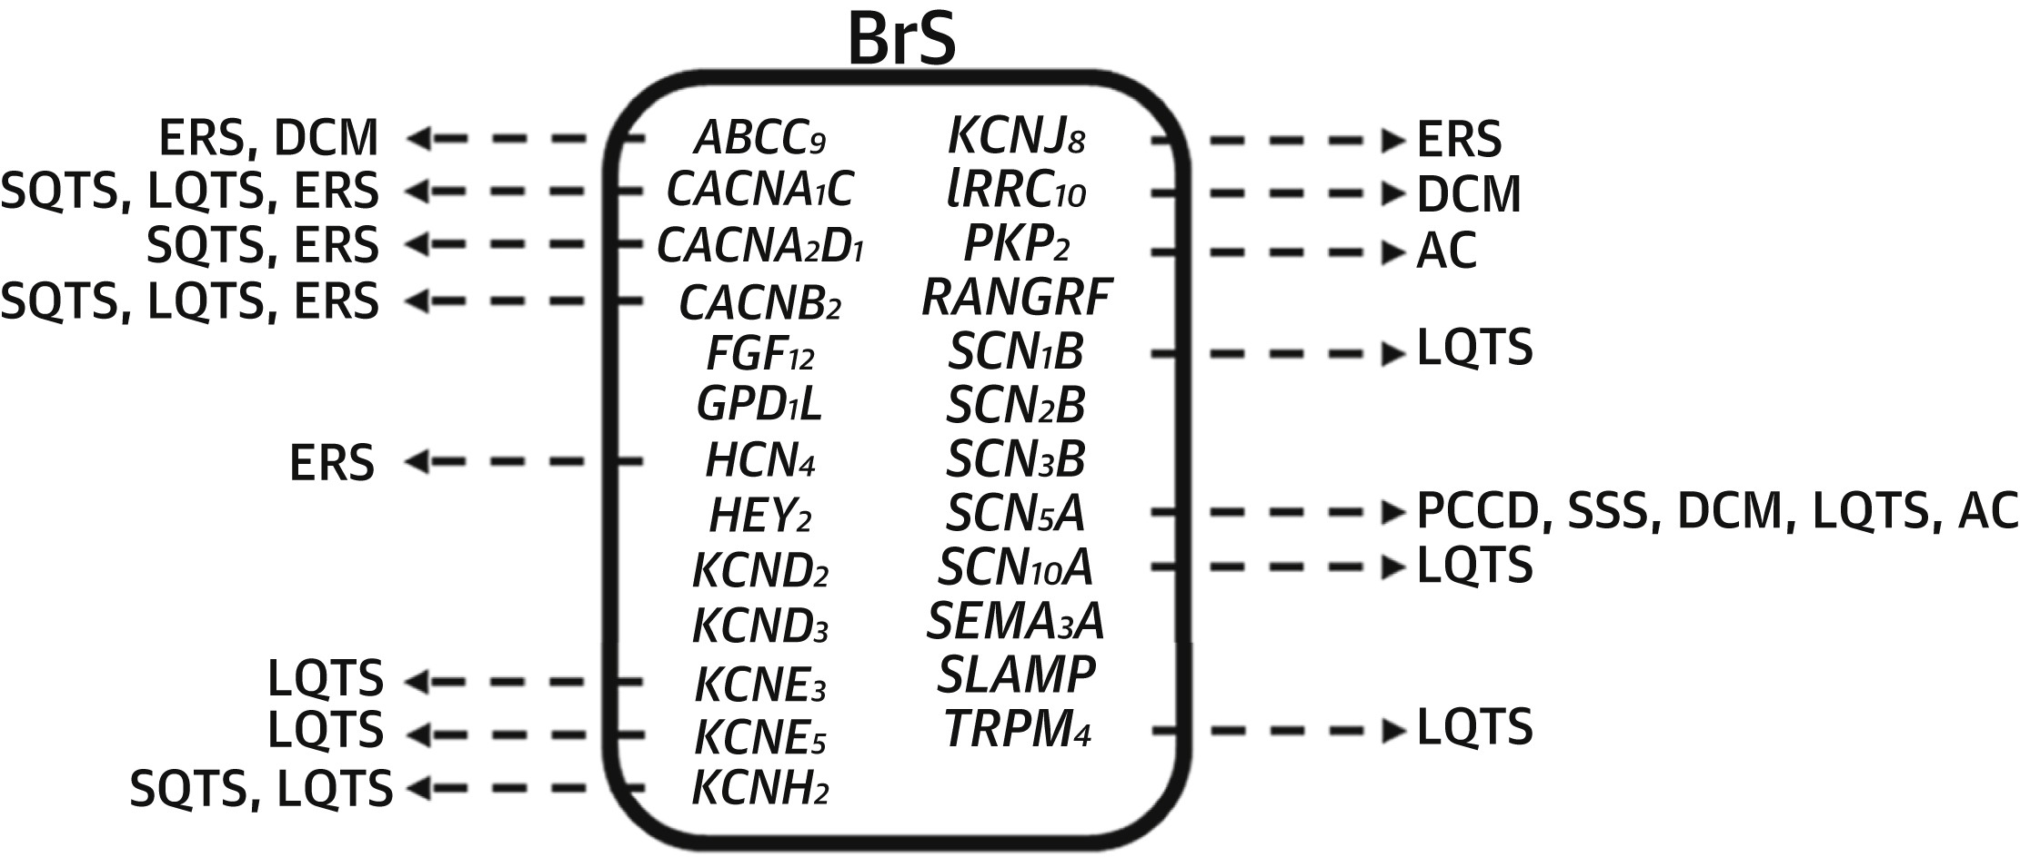
Genetic Aspect
Up to 70% have no genetic implication
SCN5A

Slide 24
Genetic Aspect
Notes:
Gene mutations in BrS Approximately 20% of BrS patients have been shown to have sodium channel gene mutations (BrS 1, 5, 7, and 11) and about 10% of patients have been shown to have L-type calcium channel gene mutations (BrS 3, 4, and 9) (Table 1). In rare cases (o1%), mutations of glycerol-3-phosphate dehydrogenase-like peptide (GPD1-L: BrS 2), transient outward potassium current (BrS 6 and 10), and ATP-sensitive potassium channel (BrS 8 and 12) have been reported. Genotype–phenotype correlations have been reported in BrS. For example, patients with an SCN5A mutation had longer and progressive conduction delays (PQ, QRS, and HV intervals) [16,17], frequent occurrence of fragmented QRS complex (f-QRS: defined as an abnormal fragmentation within the QRS complex as Z4 spikes in 1 or Z8 spikes in all of the V1, V2, and V3 leads) [6], and ventricular arrhythmias of extra-RVOT origin [18]. Patients with calcium channel gene mutations have a short QT interval [19].
Kengo F. Kusano. Brugada syndrome: Recent understanding of pathophysiological mechanism and treatment. Journal of Arrhythmia 2013; 29(2):77-82.

Slide 25
Diagnostic Criteria
Before 2013
Presence of a type 1 ECG pattern, and
Clinical manifestations such as
Resuscitated SCD
documented PVT
History of non-vasovagal syncope, and/or
Family history of non-coronary SCD at age <45 years
PVT, polymorphic ventricular tachycardia; SCD, sudden cardiac death
Notes:
Before 2013:
The presence of a type 1 ECG pattern and
Clinical manifestations such as resuscitated SCD, documented PVT, history of non vasovagal syncope, and/or family history of noncoronary SCD age <45 years.
the 2013 expert consensus statement:
Type 1 ST elevation is observed either spontaneously or after intravenous administration of a sodium channel blocker in at least one right precordial lead (V₁ and V₂), placed in a standard or superior position (up to the 2nd intercostal space),” without requiring any further evidence of malignant arrhythmias.

Slide 26
Diagnostic Criteria
2013 Expert consensus statement (Type 1)
STE is observed either spontaneously or after IV administration of a sodium channel blocker in at least one right precordial lead (V₁ and V₂) without requiring any further evidence of malignant arrhythmias
Leads placed in standard or superior position (up to 2nd intercostal space)
IV, intravenous; STE, ST-segment elevation
Notes:
Before 2013:
The presence of a type 1 ECG pattern and
Clinical manifestations such as resuscitated SCD, documented PVT, history of non vasovagal syncope, and/or family history of noncoronary SCD age <45 years.
the 2013 expert consensus statement:
Type 1 ST elevation is observed either spontaneously or after intravenous administration of a sodium channel blocker in at least one right precordial lead (V₁ and V₂), placed in a standard or superior position (up to the 2nd intercostal space),” without requiring any further evidence of malignant arrhythmias.

Slide 27
Risk Stratification
Syncope indisputable risk factor
17% up to 62% of BrS patients will have new arrhythmic event within 48 to 84 months
Syncope PLUS spontaneous type 1 ECG pattern
6% to 19% arrhythmic event within 24 to 39 months of follow-up
Vasovagal/neurogenic syncope should be excluded
Notes:
Syncope is an indisputable risk factor:
17% 62% of BrS patients will have a new arrhythmic event 48 to 84 months.
syncope + spontaneous type 1 ECG pattern = (6% to 19% arrhythmic event within 24 to 39 months of follow-up.
Need to exclude vasovagal/neurogenic syncope.
Asymptomatic patients:
The arrhythmic events (0.5% to 1.2% annual incidence), l2% malignant ventricular arrhythmia rate at 10-year follow-up in a population with a mean age of 40 years.
Fever-induced type 1 ECG, intermediate risk for sudden death.
Inducibility of arrhythmia.
Ventricular refractory period <200 ms.
Family history.
Genetic testing.
Polymorphism.

Slide 28
Risk Stratification
Asymptomatic patients
Arrhythmic events: 0.5% to 1.2% annual incidence
l2% malignant ventricular arrhythmia rate at 10-year follow-up in population with mean age of 40 years
Fever-induced type 1 ECG is intermediate risk for sudden death
Notes:
Syncope is an indisputable risk factor:
17% 62% of BrS patients will have a new arrhythmic event 48 to 84 months.
syncope + spontaneous type 1 ECG pattern = (6% to 19% arrhythmic event within 24 to 39 months of follow-up.
Need to exclude vasovagal/neurogenic syncope.
Asymptomatic patients:
The arrhythmic events (0.5% to 1.2% annual incidence), l2% malignant ventricular arrhythmia rate at 10-year follow-up in a population with a mean age of 40 years.
Fever-induced type 1 ECG, intermediate risk for sudden death.
Inducibility of arrhythmia.
Ventricular refractory period <200 ms.
Family history.
Genetic testing.
Polymorphism.

Slide 29
Risk Stratification
Asymptomatic patients
Inducibility of arrhythmia
Ventricular refractory period <200 ms
Family history
Genetic testing
Polymorphism
Notes:
Syncope is an indisputable risk factor:
17% 62% of BrS patients will have a new arrhythmic event 48 to 84 months.
syncope + spontaneous type 1 ECG pattern = (6% to 19% arrhythmic event within 24 to 39 months of follow-up.
Need to exclude vasovagal/neurogenic syncope.
Asymptomatic patients:
The arrhythmic events (0.5% to 1.2% annual incidence), l2% malignant ventricular arrhythmia rate at 10-year follow-up in a population with a mean age of 40 years.
Fever-induced type 1 ECG, intermediate risk for sudden death.
Inducibility of arrhythmia.
Ventricular refractory period <200 ms.
Family history.
Genetic testing.
Polymorphism.

Slide 30
Management
Non-pharmacological
Pharmacological

Slide 31
Device Therapy
ICD
Guidelines

Slide 32
Pharmacological Agents
Notes:
Please note that there are no randomized clinical studies in Brugada syndrome patients, therefore the level of evidence is mostly C (only consensus opinion of experts, case studies, or standard-of-care) and for some B (non-randomized studies). Drugs preferably avoided by Brugada syndrome patients | BrugadaDrugs.org

Slide 33
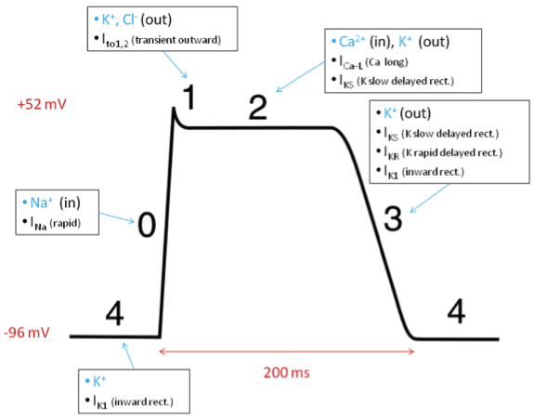
Action Potential
Myocyte repolarization: Ionic flow (openanesthesia.org)
Notes:
A quick refresher slide (to what Dr Ammar has explained_
Myocyte repolarization: Ionic flow (openanesthesia.org)
Rapid sodium
Transient outward (Calcium-independent)

Slide 34
Proyecto ITACA
Notes:
A quick refresher slide (to what Dr Ammar has explained_
Proyecto ITACA

Slide 35
Pharmacological Agents
Medications to use
Drugs that counteract ionic current imbalance
Block transient outward potassium current (Ito)
Medications to avoid or diagnose
Sodium channel blockers
Calcium channel blockers
Potassium channel openers
Notes:
Luckily, this is the easiest part in BrS but maybe the most dangerous if we prescribe the wrong medication for BrS patients!
Let me take you back to the gene mutation slide that was explained by Dr Ammar. As you see ……….
We have very limited medications to use but without a very good evidence. Yet on the other side, many should be avoided and as much are preferably to be avoided!
To avoid → induce Brugada and some are used to diagnose
Let’s see how the patients are classified
K-channel opener e.g., nicorandil
Theoretically, drugs that counteract the ionic current imbalance in Brugada syndrome could be used to treat it.
For example, quinidine, which blocks the calcium-independent transient outward potassium current (Ito), has been shown to normalize the ECG pattern in patients with Brugada syndrome.

Slide 36
Medications to Use
With Potential Antiarrhythmic Effect
Antiarrhythmics
Quinidine (Class I)
Bepridil (Class IIa)
Phosphodiesterase inhibitor
Cilostazol (Class IIb)
β-adrenergic agonists
Isoprenaline (or isoproterenol) (Class I)
Orciprenaline (Class IIa)
Class I: convincing evidence/opinion
Class IIa: evidence/opinion less clear
Class IIb: conflicting evidence/opinion
Notes:
Recommendation class: Class I: convincing evidence/opinion; Class IIa: evidence/opinion less clear; Class IIb: conflicting evidence/opinion; Class III: very little evidence.
However, quinidine also blocks sodium (Na) currents, which could have contrary effects.
Tedisamil, a potent Ito blocker without strong Na channel effects, may be more effective than quinidine. ^{[47]} Isoproterenol, which boosts the L-type calcium current, can also counteract the ionic current imbalance. ^{[47]}
Thus far, no drug therapy for Brugada syndrome is recommended because clinical trials have failed to convincingly prove effectiveness. ^{[28, 48, 49, 50]} However, drugs such as isoproterenol can be used to treat VT storm. Quinidine can be used for patients who have recurrent appropriate ICD therapy.
A number of medications can unmask the Brugada pattern on ECG and potentially exacerbate the clinical manifestations of Brugada syndrome.
class IA and IC antiarrhythmic drugs, which possess potent use-dependent sodium channel blocking activity [3].
These drugs induce or exaggerate the appearance of a coved-type ST with J point elevation (type 1 BrS ECG) and can convert type 2 to type 3 ST segment elevations to type 1 (coved-type) elevations.
Pilsicainide (Japan), procainamide (USA), ajmaline (Europe), and flecainide (Europe) have all demonstrated good efficacy in unmasking BrS and have become valuable tools for the diagnosis of BrS [4,5].
Minoura Y, Kobayashi Y, Antzelevitch C. Drug-induced Brugada syndrome. Journal of Arrhythmia, 2013; 29(2):88-95.

Slide 37
Quinidine
2017 VA/SCD Guidelines
In patients with BrS experiencing recurrent ICD shocks for polymorphic VT, intensification of therapy with quinidine or catheter ablation is recommended (Class 1; B-NR)
In patients with spontaneous type 1 Brugada ECG pattern and symptomatic VA who either are not candidates for or decline an ICD, quinidine or catheter ablation is recommended (Class 1; B-NR)
Class I: strong; benefit >>> risk
B: moderate-quality evidence
NR: non-randomized
ICD, implantable cardioverter deactivator; SCD, sudden cardiac death VA, ventricular arrhythmia
Notes:
2017 GLs: Except in specific circumstances, sodium channel blockers (Vaughn-Williams class I agents) have a limited role in the prevention of VT/SCD; this is based on a lack of survival benefit and increased mortality observed during chronic therapy in patients with ischemic heart disease (see Section 10.7). Specific circumstances where sodium channel blockers have been used to treat VT/ SCA include: intravenous lidocaine for patients with refractory VT/cardiac arrest (especially witnessed)S5.1.5.2-3; oral mexiletine for congenital long QT syndromeS5.1.5.2-4; quinidine for patients with Brugada syndrome; and flecainide for patients with catecholaminergic polymorphic ventricular tachycardia.S5.1.5.2-5 These medications could also be used in ICD patients with drug- and ablation-refractory VT.
2017 GLs (page#e332):
3. Ablation of abnormal areas of epicardial late activation in the RV can suppress recurrent VA as shown in a small number of patients.S7.9.1.3-8,S7.9.1.3-9,S7.9.1.3-11,S7.9.1.3-27 In these reports, the spontaneous type 1 Brugada pattern on ECG may be eliminated in >75% of patients, and recurrences of VT/VF are markedly reduced.S7.9.1.3-9–S7.9.1.3-11 Experience and follow-up after ablation are limited, and an ICD for patients who have had syncope or SCA is recommended. A series of patients with Brugada syndrome treated with quinidine had no deaths during a mean follow-up of over 9 years, although adverse effects of quinidine were reported in 38% of patients, these authors felt that quinidine could be used as an alternative to the ICD in selected patients.S7.9.1.3-7 4. Observational studies show that quinidine can suppress VF storm in patients with Brugada syndrome, and a low risk of arrhythmia was observed in a long-term observational study.7.9.1.3-7 No patient treated with quinidine experienced SCD. Adverse effects of quinidine occur in up to 37% of patients. Catheter ablation targeting the epicardial right ventricular areas of abnormality has also been shown to reduce recurrent VF episodes and normalize the ECG.7.9.1.3-9–7.9.1.3-1

Slide 38
Medications to Avoid/Diagnose
Medications to avoid
Antiarrhythmics Class IA/IC (Na channel)
Psychotropic drugs
Anaesthetics/analgesics
Others
Cocaine (Class IIa)
Cannabis (Class IIb)
Alcohol overdose (Class IIb)
Medications to diagnose
Procainamide (USA) – IA
Ajmaline (Europe) – IA
Flecainide (Europe) – IC
Pilsicainide (Japan) – IC
(Class I)
Propafenone
(Class IIb)
Tricyclic antidepressants
(Class IIa)
Lithium
(Class IIb)
Bupivacaine
Procaine
Propofol
(Class IIa)
Class I: convincing evidence/opinion
Class IIa: evidence/opinion less clear
Class IIb: conflicting evidence/opinion
Notes:
Recommendation class: Class I: convincing evidence/opinion; Class IIa: evidence/opinion less clear; Class IIb: conflicting evidence/opinion; Class III: very little evidence.
However, quinidine also blocks sodium (Na) currents, which could have contrary effects.
Tedisamil, a potent Ito blocker without strong Na channel effects, may be more effective than quinidine. ^{[47]} Isoproterenol, which boosts the L-type calcium current, can also counteract the ionic current imbalance. ^{[47]}
Thus far, no drug therapy for Brugada syndrome is recommended because clinical trials have failed to convincingly prove effectiveness. ^{[28, 48, 49, 50]} However, drugs such as isoproterenol can be used to treat VT storm. Quinidine can be used for patients who have recurrent appropriate ICD therapy.
A number of medications can unmask the Brugada pattern on ECG and potentially exacerbate the clinical manifestations of Brugada syndrome.
class IA and IC antiarrhythmic drugs, which possess potent use-dependent sodium channel blocking activity [3].
These drugs induce or exaggerate the appearance of a coved-type ST with J point elevation (type 1 BrS ECG) and can convert type 2 to type 3 ST segment elevations to type 1 (coved-type) elevations.
Pilsicainide (Japan), procainamide (USA), ajmaline (Europe), and flecainide (Europe) have all demonstrated good efficacy in unmasking BrS and have become valuable tools for the diagnosis of BrS [4,5].
Minoura Y, Kobayashi Y, Antzelevitch C. Drug-induced Brugada syndrome. Journal of Arrhythmia, 2013; 29(2):88-95.

Slide 39
Medications Preferably Avoided (Class IIa)
Antiarrhythmics
Class IA (Na channel)
Disopyramide, lidocaine
Amiodarone (IA, II – IV)
Propranolol (II)
Verapamil (IV)
Anaesthetics/analgesics
Ketamine
Tramadol
Psychotropic drugs
Bupropion
Carbamazepine
Fluoxetine/paroxetine
Phenytoin
Others
Antihistamines
Diphenhydramine, fexofenadine
Class IIb: conflicting evidence/opinion
Notes:
Recommendation class: Class I: convincing evidence/opinion; Class IIa: evidence/opinion less clear; Class IIb: conflicting evidence/opinion; Class III: very little evidence.
Use of propranolol, or rather betablockers in general, can be suitable when anti-bradycardia therapy is ensured by a pacemaker or implantable cardioverter defibrillator. Moreover, especially in the situation of a use-dependant conduction disease phenotype (see also Emergencies) betablockers are even first choice therapy to lower heart rate and decrease arrhythmic risk.
However, quinidine also blocks sodium (Na) currents, which could have contrary effects.
Tedisamil, a potent Ito blocker without strong Na channel effects, may be more effective than quinidine. ^{[47]} Isoproterenol, which boosts the L-type calcium current, can also counteract the ionic current imbalance. ^{[47]}
Thus far, no drug therapy for Brugada syndrome is recommended because clinical trials have failed to convincingly prove effectiveness. ^{[28, 48, 49, 50]} However, drugs such as isoproterenol can be used to treat VT storm. Quinidine can be used for patients who have recurrent appropriate ICD therapy.
A number of medications can unmask the Brugada pattern on ECG and potentially exacerbate the clinical manifestations of Brugada syndrome.
class IA and IC antiarrhythmic drugs, which possess potent use-dependent sodium channel blocking activity [3].
These drugs induce or exaggerate the appearance of a coved-type ST with J point elevation (type 1 BrS ECG) and can convert type 2 to type 3 ST segment elevations to type 1 (coved-type) elevations.
Pilsicainide (Japan), procainamide (USA), ajmaline (Europe), and flecainide (Europe) have all demonstrated good efficacy in unmasking BrS and have become valuable tools for the diagnosis of BrS [4,5].
Minoura Y, Kobayashi Y, Antzelevitch C. Drug-induced Brugada syndrome. Journal of Arrhythmia, 2013; 29(2):88-95.

Slide 40
Notes:
Now, Dr Ammar to wrap up management and discuss the clinical cases

Slide 41
Wrap up

Slide 42
Management
Documented or suspected BrS
Adapted from 2017 VA/SCD Guidelines
Spontaneous type 1 ECG pattern
Other ECG changes but not type 1
Asymptomatic
Symptomatic*
Asymptomatic
Negative
Pharmacological challenge
(Class IIa)
Negative
Observe without treatment
Observe without treatment
EPS for risk stratification
(Class IIb)
Positive
ICD candidate
No
Life style education
Treat fever
Avoid Brugada inducing drugs
Avoid excessive alcohol
Avoid cocaine
Yes
ICD implantation
(Class I)
Quinidine
Catheter ablation
(Class I)
Recurrent VT/VF
*SCD, syncope, seizure, agonal breathing
EPS, electrophysiological study; VT/VF, ventricular tachycardia/fibrillation

Slide 43
Management
Documented or suspected BrS
2017 VA/SCD Guidelines
Genotyping
(Class IIb)
Spontaneous Type 1 BrS ECG
Suspected BrS without Type 1 ECG
Positive
Genetic counselling
(Class IIb)
Pharmacological challenge
(Class IIa)
Cardiac arrest, unexplained syncope
Yes
ICD candidate
Life style education
Treat fever
Avoid Brugada inducing drugs
Avoid excessive alcohol
Avoid cocaine
Yes
No
No
EPS for risk stratification
(Class IIb)
Observe without treatment
Quinidine or catheter ablation
(Class I)
ICD
(Class I)
Recurrent VT, VF storm
Yes
EPS, electrophysiological study; VT/VF, ventricular tachycardia/fibrillation

Slide 44
Management
2017 VA/SCD Guidelines

Slide 45
Summary
BrS is rare genetic entity characterized by a typical ECG leading to VF and SCD
SCN5A, the only convincingly implicated gene
Recent reclassification of pathogenic variants will change percentage of patients identified with a clear pathological gene
Notes:
BrS is a rare genetic entity characterized by a typical ECG leading to VF and SCD.
Despite recent advances, pathophysiological mechanisms responsible for incomplete penetrance and variable expression remain to be elucidated.
The only gene convincingly implicated is SCN5A.
Recent reclassification of pathogenic variants associated with BrS will change the percentage of patients identified with a clear pathological gene.
The distinctive BrS or BrS-like ECG may be due to a variety of distinctly different underlying mechanisms.
These variables, the asymptomatic and symptomatic presentations, the unmasking of BrS only in the setting of specific triggers all lead to the present uncertainty and difficulty in forming the correct clinical diagnosis, risk stratification, and management.
Currently, the ICD is the most accepted therapy to protect patients at risk.
Epicardial ablation in selected patients has been used as a new therapy.

Slide 46
Summary
The distinctive BrS or BrS-like ECG may be due to a variety of distinctly different underlying mechanisms.
Currently, the ICD is the most accepted therapy to protect patients at risk.
Epicardial ablation in selected patients has been used as a new therapy.
Notes:
BrS is a rare genetic entity characterized by a typical ECG leading to VF and SCD.
Despite recent advances, pathophysiological mechanisms responsible for incomplete penetrance and variable expression remain to be elucidated.
The only gene convincingly implicated is SCN5A.
Recent reclassification of pathogenic variants associated with BrS will change the percentage of patients identified with a clear pathological gene.
The distinctive BrS or BrS-like ECG may be due to a variety of distinctly different underlying mechanisms.
These variables, the asymptomatic and symptomatic presentations, the unmasking of BrS only in the setting of specific triggers all lead to the present uncertainty and difficulty in forming the correct clinical diagnosis, risk stratification, and management.
Currently, the ICD is the most accepted therapy to protect patients at risk.
Epicardial ablation in selected patients has been used as a new therapy.

Slide 47
Clinical Cases

Slide 48
Type 1 BrS - ECG
STE ≥2 mm in ≥1 right precordial lead (V₁ to V₃), following an rʹ-wave and a concave or straight ST segment
Descending ST segment crosses isoelectric line and followed by negative and symmetric T-wave
STE, ST-segment elevation
Notes:
Type 1 (“coved type”) :
This alteration is the only diagnostic pattern for BrS. It is characterized by an ST-segment elevation ≥2 mm in ≥1 right precordial lead (V₁ to V₃), following an rʹ-wave and a concave or straight ST segment. The descending ST segment crosses the isoelectric line and is followed by a negative and symmetric T-wave.

Slide 49
Case 1
37-year old Nepalese gentleman
Abnormal sound while sleeping witnessed by room-mate
Unable to wake him up for few minutes
EMS
Fully conscious, oriented without complaint
A&E
Fully conscious, oriented
Not in distress or dyspneic, normal vital signs
A&E, Accident and Emergency; EMS, Emergency Medical Services
Notes:
A 37 year old Nepalese gentleman
His room mate noticed him while sleeping producing abnormal sound and unable to wake him up which took few minutes
By the rime EMS arrived, he was fully conscious oriented with out any complain.
A&E assessment fully conscious oriented, not in distress and not dyspneic, Vital signs with in normal

Slide 50
ECG - Case 1

Slide 51
Case 2
34-year old Nepalese gentleman, laborer
No previous medical history
A&E
Presented with complaint of transient LOC
Collapsed and found in cardiac arrest (VF)
CPR initiated and was resuscitated
CPR, cardiopulmonary resuscitation; LOC, loss of consciousness; VF, ventricular fibrillation
Notes:
34 year old Nepalese gentleman
laborer in construction company, no previous medical history
Presented to A&E with a complain of transient LOC
While in A&E, he collapsed and found to be in cardiac arrest
CPR initiated and his initial rhythm showed VF
Resuscitated

Slide 52
ECG - Case 2

Slide 53
References
Kengo F. Kusano. Brugada syndrome: Recent understanding of pathophysiological mechanism and treatment. Journal of Arrhythmia 2013; 29(2):77-82
Al-Khatib SM, Stevenson WG, Ackerman MJ, et al. 2017 AHA/ACC/HRS Guideline for Management of Patients With Ventricular Arrhythmias and the Prevention of Sudden Cardiac Death: A Report of the American College of Cardiology/American Heart Association Task Force on Clinical Practice Guidelines and the Heart Rhythm Society. Circulation. 2018;138(13):e272-e391
Drugs preferably avoided by Brugada syndrome patients | BrugadaDrugs.org - accessed 11/09/2021
Notes:
34 year old Nepalese gentleman
laborer in construction company, no previous medical history
Presented to A&E with a complain of transient LOC
While in A&E, he collapsed and found to be in cardiac arrest
CPR initiated and his initial rhythm showed VF
Resuscitated

Slide 54
Thank You for Listening

