Slide 1
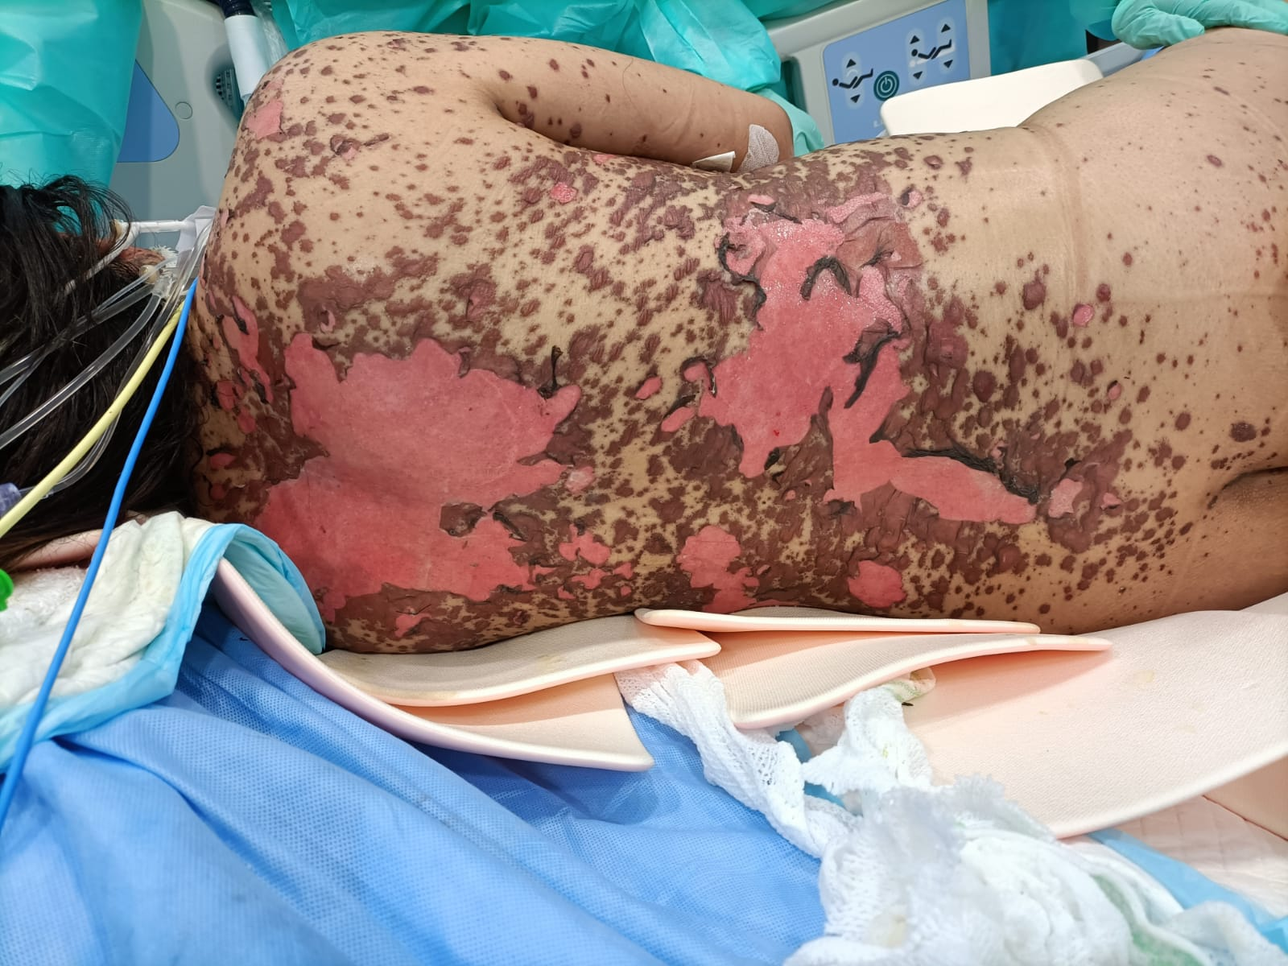
Stevens-Johnson Syndrome/Toxic Epidermal Necrolysis: Mechanisms and Treatment Establishing Qatar’s First Epidemiological Database, Understanding Pathophysiology Towards Personalized Treatment
Sara Al-Khawaga, MD, PhD
Associate Clinical Professor-College of Health and Life Sciences- HBKU-Qatar
Assistant Professor of Clinical Dermatology- Weill Cornell Medicine
Rumaila Hospital- Hamad Medical Corporation, Doha-Qatar
Weill Cornell Medicine NYP
Hamad Bin Khalifa University, Qatar

Slide 2
Conflict of interest
I do not have any conflict of interest to disclose

Slide 3
Objectives of the Talk
1- Describe the Diagnostic criteria for Stevens-Johnson syndrome/toxic epidermal necrolysis (SJS/TEN).
2- Describe the Clinical characteristics of Stevens-Johnson syndrome/toxic epidermal necrolysis (SJS/TEN).
3- List the Pathogenesis/mechanisms of Stevens-Johnson syndrome/toxic epidermal necrolysis (SJS/TEN).
4- Summarize the Management of Stevens-Johnson syndrome/toxic epidermal necrolysis (SJS/TEN).
5- Describe Qatar’s epidemiology data and describe the National Clinical Practice Guidelines on Stevens-Johnson syndrome/toxic epidermal necrolysis (SJS/TEN).

Slide 4
SJS/TEN: Rare but acute, serious, and potentially fatal Severe cutaneous adverse reaction (SCAR) Mortality risk: 3-90% Long-term sequelae: >60%

Slide 5
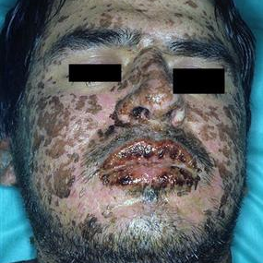
Case presentation
A 21-year-old gentleman comes to the emergency room with a painful rash all over his body, including some lesions in his mouth. He also describes feeling feverish. On physical exam, his skin has multiple bullae that sloughs off easily with a single rub. The rash covers > 30% of his body. A careful history reveals that he was recently put on lamotrigine for his epilepsy. The lamotrigine is stopped and patient is immediately admitted to the burn unit.

Slide 6
SJS and TEN: Definition
Stevens-Johnson syndrome (SJS) and toxic epidermal necrolysis (TEN) are severe cutaneous adverse reactions characterized by extensive necrosis and detachment of the epidermis¹.
Mucous membranes are affected in more than 90 percent of patients, usually at two or more distinct sites¹
1- Frey, Net al. The Journal of investigative dermatology, 2017
2- Rzany, B., et al. Journal of clinical epidemiology, 1996

Slide 7
Epidemiology
Incidence of SJS and TEN is estimated at 1.0 to 6.0 per million and 0.4 to 1.2 per million, respectively. ¹
Data from a nationwide German registry indicate that the incidence is probably one to two per million per year ²
In the US, the mean estimated incidences of SJS, SJS/TEN, and TEN were 9.2, 1.6, and 1.9 per million adults per year, respectively
Qatar: Incidence of SJS, SJS/TEN, and TEN is 6, 2, and 4 per million per year ( among the highest reported worldwide for TEN).
1- Frey, Net al. The Journal of investigative dermatology, 2017
2- Rzany, B., et al. Journal of clinical epidemiology, 1996

Slide 8
SJS and TEN Clinical Presentation
Prodromal symptoms — malaise, fever, myalgia, sore throat, and conjunctivitis.
These symptoms may precede or occur concurrently with the mucocutaneous presentation
1- Frey, Net al. The Journal of investigative dermatology, 2017
2- Rzany, B., et al. Journal of clinical epidemiology, 1996

Slide 9
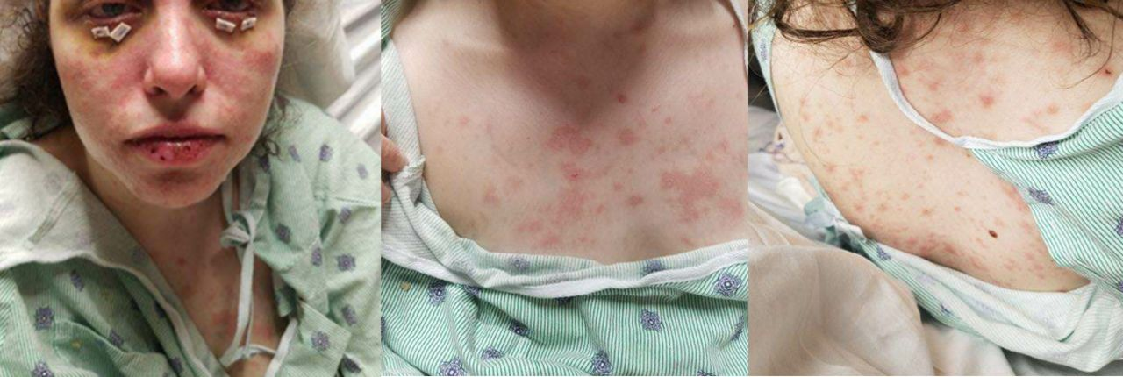
SJS and TEN Clinical Presentation
Cutaneous lesions — The initial cutaneous presentation of SJS/TEN may mimic an exanthematous rash.
Lesions start on the face and thorax before spreading to other areas and are symmetrically distributed.

Slide 10
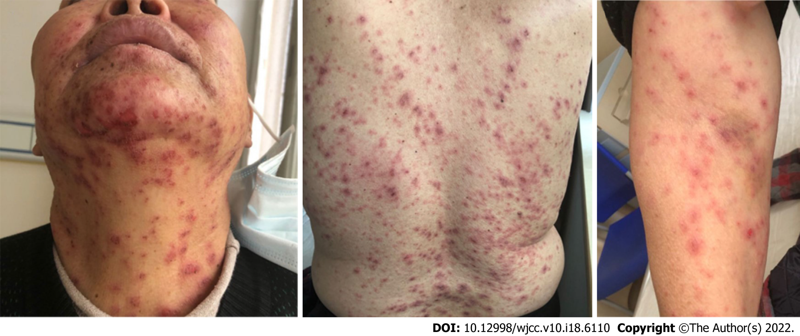
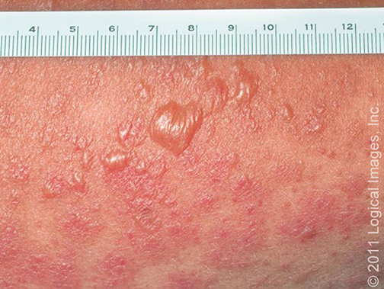
SJS and TEN Clinical Presentation
Early lesions typically begin with ill-defined, coalescing, erythematous macules, which evolve over the course of one to two days to develop dusky erythema, purpuric spots, atypical targets, and flaccid bullae

Slide 11
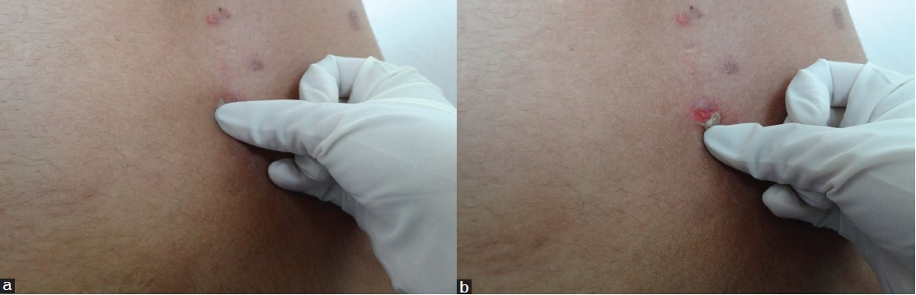
SJS and TEN Clinical Presentation
Nikolsky sign is positive
The ability to extend the area of epidermal detachment with gentle lateral pressure.
Easy to peel the skin off

Slide 12
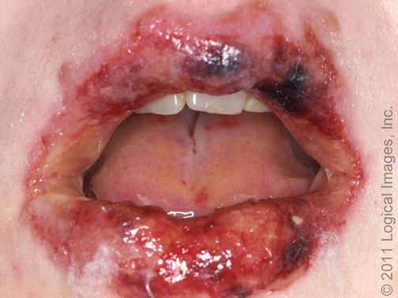
Extracutaneous involvement and complications
Mucosal involvement — All mucosal surfaces can be involved during the acute phase of the disease and often include the buccal, oro/nasopharyngeal, and anogenital mucosa.
In up to 80 percent of patients, two or more mucosal surfaces are involved.
Oral cavity involvement is the most common (90 % of patients), followed by nasal (50 %), ear (50 %), and laryngeal involvement (30 %)

Slide 13
Extracutaneous involvement and complications
Eye involvement — Ocular involvement is common (affecting 60 to 100 % of patients) and may present as conjunctival hyperemia , pseudomembrane formation, or complete corneal epithelial defect.
Acute ocular surface involvement can be graded as follows :
No ocular involvement – 0 (none)
Conjunctival hyperemia – 1 (mild)
Either ocular surface epithelial defect or pseudomembrane formation – 2 (severe)
Both ocular surface epithelial defect and pseudomembrane formation – 3 (very severe)

Slide 14
Extracutaneous involvement and complications
Renal involvement — Acute kidney injury is common and has been reported in approximately 20 to 30 percent of SJS/TEN cases
Pulmonary involvement — During the acute phase of the disease, respiratory complications are frequent. These include specific lung injury (e.g., sloughing of the bronchial epithelium), pneumonia, pulmonary edema, and atelectasis. 25% of patients with pulmonary involvement may develop acute respiratory failure requiring mechanical ventilation
Gastrointestinal involvement — is not well defined; may include abdominal pain, diarrhea, hematemesis, melena/rectal bleeding, or ileus
Liver injury
Hematologic abnormalities — anemia, leukopenia, thrombocytopenia
Bacteremia and sepsis — Bacteremia occurs in up to 30 to 50 % of patients with SJS/TEN and is associated with a 3-to-4-fold increased mortality risk

Slide 15
SJS/TEN Clinical classification: Timeline
EM minor
EM major
SJS
TEN/Lyell’s syndrome
1866
1922
1956
7 and 8-year-old with “an extraordinary, generalized eruption with continued fever, inflamed buccal mucosa, and severe purulent conjunctivitis.”
Notes:
The SJS was first described
in 1922, when the American pediatricians Albert Mason Stevens
and Frank Chambliss Johnson reported the cases of 2 boys aged
7 and 8 year-old with “an extraordinary, generalized eruption
with continued fever, inflamed buccal mucosa, and severe purulent
conjunctivitis.”

Slide 16
Adapted from Bastuji-Garin. Clinical classification of cases of toxic epidermal necrolysis, Stevens–Johnson syndrome, and erythema multiforme. Arch Dermatol 1993;129:92–6

Slide 17
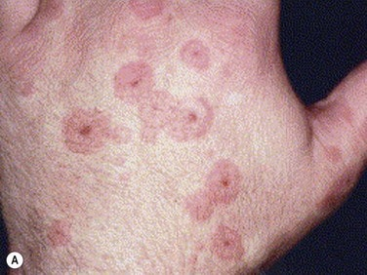
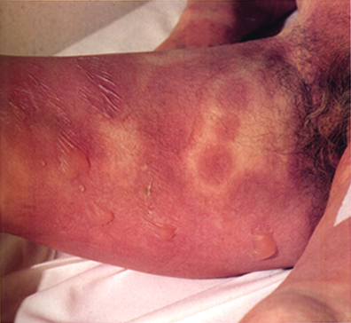
Clinical classification
EM Major
SJS/TEN
A
B
Typical target
3 different zones
Palpable
Regular
Acral
Atypical target
2 zones
Non-Palpable
Poorly defined
Central

Slide 18
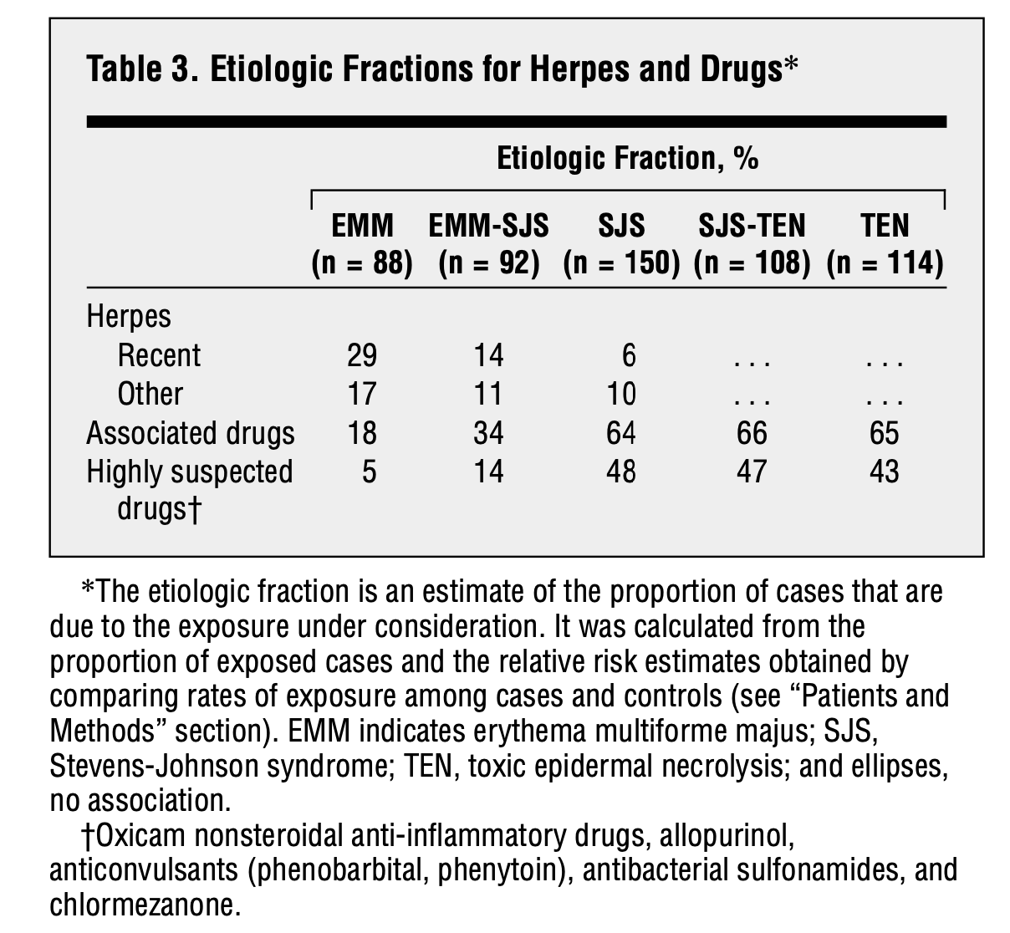
Validate the Clinical Separation: EM major, SJS/TEN
Distinct patterns: demographics, associated diseases, severity
EMM: younger, male, recurrent, etiology: herpes infection
SJS/TEN: older, higher mortality, etiology: medications
Conclusion: Diverse groups of diseases
Ariane Auquier-Dunant et al. Arch Dermatol. 2002

Slide 19
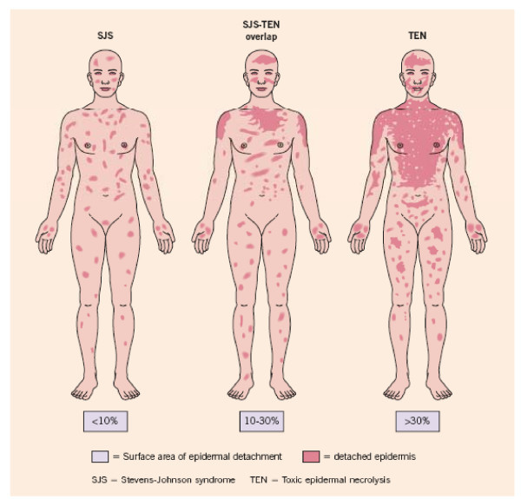
SJS, SJS/TEN, TEN: Clinical classifications
SJS and TEN exist as a continuum and are classified based on the percentage of skin body surface area (BSA) detached :
<10 % of BSA detached – SJS
10 to 30 % of BSA detached – SJS/TEN overlap
>30 % of BSA detached – TEN
Notes:
SJS and TEN are distinguished
based on the severity and involvement of the body
surface area. SJS is less severe and the skin sloughing is less than
10% of the body surface (BSA). TEN is more severe and the
sloughing is more than 30% of BSA. When the involvement is
greater than 10% but less than 30% of the body surface, it is
referred to as SJS/TEN overlap syndrome

Slide 20
Mortality
The overall mortality rate for SJS/TEN during the acute episode was 23 %, varying from 12 to 49 % across the SJS/TEN severity spectrum

Slide 21
Which of the following is incorrect about Stevens-Johnson syndrome (SJS)?
A | It is a milder form of toxic epidermal necrolysis with less than 20% body surface area detachment
B | Nevirapine is a trigger
C | Loss of vision could be a complication
D | Corticosteroid may be used in the treatment of patients with SJS

Slide 22
Question 2 Explanation:
SJS is a milder form of toxic epidermal necrolysis with less than 10% body surface area detachment. All other statements are correct.

Slide 23
Etiology: SJS/TEN
Medications are the leading trigger of Stevens-Johnson SJS/TEN in both adults and children.
The risk seems to be limited to the first eight weeks of treatment.
However, approximately 25 to 33 % of cases, and probably an even higher proportion of pediatric cases, cannot be clearly attributed to a drug
Responsible for 50% of all cases

Slide 24
Which of the following drugs is not implicated as a trigger for Stevens-Johnson syndrome?
A | Valproic acid
B | Sulfonamides
C | Penicillin
D | Clarithromycin

Slide 25
Question 1 Explanation:
Clarithromycin has not been shown to induce Stevens-Johnson syndrome. All other options are potential triggers.

Slide 26
Challenges: Causality
15% are unlikely to be drug-related
10% of idiopathic cases are mycoplasma-related
Qatar: Mycoplasma testing
Causality assessments using the algorithm of drug for epidermal necrolysis (ALDEN)
Sassolas et al. Nature Clinical Pharmacology & Therapeutics. 2010

Slide 27
How to avoid challenges in causality: ALDEN algorithm has been developed as a tool for rapid assessment of drug causality in patients presenting with SJS/TEN
Latency, presence of a high risk drug, effect of challenge ( like pre-challenge, rechallenge)
Some anti-epileptics could take up to 8 weeks to cause SJS/TEN
The score is categorized as very probable (≥6), probable (4 to 5), possible (2 to 3), unlikely (0 to 1), and very unlikely (≤0).
Sassolas et al. Nature Clinical Pharmacology & Therapeutics. 2010
Notes:
Composite score that looks into various factors such as latency , presence of a drug, notoriery, affect of challenge ( like pre-challenge, rechallenge)

Slide 28
What can we do if we don’t find a strong drug association
History: Other drug exposure, complementary/supplements, and herbal/traditional medicine ( common in Qatar).
Vaccinations
Infections: Mycoplasma, EBV, CMV, HSV, HHV-6&7, Parvovirus ( included in Qatar’s algorithm/CPG)
SJS/TEN-like acute lupus
Manifestation of acute graft-versus-host disease after bone marrow transplantation (BMT)
Biopsy with DIF to r/o immunobullous disease ( Qatar’s algorithm /CPG)

Slide 29
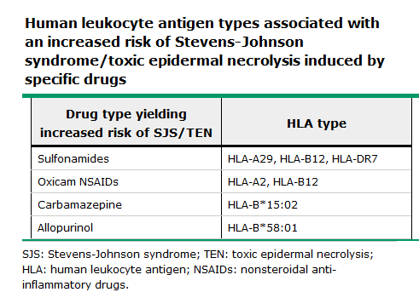
Associations Between Specific Drugs and HLA in the Pathogenesis of SJS/TEN
Several HLA haplotypes have been implicated in drug-specific susceptibility in certain ethnic groups ¹
Genetic Factors: Ethnic and Geographic Variations
HLA alleles could be the primary genetic factor for determining an individual’s susceptibility to SJS/TEN.
1- Tangamornsuksan, W., Chaiyakunapruk, N., Somkrua, R., Lohitnavy, M., & Tassaneeyakul, W. (2013). Relationship between the HLA-B*1502 allele and carbamazepine-induced Stevens-Johnson syndrome and toxic epidermal necrolysis: a systematic review and meta-analysis. JAMA dermatology, 149(9), 1025-32.

Slide 30
HLA–drug–TCRs initiate a series of immune reactions
R. P. Dodiuk-Gad et al. Am J Clin Dermatol.2015

Slide 31
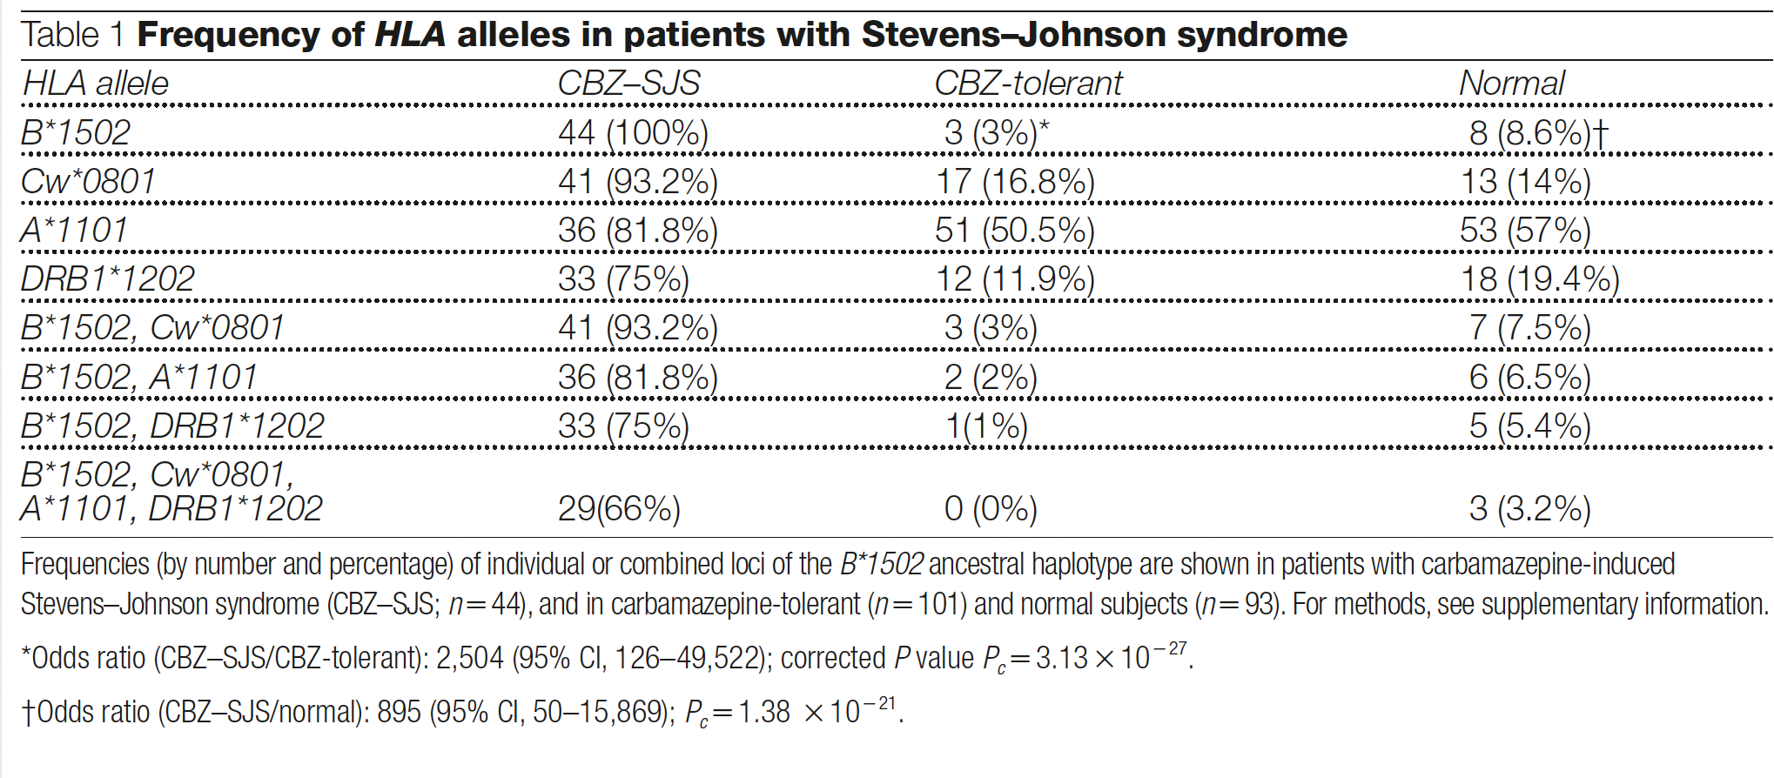
SJS/TEN: Strongest so far described between an HLA marker and a disease
Han Chinese population HLA-B*15:02 and SJS/TEN: Odds ratio: 2,504 (95% CI, 126–49,522)
Chung WH et al. Nature 2004

Slide 32
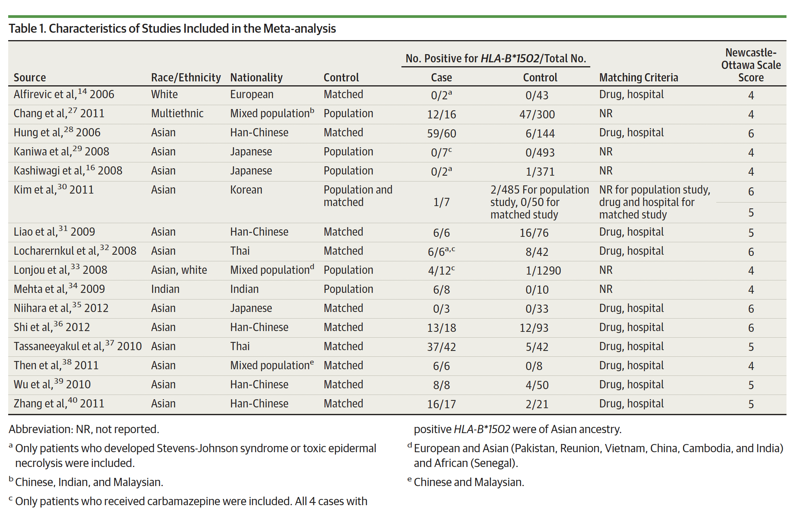
The summary OR for the relationship between HLA-B*1502 and carbamazepine-induced SJS and TEN was 79.84
A strong relationship between the HLA-B*1502 allele and carbamazepine-induced SJS and TEN in Han-Chinese, Thai, and Malaysian populations.
HLA-B*1502 screening in patients requiring carbamazepine therapy is warranted
Tangamornsuksan et al. JAMA Dermatology.2013

Slide 33
Genetic Factors: Ethnic and Geographic Variations
HLA-B*15:02 CBZ-related SJS/TEN
Han-Chinese population: strong association
Thai, and Malaysian populations: strong association
European population: not significantly associated
This proves that HLA-B*15:02 is not a universal marker for CBZ-related SJS/TEN.
Hence, it is important to study well-defined ethnic populations, identify the causative drug accurately, and test for specific HLA associations.
Hung, S. I., Chung, W. H., and Chen, Y. T. (2005a). HLA-B genotyping to detect carbamazepine-induced Stevens-Johnson syndrome: implications for personalizing medicine. Per. Med. 2, 225–237. doi: 10.2217/17410541.2.3.225

Slide 34
HLA-B*58:01 allele with allopurinol-induced SJS/TEN: * Unlike carbamazepine, the distribution of cases is similar globally. * Conclusion: SJS/TEN mechanism is drug, phenotype, and ethnic-specific
Hung et al. PNAS.2005
Chau Yee Ng et al. Journal of Investigative Dermatology (2016)

Slide 35
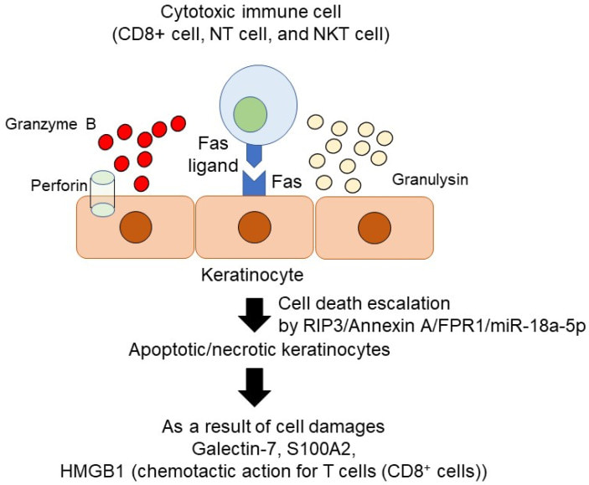
The molecular mechanism of cytotoxic cells mediated keratinocytes damages
Three key mechanisms:
Fas-Fas ligand-mediated cell death
Perforin/granzyme B mediated cell death
Granulysin mediated cell death.
Keratinocytes in patients with SJS/TEN highly express FPR1 in the skin.
Therefore, annexin A is not only a biomarker but is also possibly a therapeutic target in SJS/TEN
Annexin A1 binds formyl peptide receptor 1 (FPR1) expressed on dendritic cells
Yoshioka et al. Int J Mol Sci. 2021
Notes:
Once annexin A1 binds formyl peptide receptor 1 (FPR1) expressed on dendritic cells, this interaction enhances long-term between apoptosis cells and dendritic cells

Slide 36
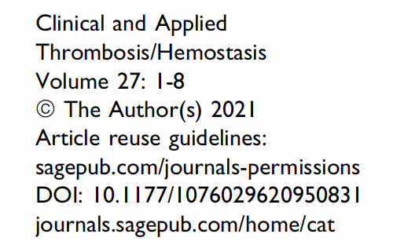
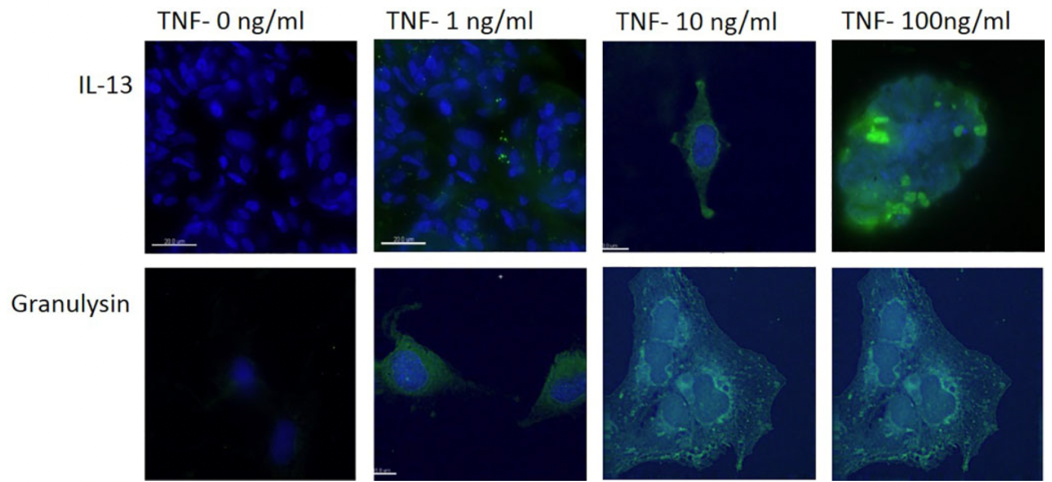
IL-13, IL-15, and Granulysin play a role in the pathogenesis of SJS/TEN ( patient plasma and cell culture studies)
Sadek et al. Clinical and Applied Thrombosis/Hemostasis. 2021

Slide 37
Successful Implementation of Preemptive Genotyping for Prevention of SJS/TEN
FDA in 2007 issued alert labeling and recommended genotyping in all East Asian patients prior to prescribing CBZ ¹
Taiwan, Hong Kong, Singapore, and Thailand, have since then started HLA-B*15:02 screening programs before the prescription of CBZ
This has been incorporated into the electronic prescribing system.
¹ Ferrell, P. B. Jr., and McLeod, H. L. (2008). Carbamazepine, HLA-B*1502 and risk of Stevens-Johnson syndrome and toxic epidermal necrolysis: US FDA recommendations. Pharmacogenomics 9, 1543–1546. doi: 10.2217/14622416.9.10.1543

Slide 38
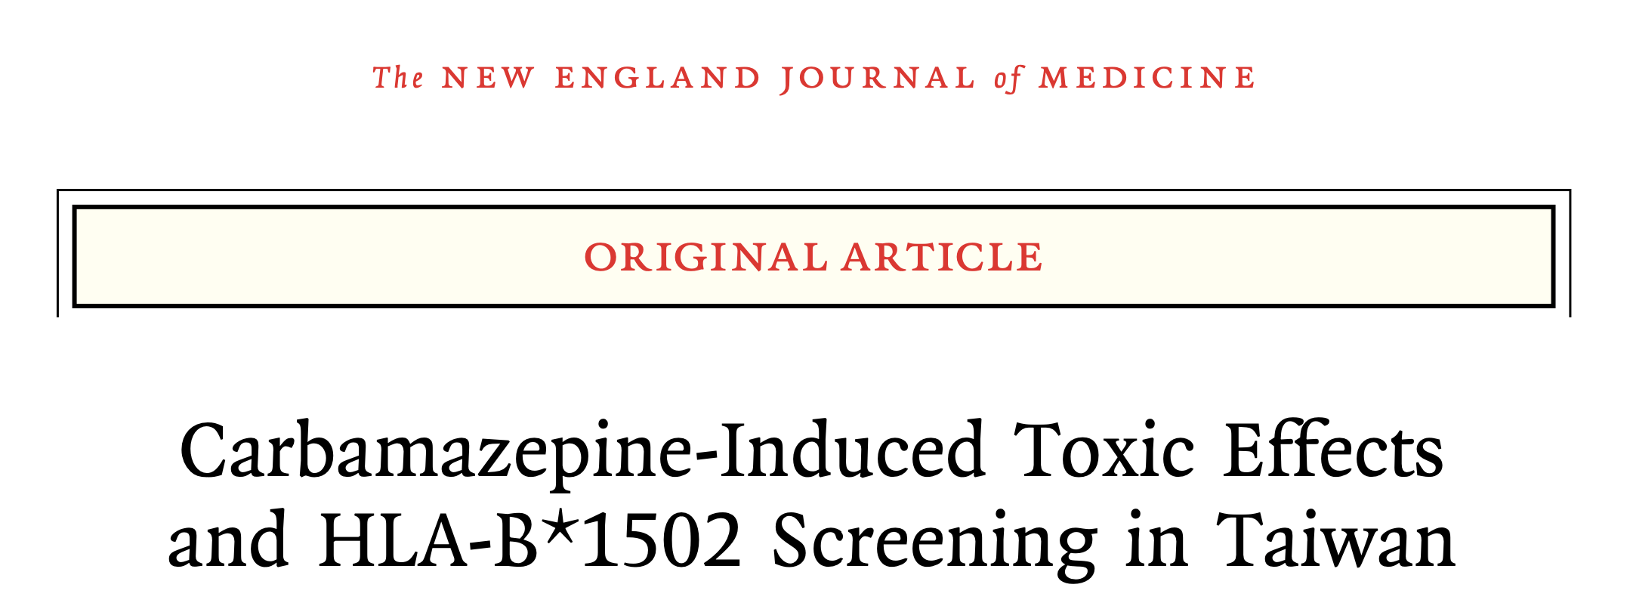
Taiwan: Strongly associated with a decrease in the incidence of carbamazepine-induced SJS–TEN ¹
¹ Chen, P., Lin, J. J., Lu, C. S., Ong, C. T., Hsieh, P. F., Yang, C. C., et al. (2011). Carbamazepine-induced toxic effects and HLA-B*1502 screening in Taiwan. N. Engl. J. Med. 364, 1126–1133. doi: 10.1056/NEJMoa1009717

Slide 39
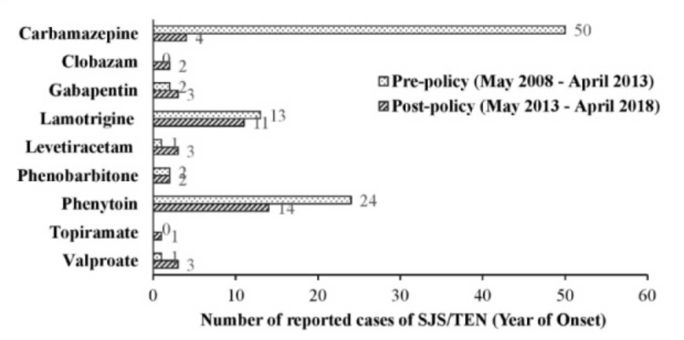
Genotyping as Standard-of-Care
Reduction in CBZ SJS/TEN in Singapore by >90%
Sung et al. Front Pharmacol. 2020

Slide 40
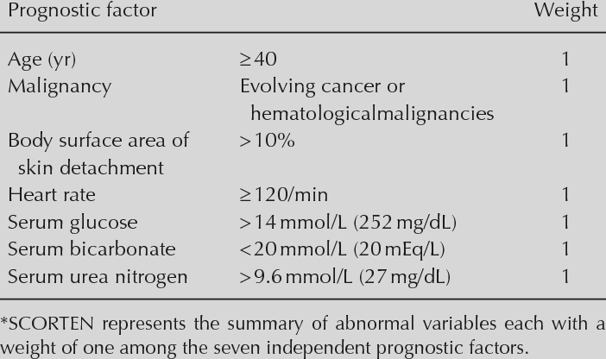
What is the Prognosis of SJS/TEN: SCORTEN
Validated tool
Challenges: SCORTEN might have deteriorated with time --> improving supportive care/ICU ( overestimation of mortality)
Limitation: Does not account for lung involvement ( 60% mortality)
Notes:
We rely on SCORTEN which is a score made of 7 biochemical and clinical factors that can predict the mortality risk from 3% to 90%

Slide 41
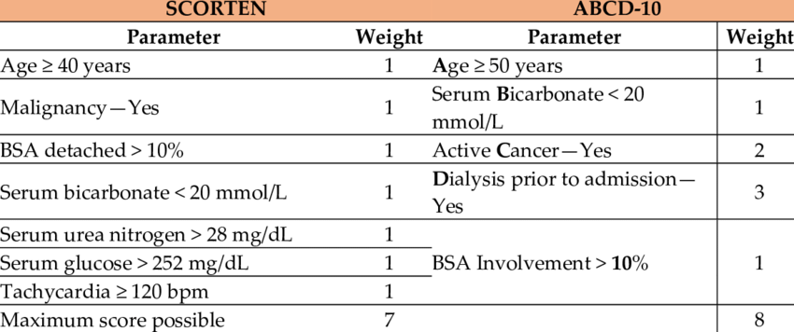
Mortality risk: 3% to 90%
Mortality risk: 2.3% to 83.6%
Duplisea et al. American Academy of Dermatology. 2021
Notes:
More recent and New scoring criteria looking into 5 factors which is age >50, bicarbo <20 , active malignancy, dialysis, SBSA , depending on the number of factors, the mortality rate for the ABCD-10 is 2.3% to 83.6%

Slide 42
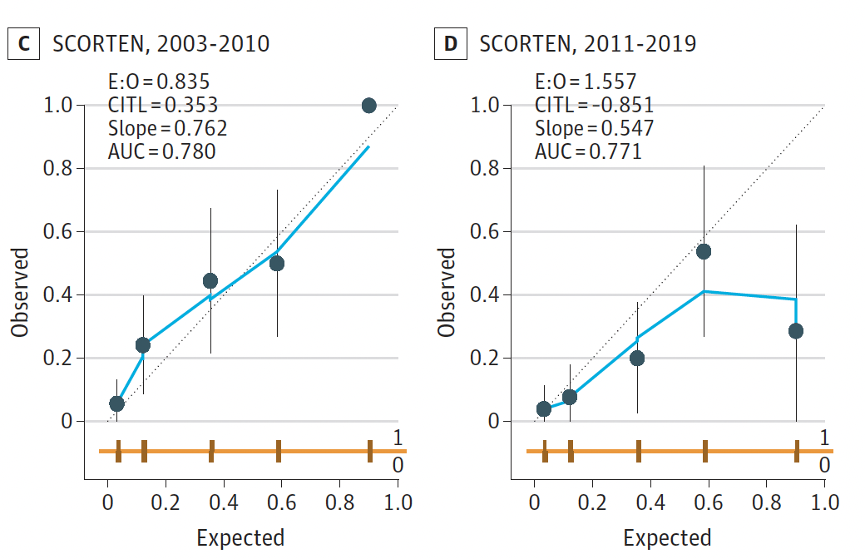
SCORTEN was superior to ABCD-10 in mortality prognostication in epidermal necrolysis.
However, it did display time-associated deterioration in calibration leading to an overestimation of the mortality risk
Are we overestimating death in our prognosis discussion with patients?
Challenge: Is treatment efficacy impacted by the overestimation of mortality due to SCORTEN?
Hui Kai Koh, et al. JAMA Dermatol. 202

Slide 44
Mortality Rates Improved Overtime: Trends in reference centers
Qatar: 2015-2018 ( 57%); 2019-2022: (0%) Steroid+ Cyclosporine+ IVIG ( CPG protocol). 57% Reduction in mortality [among the highest reported incidence of TEN worldwide reaching up 4 per million per year].
Singapore: 2003-2005 (27%); 2015-2017 (8%) cyclosporine/supportive. 19% Reduction in mortality
Taiwan: 2001-2008 ( 26.3%); 2009-2016 (8.3% Anti TNF, 16.3% Steroids). 10-18% Reduction in mortality
France: 1972-1985 ( 25%); 2005-2016 (11.4%, 6.3% cyclosporine). 13.6-18.7% Reduction in mortality
Japan: 1981-1997 ( 21.6%); 2000-2006 (6.2%) steroid pulse, plasmapheresis. 15.4% Reduction in mortality
Improvement in supportive care

Slide 46
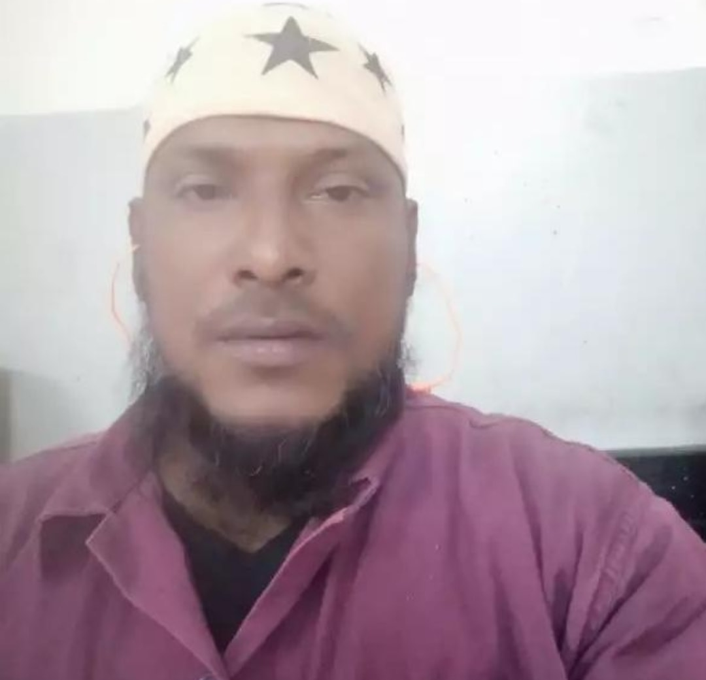
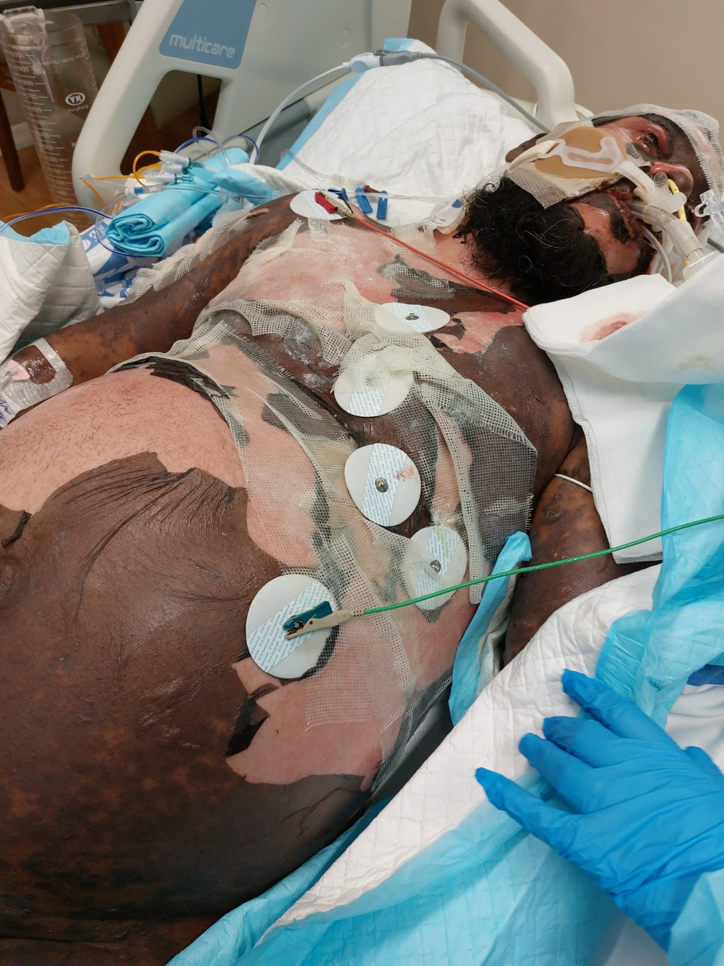
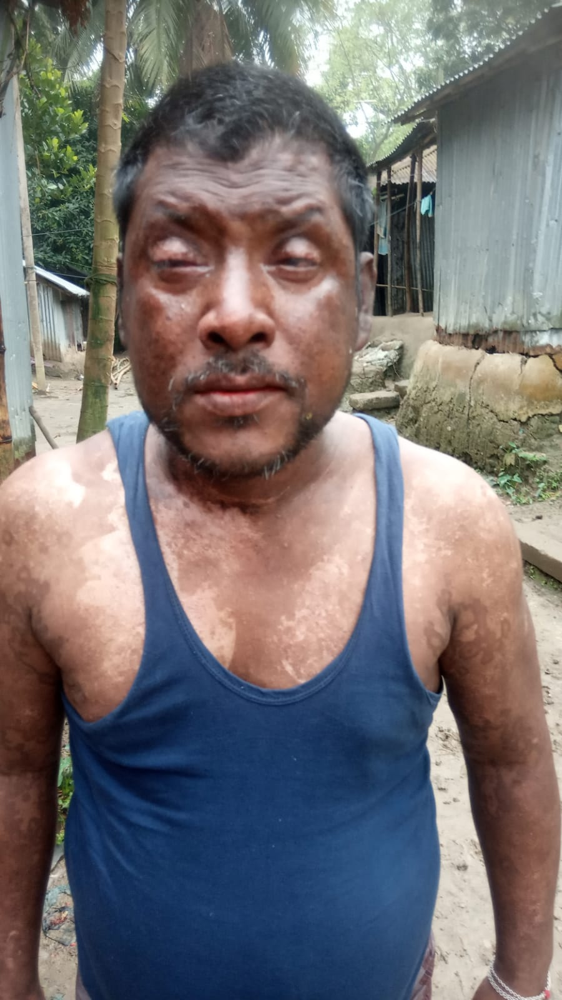
SJS/TEN: 30 years of progress but still much to be done: Treatment Dilemma and Research Gaps of SJS/TEN

Slide 47
SJS/TEN: Treatment Dilemmas Ideal Treatment intervention?
Randomized trials
Wolkenstein (Lancet 1998): Thalidomide- Deleterious
Chung (JCI 2018): Anti-TNF vs Corticosteroids: non-significant mortality
Controversy
Systemic CS
Cyclosporine
IVIG
Anti-TNF
Combination therapy
Systematic Review/Meta-Analysis
Zimmerman (JAMA Derm 2017): corticosteroids and cyclosporine were the most promising systemic immunomodulating therapies for SJS/TEN
Tsai ( JAAD 2021): Combination therapy with corticosteroids and IVIg may reduce mortality risks
Torres-Navarro ( JEADV 2021): no treatment achieved a significant reduction in the standardized mortality ratio (SMR).
Recommendations: French Guidelines (2018), UK Guidelines (2016) : Insufficient evidence to recommend for/against interventions

Slide 48
Understanding the Natural History of SJS/TEN
2 weeks-2 months
Progressive
Self-limiting
Disease arrest
Skin failure-acute complications
Could wrongly attribute this arrest of disease to the therapeutic effect of the intervention
RE-EPETHELIZATION
Heng et al. British Journal of Dermatology (2015)
Data from EuroSCAR
EADV- Stevens-Johnson Syndrome / Toxic Epidermal Necrolysis
Notes:
Identifying a Therapeutic Window: Many of the challenges arise due to underestimation of the natural history of SJS/TEN natural history and so it is important to review the natural history, a high risk drug is taken 2 weeks-2 months prior to the development of symptoms, the first symptoms are prodromal in nature like flu like, fever, cough, sore throat, conjunctivitis, then the rash starts, then starts to blister , and over the next 7-9 days the disease increases in extent, then it arrests and the skin starts to re epithelizes. The time between the onset of blistering to the repepthelization is the time when the patient is at risk of skin failure. Progression of the disease last 7-9 days and this is the short therpautic window we actually have in impactinG the disease

Slide 49
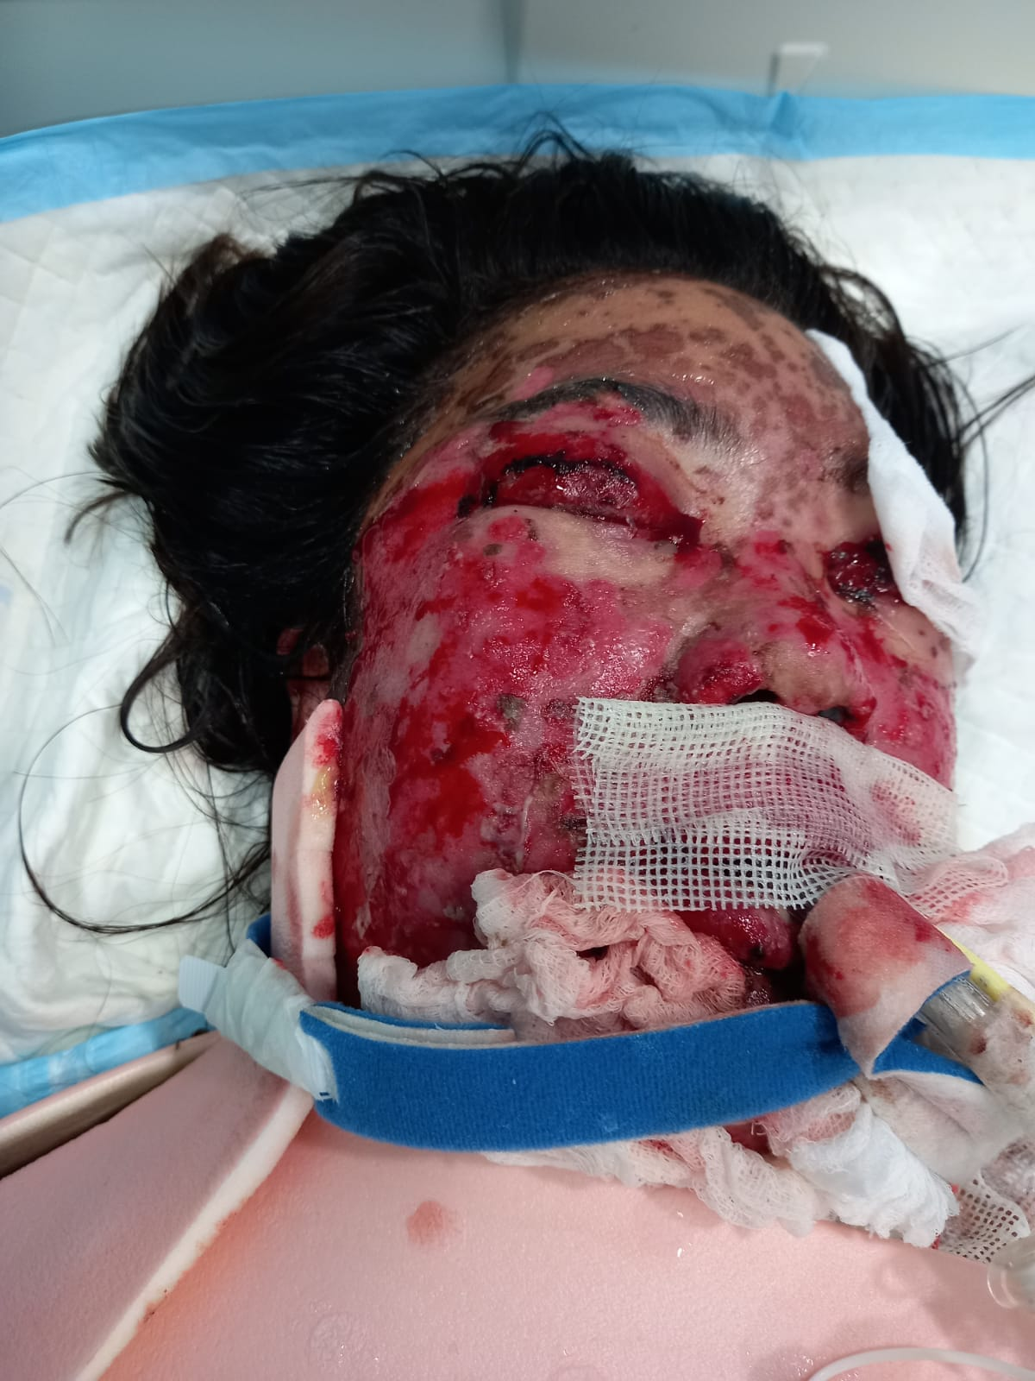
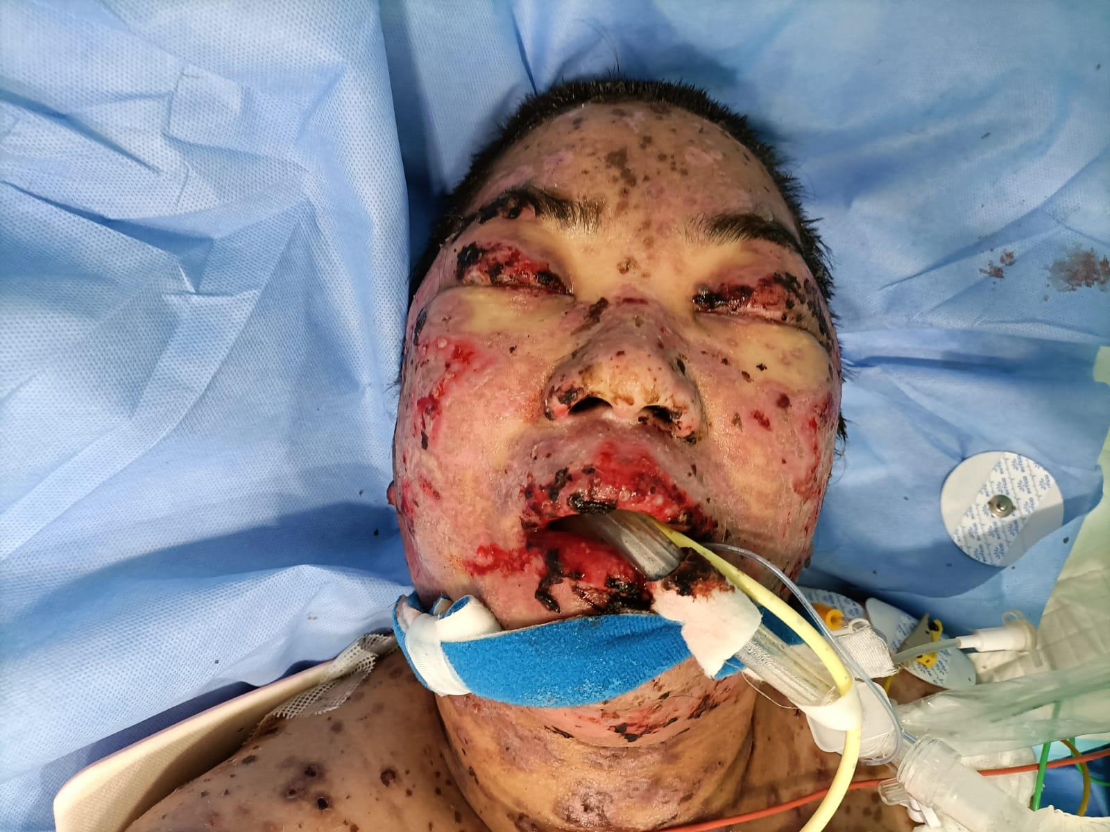
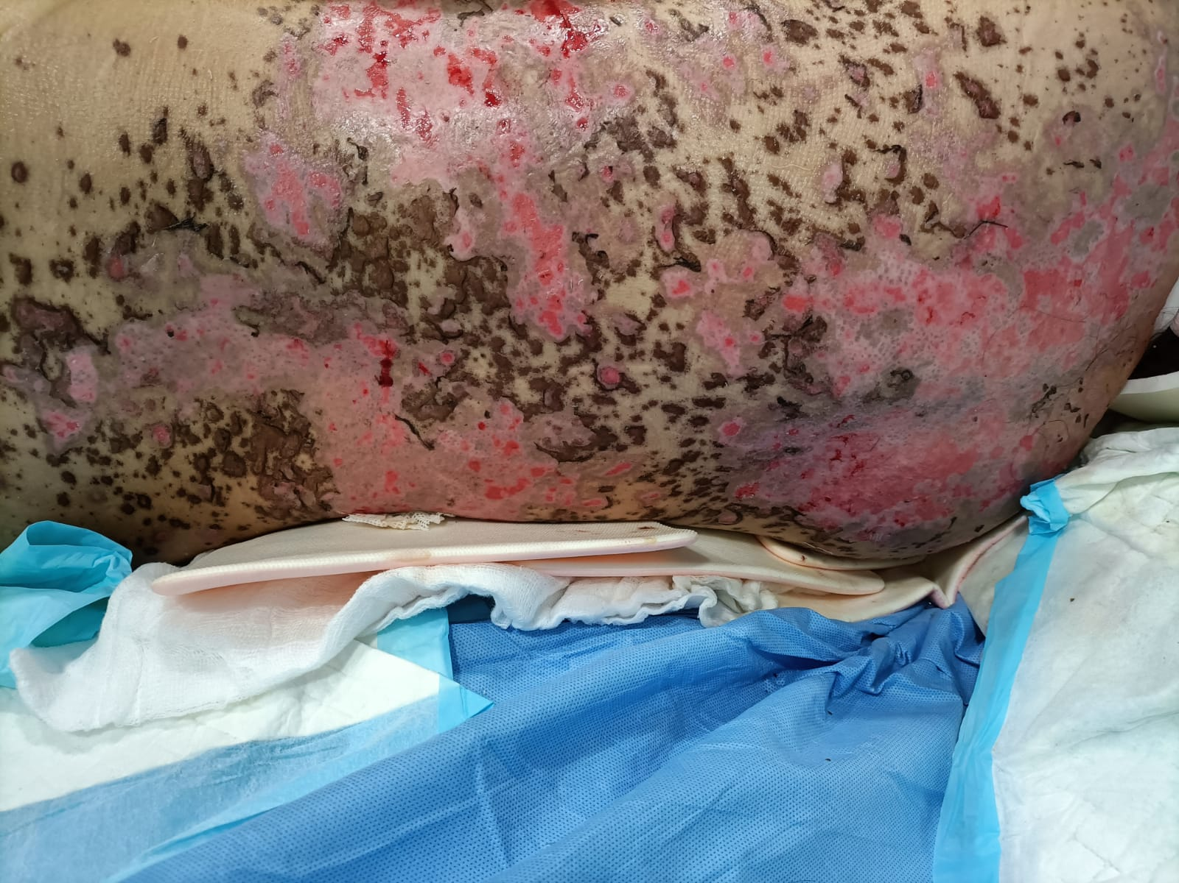
DAY 3
DAY 5
DAY 12
DAY 15
Notes:
The pictures show the progression of SJS/TEN: Over the course of 24-48 hours, the blisters start to be noticed, the rash starts to dethatch, Nikolsky sign is positive. Over the next few days some of the erosions are healing with evidence of post inflamator hyperpigmentation and by By Day 15 the repethelization start to be evident

Slide 50
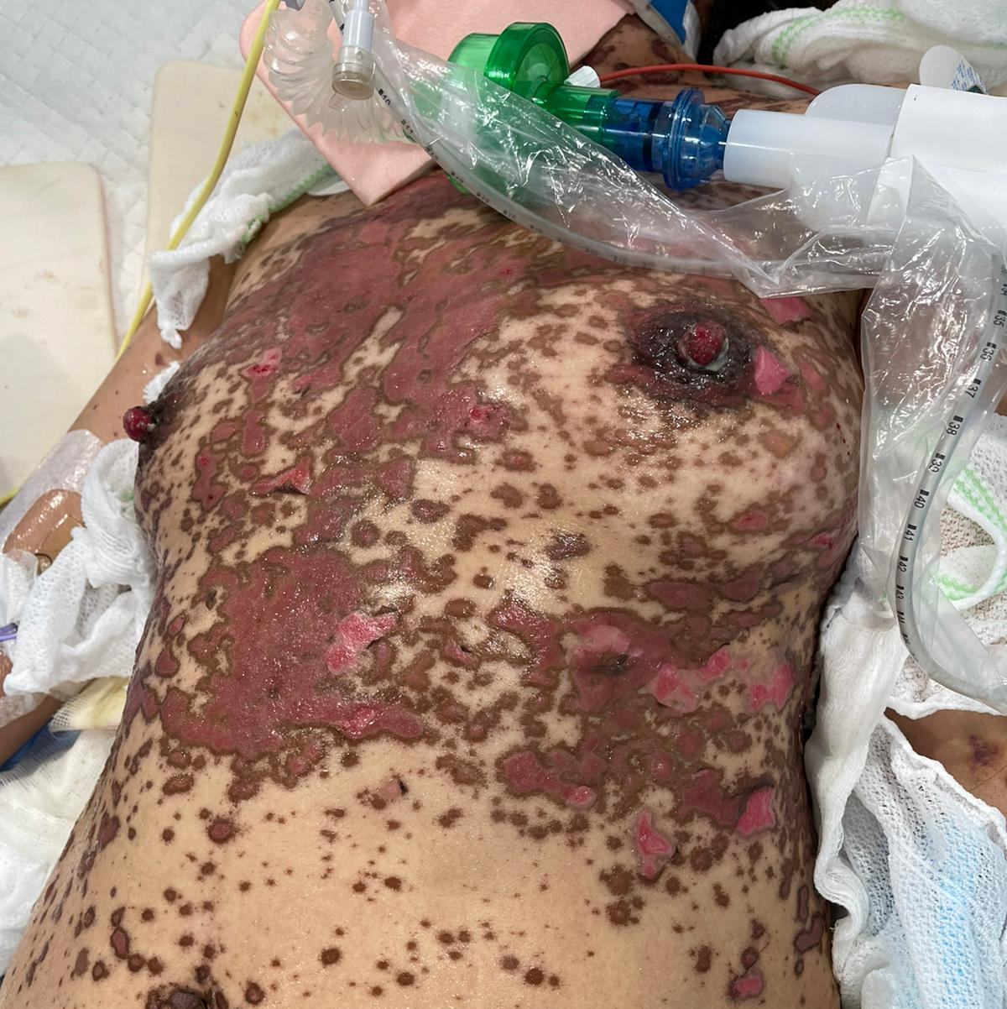
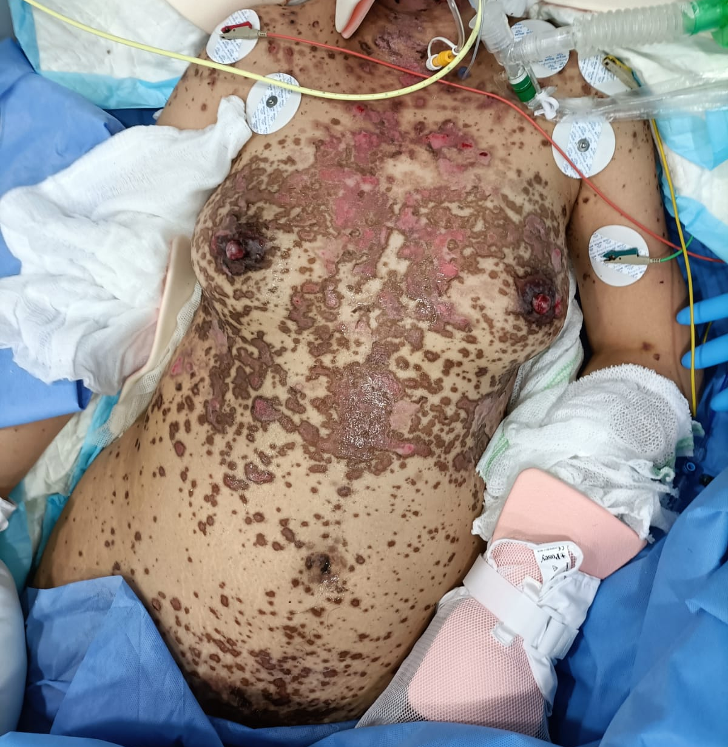
Qatar’s SJS/TEN CPG: Wound strategies
Left in-situ as a biological dressing- reduces the incidence of post-inflammatory hypopigmentation
Anti-shear therapy

Slide 51
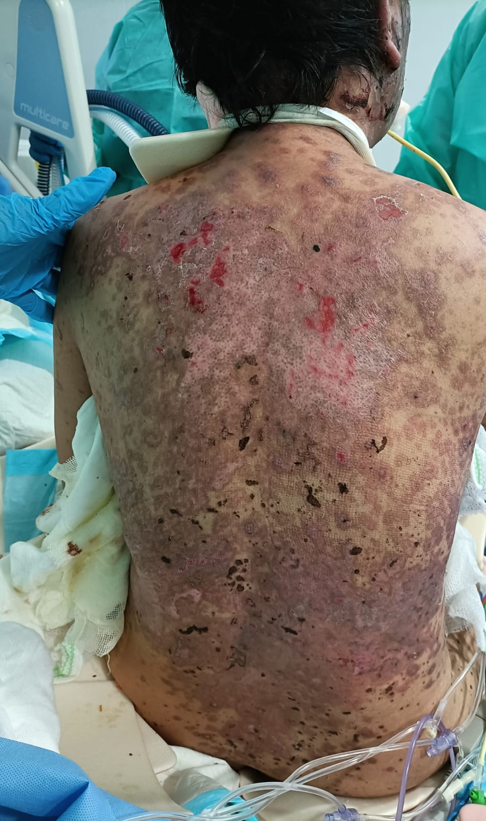
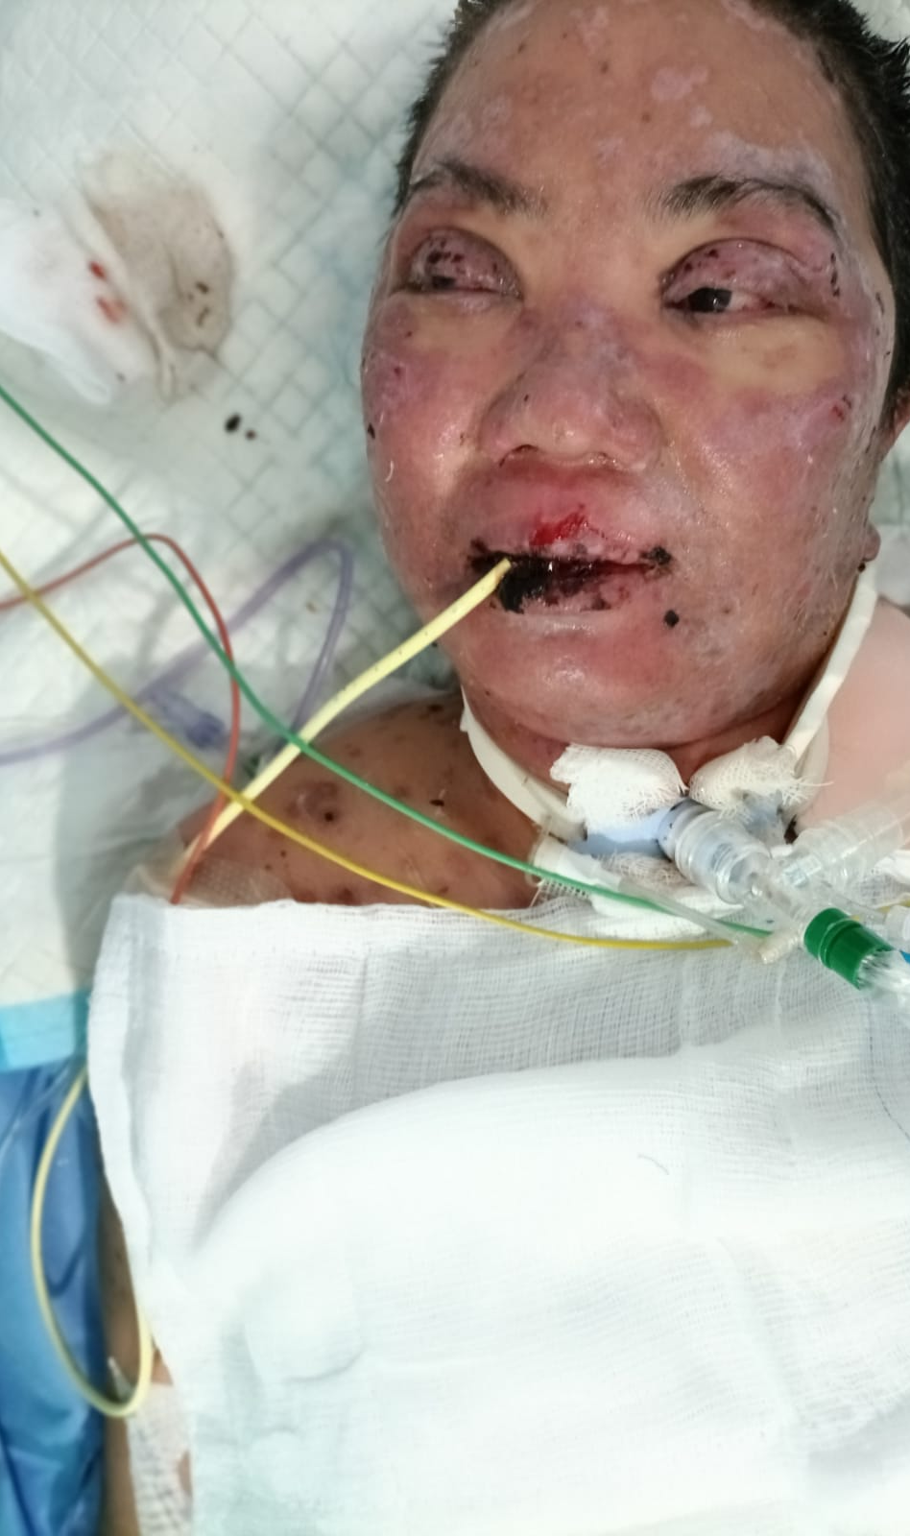
DAY 22
DAY 22
DAY 40

Slide 52
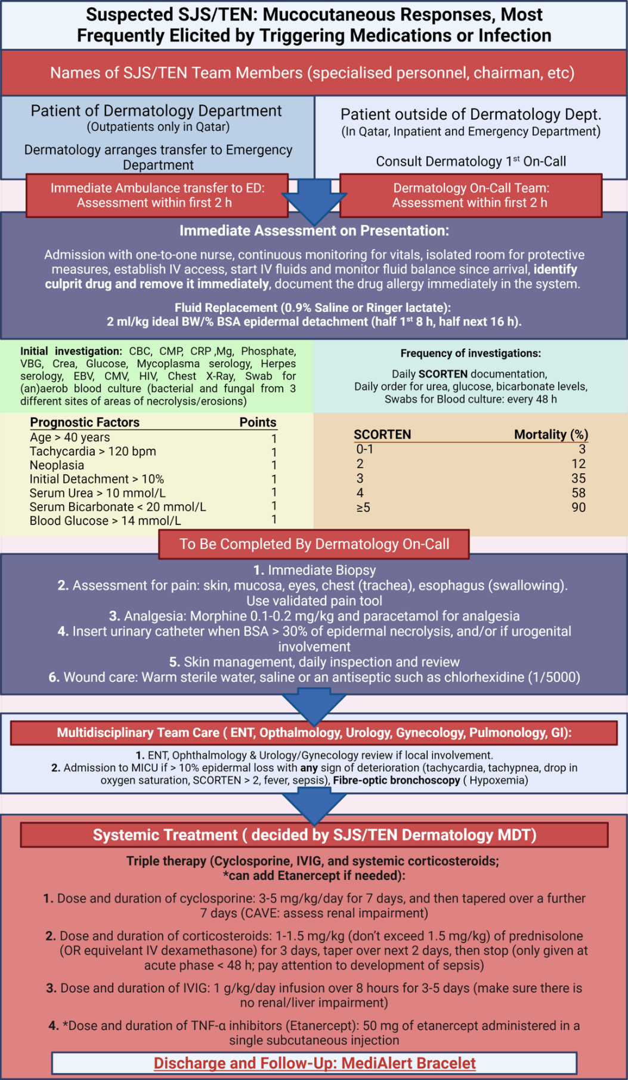
Qatar’s Clinical Practice Guideline (CPG): Holistic approach looking into Factors Influencing Mortality in SJS/TEN ( PI: Professor Martin Steinhoff)
Early drug withdrawal
Early access to a specialized center
Intervention with Triple therapy ( steroids 0.5-1mg/kg, doesn’t exceed 12 days, cyclosporine 3mg/kg tapered over 14-20 days), IVIG 1-2g/kg for 3 days; Anti-TNF to renal failure, pregnancy)
Multi-disciplinary team
Sepsis and bacteremia management: CRP, Procalcitonin, wound culture, blood culture Q48 hourly
Analgesia
Nutrition/fluid replacement
ICU team
Dialysis
Supportive care
Advances in automated ordering
Wound care
Discharge and Follow up: MediAlert Bracelet and electronic alert

Slide 53
Qatar Guidelines for The Management of Stevens-Johnson Syndrome/Toxic Epidermal Necrolysis
(1) Initial Assessment on Presentation
(2) Determination of Drug Causality and Prognostic scoring
(3) Care setting: A Multi-disciplinary Team
(4) Skin management: Applicable to all patients
(5) Skin management: Daily review
(6) Skin management: TEN > 30% BSA epidermal loss
(7) Analgesia and Supportive Therapeutic Measures: Patient-appropriate validated pain tool
(8) Treatment of Eye Involvement: Daily ophthalmic review
(9) Treatment of Mouth Involvement: Daily Oral Review
(10) Treatment of Urogenital Involvement: Daily Urogenital Review
(11) Discharge and Follow up: MediAlert Bracelet

Slide 54
(1) Initial Assessment on Presentation
Vitals, History, PE, Pain Assessment tool. and Investigations
Primary management plan
* Full physical examination
* Baseline body weight
* Vital signs, including oxygen saturation
* Pain Assessment Tool
*CBC, U&E, LFT, glucose, magnesium, phosphate, bicarbonate, mycoplasma serology
*CXR
*Skin biopsy
*Establish peripheral venous access
* Analgesia
*Change peripheral venous cannulas every 48 hours
*Maintain adequate nutrition
* Insert a nasogastric tube and institute nasogastric feeding
*Insert a urinary catheter if urogenital involvement is causing significant dysuria/retention
*Monitor fluid balance carefully
Replacement volumes: 2 ml/kg body weight/% BSA epidermal detachment

Slide 55
(3) Care setting: A Multi-disciplinary Team
Care Setting
Dermatology
Admission to Intensive Care
ENT
Ophthalmology
Wound Care
Emergency
EBCA protocol: notify dermatologist <2 hours
>10% BSA epidermal loss , SCORTEN >3
Barrier-nursed Side room
Pressure-relieving mattress Temperature raised to between 25° and 28°C
Fiber-optic bronchoscopy ( Hypoxemia)
Daily ophthalmological review in the acute illness

Slide 56
Employ strict barrier nursing to reduce nosocomial infections
Take swabs for bacterial and fungal culture from 3 areas of lesional skin, particularly sloughy or crusted areas, on alternate days throughout the acute phase
Administer systemic antibiotics only if there are clinical signs of infection
(4) Skin management: Applicable to all patients
Isolated Room Order for Protective Measures

Slide 57
(5) Skin management: Daily review
Wounds and Intact Skin
Cleanse
Warmed sterile water, saline or an antimicrobial such as chlorhexidine (1/5000)
Emollient
50% white soft paraffin with 50% liquid paraffin (50/50 WSP/LP), over the whole epidermis, including denuded areas.
Dressing: Detached Lesional Epidermis
Non-adherent Dressing
The detached, lesional epidermis may be left in situ to act as a biological dressing and covered with paraffin gauze. Blisters should be decompressed by piercing and expression or aspiration
Emollient and Topical Antimicrobials
Burn Dressing: Detached Lesional Epidermis
Dressing
Paraffin gauze ( Jelonet)
TEN (< 30% BSA epidermal loss)

Slide 58
(6) Skin management: TEN > 30% BSA epidermal loss
Debridement
Cleanse
Remove necrotic/loose infected epidermis and clean wounds using a topical antimicrobial agent (e.g. betadine or chlorhexidine) under general anaestheti
Fluid Balance
Fluid replacement can be guided by urine output and other endpoint measurements.
Individualized fluid management should be adjusted on a daily basis
Mouth Involvement
Oral Intake
With improvement of SJS/TEN mouth involvement, oral administration of fluids should be progressively increased
Fluid replacement regimen
Nutrition regimen
Calories
Deliver up to 20 to 25 kcal/kg/day during the early, catabolic phase and 25 to 30 kcal/kg/day during the anabolic, recovery phase
TEN (> 30% BSA epidermal loss)

Slide 59
(7) Analgesia and Supportive Therapeutic Measures: Patient appropriate validated pain tool
Patients should receive adequate analgesia to ensure comfort at rest, with the addition of supplementary opiates, as required
Morphine or Fentanyl
Immobile patients should receive low molecular weight heparin
Patients in whom enteral nutrition cannot be established should receive a proton pump inhibitor to reduce the risk of stress-related gastro-intestinal ulceration
Neutropenic patients may benefit from recombinant human G-CSF

Slide 60
Hamad Medical Corporation Guidelines for The Management of Stevens-Johnson Syndrome/Toxic Epidermal Necrolysis 2020
(1) Initial Assessment on Presentation
(2) Determination of Drug Causality and Prognostic scoring
(3) Care setting: A Multi-disciplinary Team
(4) Skin management: Applicable to all patients
(5) Skin management: Daily review
(6) Skin management: TEN > 30% BSA epidermal loss
(7) Analgesia and Supportive Therapeutic Measures: Patient appropriate validated pain tool
(8) Treatment of Eye Involvement: Daily Opthalmic Review
(9) Treatment of Mouth Involvement: Daily Oral Review
(10) Treatment of Urogenital Involvement: Daily Urogenital Review
(11) Discharge and Follow up: MediAlert Bracelet

Slide 61
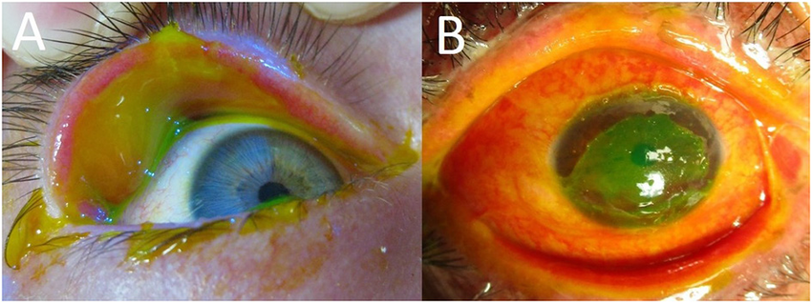
(8) Treatment of Eye Involvement: Daily Ophthalmic Review
Daily ophthalmological review is necessary during the acute illness
Apply an ocular lubricant (e.g. non-preserved hyaluronate or carmellose eye drops) every two hours through the acute illness
Ocular hygiene must be carried out each day by an ophthalmologist or ophthalmic-trained nurse
Application of topical corticosteroid drops (e.g. non-preserved dexamethasone 0.1% twice a day) may reduce ocular surface damage
Administer a broad-spectrum topical antibiotic as prophylaxis (e.g. moxifloxacin drops four times a day) in the presence of corneal fluorescein staining or frank ulceration

Slide 62
Hamad Medical Corporation Guidelines for The Management of Stevens-Johnson Syndrome/Toxic Epidermal Necrolysis 2020
(1) Initial Assessment on Presentation
(2) Determination of Drug Causality and Prognostic scoring
(3) Care setting: A Multi-disciplinary Team
(4) Skin management: Applicable to all patients
(5) Skin management: Daily review
(6) Skin management: TEN > 30% BSA epidermal loss
(7) Analgesia and Supportive Therapeutic Measures: Patient appropriate validated pain tool
(8) Treatment of Eye Involvement: Daily Opthalmic Review
(9) Treatment of Mouth Involvement: Daily Oral Review
(10) Treatment of Urogenital Involvement: Daily Urogenital Review
(11) Discharge and Follow up: MediAlert Bracelet

Slide 63
(9) Treatment of Mouth Involvement: Daily Oral Review
Daily oral review is necessary during the acute illness
Apply white soft paraffin ointment to the lips every two hours through the acute illness
Clean the mouth daily with warm saline mouthwashes or an oral sponge
Use an anti-inflammatory oral rinse or spray containing benzydamine hydrochloride every three hours, particularly before eating
Use an anti-septic oral rinse containing chlorhexidine twice a day
Use a potent topical corticosteroid mouthwash (e.g. betamethasone sodium phosphate) four times a day

Slide 64
Hamad Medical Corporation Guidelines for The Management of Stevens-Johnson Syndrome/Toxic Epidermal Necrolysis 2020
(1) Initial Assessment on Presentation
(2) Determination of Drug Causality and Prognostic scoring
(3) Care setting: A Multi-disciplinary Team
(4) Skin management: Applicable to all patients
(5) Skin management: Daily review
(6) Skin management: TEN > 30% BSA epidermal loss
(7) Analgesia and Supportive Therapeutic Measures: Patient appropriate validated pain tool
(8) Treatment of Eye Involvement: Daily Opthalmic Review
(9) Treatment of Mouth Involvement: Daily Oral Review
(10) Treatment of Urogenital Involvement: Daily Urogenital Review
(11) Discharge and Follow up: MediAlert Bracelet

Slide 65
(10) Treatment of Urogenital Involvement: Daily Urogenital Review
Daily urogenital during the acute illness : Urologists, Gynecologist
Apply white soft paraffin ointment to the urogenital skin and mucosae every four hours through the acute illness
Use a potent topical corticosteroid ointment once a day to the involved, but non-eroded, surfaces
Use a silicone dressing or paraffin gauze to eroded areas

Slide 66
Hamad Medical Corporation Guidelines for The Management of Stevens-Johnson Syndrome/Toxic Epidermal Necrolysis 2020
(1) Initial Assessment on Presentation
(2) Determination of Drug Causality and Prognostic scoring
(3) Care setting: A Multi-disciplinary Team
(4) Skin management: Applicable to all patients
(5) Skin management: Daily review
(6) Skin management: TEN > 30% BSA epidermal loss
(7) Analgesia and Supportive Therapeutic Measures: Patient appropriate validated pain tool
(8) Treatment of Eye Involvement: Daily Opthalmic Review
(9) Treatment of Mouth Involvement: Daily Oral Review
(10) Treatment of Urogenital Involvement: Daily Urogenital Review
(11) Discharge and Follow up: MediAlert Bracelet

Slide 67
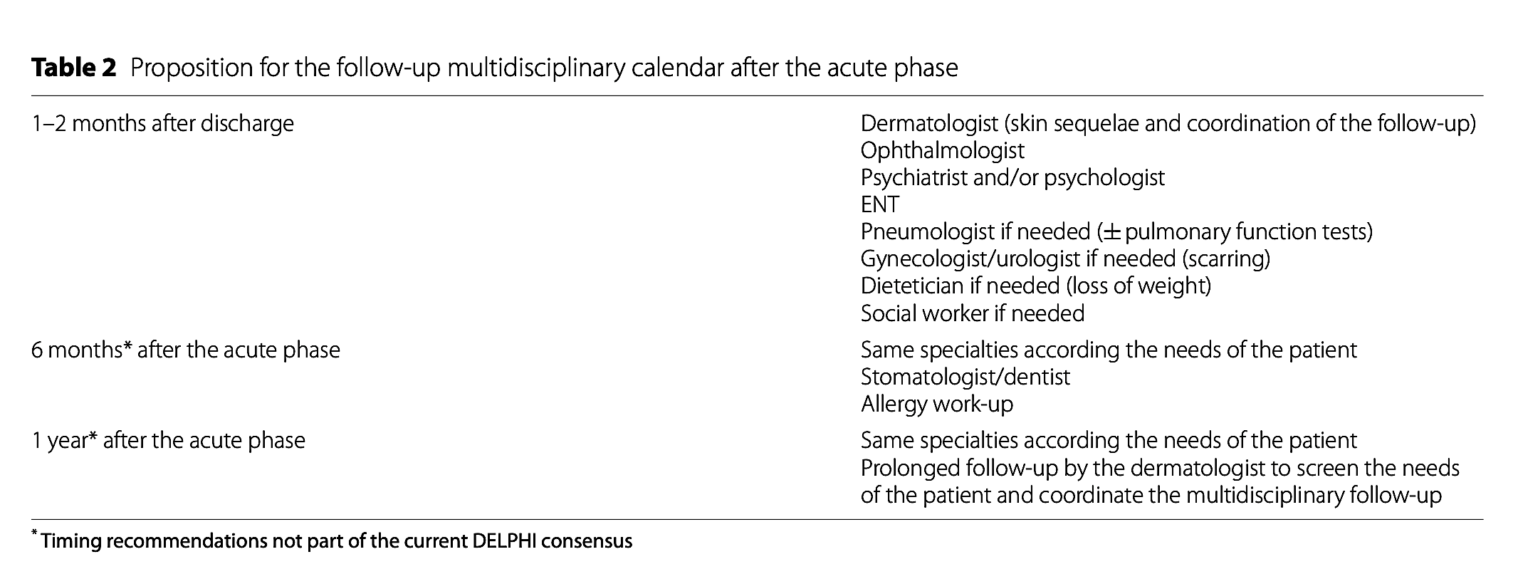
The story doesn’t end here: Multidisciplinary expert consensus to standardize recommendations regarding the management of SJS/TEN sequelae
Chronic eye sequelae (30-80% survivors): dry eyes, subconjunctival fibrous scarring , adhesions of eyelids (sympblepharon, ankyloblepharon
Loss of vision ( 5-10%)
Ingen‑Housz‑Oro et al. Orphanet Journal of Rare Diseases (2023)

Slide 68
Changing Disease Model
Qatar ( 2021)
Qatar ( 2020)
71% : Psychological distress
65% : post-traumatic stress
53%: Anxiety
29%: depression
Only 24% : follow-up by a mental health professional following hospitalization due to SJS/TEN
Nepal ( 2022)
Lee et al. British Journal of Dermatology 2017
Notes:
: Chronic Sequelae we don’t talk aboutIn addition to the sequelae that can be detected easily with a professional eye such as post-inflammatory pigmentation and ocular complications, there are serious psychological impact that we don’t usually talk about. Could not wait to fly back to his home country after severe post-traumatic stress disorder

Slide 69
Part 1: Conclusion
Advances in Clinical Classification SJS/TEN
Advances in Pathomechanism: Causality
Advances in Prevention: HLA Screening
Notes:
A DISEASE THAT IS NO LONGER IDIOSYNCRATIC, UNPREDECTABLE, UNPREVENTABLE

Slide 70
Acknowledgment
Professor Martin Steinhoff- PI
Chairman –Dermatology & Venerology- Rumaila Hospital, Qatar). Director: Translational Research Institute (iTRI) - Hamad Medical Corporation. Weill Cornell University-Qatar & Qatar University. Professor, Department of Dermatology Weill Cornell University- New York City, USA. MSteinhoff@hamad.qa
Dr. Jorg Buddenkotte, Scientist, iTRI (Dermatology & Venerology- Rumaila Hospital, Qatar)

Slide 71
Thank you

Slide 72
References
Dr Lee Haur Yueh, Department of Dermatology, Singapore General Hospital. EADV
Ingen‑Housz‑Oro et al. Orphanet Journal of Rare Diseases (2023)
D. Creamer et al. British Journal of Dermatology 2016

