Slide 1
Primary Hyperparathyroidism:
2022 Guidelines and Evolving Clinical Paradigms
Jad G. Sfeir, M.D., M.S.
Assistant Professor of Medicine
Robert and Arlene Kogod Center on Aging
Division of Endocrinology, Diabetes, Metabolism, and Nutrition
Division of Geriatric Medicine and Gerontology
Mayo Clinic, Rochester
@sfeirjad

Slide 2
Disclosure Statement
Speaker:
Dr. Jad Sfeir
Has no relevant financial relationships to disclose
Will not be discussing unlabeled/unapproved use of drugs or products

Slide 3
Learning Objectives
Demonstrate an understanding of the changing epidemiology of primary hyperparathyroidism
Review appropriate initial evaluation of patients with hyperparathyroidism
Recognize the impact of primary hyperparathyroidism on target organs
Discuss the updated 2022 guidelines in the management of primary hyperparathyroidism

Slide 4
Diagnosis of PHPT
1

Slide 5
Case 1
47-year-old man presents for evaluation of newly identified hypercalcemia.
Elevated calcium (10.7 mg/dL) was incidentally found on routine annual laboratory testing. No prior calcium on record.
History: denies any prior kidney stones or fractures
Meds: none
Family History: no calcium disorders known, only child
Physical Exam: unremarkable

Slide 6
Case 1
 | Results | Reference range
Calcium | 10.9 mg/dL | 8.9-10.1
Phosphorus | 3.1 mg/dL | 2.5-4.5
Albumin | 4.0 mg/dL | 3.5-5.0
Creatinine | 0.9 mg/dL | 0.6-1.0
PTH | 64 pg/mL | 15-65
25-hydroxyvitamin D | 28 ng/mL | 20-50
24-hour urine calcium | 171 mg
24-hour urine creatinine | 1787 mg

Slide 7
Case 1: What is your next step in evaluating this patient’s hypercalcemia?
Obtain parathyroid imaging to confirm primary hyperparathyroidism diagnosis
Diagnose primary hyperparathyroidism and refer for parathyroidectomy
Obtain calcium sensing receptor (CaSR) gene test
Obtain GNA11 gene test
Initiate cinacalcet to lower serum calcium

Slide 8
Case 1: What is your next step in evaluating this patient’s hypercalcemia?
Obtain parathyroid imaging to confirm primary hyperparathyroidism diagnosis
Diagnose primary hyperparathyroidism and refer for parathyroidectomy
Obtain calcium sensing receptor (CaSR) gene test
Obtain GNA11 gene test
Initiate cinacalcet to lower serum calcium

Slide 9
Primary Hyperparathyroidism
Dysregulated, chronic, excessive secretion of PTH from one or more parathyroid glands.
Single adenoma 85%
Multiglandular 15%
Carcinoma <1%
Bilezikian JP, JCEM, 2018
Cetani et al., Front Horm Res, 2019
Cetani et al, Endocr Relat Cancer, 2019

Slide 10
Diagnosis of PHPT
High serum calcium corrected for albumin
High or inappropriately normal PTH
2nd or 3rd generation assay
Normal (20%) – typically upper 1/2 or 1/3 of reference range
On 2 occasions, at least 2 weeks apart
Bilezikian JP, Khan AA et al., J Bone Miner Res, 2022

Slide 11
Differential diagnosis
Drugs that mimic PHPT
Thiazide diuretics
Lithium
FHH
Inactivating mutation of CaSR
Mild elevation in Ca, high-normal PTH, and hypocalciuria
Calcium to creatinine clearance ratio <0.01
U_{Ca} x S_{Cr} / U_{Cr} x S_{Ca}
Sensitivity 85%; Specificity 88%
>0.02 essentially rules out FHH
Ectopic PTH – extremely rare
El-Hajj Fuleihan 2002
Khan et al 2016

Slide 12
Back to Case 1
 | Results | Reference range
Calcium | 10.9 mg/dL | 8.9-10.1
Phosphorus | 3.1 mg/dL | 2.5-4.5
Albumin | 4.0 mg/dL | 3.5-5.0
Creatinine | 0.9 mg/dL | 0.6-1.0
PTH | 64 pg/mL | 15-65
25-hydroxyvitamin D | 28 ng/mL | 20-50
24-hour urine calcium | 171 mg
24-hour urine creatinine | 1787 mg
Ca/Cr clearance ratio: U_{Ca} x S_{Cr} / U_{Cr} x S_{Ca}
171 x 0.9 / 1787 x 10.9 = 0.008
<0.01 – FHH is very likely

Slide 13
Clues to FHH
Family history
Longstanding hypercalcemia
Any prior normal calcium on record?
High-normal PTH and normal phosphorus
Young individual
No complications
Persistent PHPT after surgery
Always rule our before recommending surgery!

Slide 14
Clinical Phenotypes of PHPT
2

Slide 15
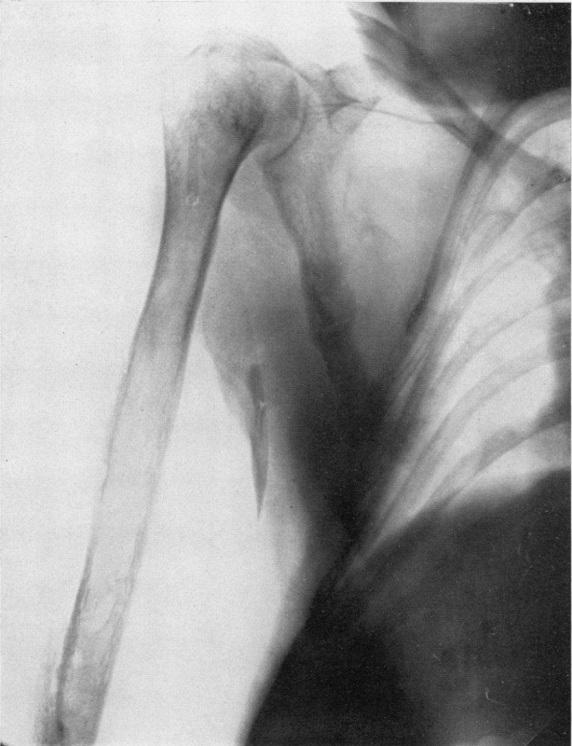
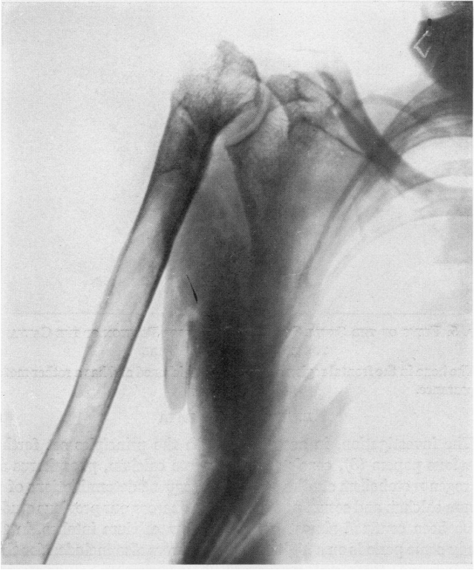
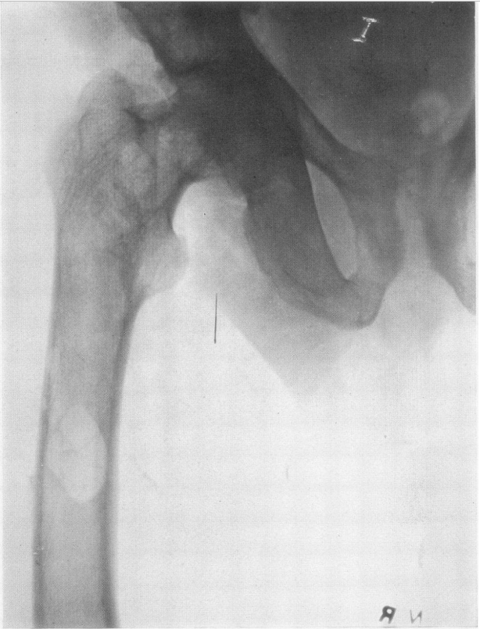
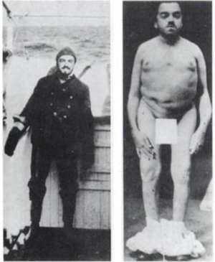
Osteitis Fibrosa Cystica The OG PHPT
Bauer W et al. J Clin Invest . 1930
Notes:
Captain Charles Martell, New York City mariner who had become disabled by demineralization of the skeleton over many years (Fig. 4). Between 1926 and 1932 his case graphically illustrated many of the features of the disease and its management. He was investigated initially in New York in 1926-7 and subsequently in Boston before undergoing a series of six neck operations without success.

Slide 16
Osteitis Fibrosa Cystica
Bone pain (diffuse or focal)
Pathologic fracture
Brown tumor (osteolysis and bone expansion)
Subperiosteal resorption (hand X-rays)
1960s: 23%
1990s: 2%
2010s: 0%
Notes:
Captain Charles Martell, New York City mariner who had become disabled by demineralization of the skeleton over many years (Fig. 4). Between 1926 and 1932 his case graphically illustrated many of the features of the disease and its management. He was investigated initially in New York in 1926-7 and subsequently in Boston before undergoing a series of six neck operations without success.

Slide 17
Changing Clinical Spectrum
Symptoms (%) | Cope 1930-1965 | Heath 1965-1974 | Silverberg 1984-1999 | Griebeler 1998-2010
Nephrolithiasis | 57 | 51 | 17 | 11
Skeletal Disease | 23 | 10 | 1.4 | 11
Hypercalciuria | -- | 36 | 39
Asymptomatic | 0.6 | 18 | 80 | 89
Automated chemistry panels
Osteoporosis screening by DXA

Slide 18
Clinical Phenotypes of PHPT
Symptomatic PHPT:
Marked hypercalcemia
Osteitis fibrosa cystica
Fractures
Chronic kidney disease
Nephrolithiasis
Nephrocalcinosis
Neuromuscular (proximal myopathy)
Bilezikian JP, Khan AA et al., J Bone Miner Res, 2022
El-Hajj Fuleihan et al., J Bone Miner Res, 2022

Slide 19
Clinical Phenotypes of PHPT
Asymptomatic PHPT:
No overt symptoms, typically discovered by biochemical screening
Asymptomatic with target organ involvement
Asymptomatic without target organ involvement
Bilezikian JP, Khan AA et al., J Bone Miner Res, 2022
El-Hajj Fuleihan et al., J Bone Miner Res, 2022

Slide 20
Clinical Phenotypes of PHPT
Normocalcemic PHPT:
Normal adjusted total calcium and normal ionized calcium levels
Elevated intact PTH (2nd or 3rd generation assay) on at least 2 occasions over 3-6 months
Alternative causes for secondary HPT ruled out:
Vitamin D deficiency (25-OH D <30ng/mL = 75nmol/L)
Renal insufficiency (eGFR < 60 mL/min)
Hypercalciuria
Bilezikian JP, Khan AA et al., J Bone Miner Res, 2022
El-Hajj Fuleihan et al., J Bone Miner Res, 2022

Slide 21
Case 2
42-year-old woman referred for evaluation of hypercalcemia.
History of bipolar disorder, well controlled on lithium for the past 15 years, and GERD. Notes generalized fatigue over the past few years.
No history of fractures or kidney stones
Family history: unremarkable
Meds: Lithium, omeprazole

Slide 22
case 2
 | Results | Reference range
Calcium | 11.2 mg/dL | 8.9-10.1
Phosphorus | 2.4 mg/dL | 2.5-4.5
Albumin | 3.9 mg/dL | 3.5-5.0
Creatinine | 1.1 mg/dL | 0.6-1.0
PTH | 100 pg/mL | 15-65
25-hydroxyvitamin D | 20 ng/mL | 20-50
24-hour urine calcium | 320 mg

Slide 23
Case 2: How would you advise this patient regarding Lithium therapy and hyperparathyroidism?
Lithium therapy is not associated with primary hyperparathyroidism
About 1% of patients treated with lithium develop hyperparathyroidism
Withdrawal of lithium is not likely to normalize her calcium
She likely has a single parathyroid adenoma
Parathyroidectomy cure rate is greater than 95% with an experienced surgeon

Slide 24
Case 2: How would you advise this patient regarding Lithium therapy and hyperparathyroidism?
Lithium therapy is not associated with primary hyperparathyroidism
About 1% of patients treated with lithium develop hyperparathyroidism
Withdrawal of lithium is not likely to normalize her calcium
She likely has a single parathyroid adenoma
Parathyroidectomy cure rate is greater than 95% with an experienced surgeon

Slide 25
Lithium and hypercalcemia
10-15% develop PHPT
Younger women (mean age 41 years)
Initially – altered set point (similar to FHH): hypercalcemia with high normal PTH
Long-term – stimulates PTH secretion
Leads to multiglandular disease (hyperplasia)
Surgical cure rate ~ 60%
Higher rate with multigland removal, but increased risk of hypoparathyroidism
Mc Henry CR et al. Endocr Pract, 2:103,1996

Slide 26
Target Organ involvement in PHPT
3

Slide 27
case 3
A 60-year-old woman is referred for evaluation of hypercalcemia noted incidentally during her routine annual physical exam, with a total serum calcium of 10.5 mg/dL.
She is concerned because while doing an online search she found that primary hyperparathyroidism is associated with left ventricular hypertrophy (LVH).
History:
HTN
Wrist fracture following a high-impact biking accident 3 years ago, but no other fractures.
She denies a history of nephrolithiasis
Meds:
No supplements containing calcium
Cholecalciferol 2,000 IU per day during winter months only
Amlodipine 5 mg daily

Slide 28
case 3
Repeat testing shows the following:
DXA scan: lowest T-score of -2.6 at the left femoral neck.
ECG obtained 2 weeks ago during an ED visit for chest pain: minimal voltage criteria for LVH. A coronary angiogram at the time showed a 50% stenosis in the obtuse marginal branch of the left circumflex.
 | Results | Reference range
Calcium | 10.5 mg/dL | 8.9-10.1
Phosphorus | 3.1 mg/dL | 2.5-4.5
Albumin | 4.0 mg/dL | 3.5-5.0
Creatinine | 0.7 mg/dL | 0.6-1.0
PTH | 88 pg/mL | 15-65
25-hydroxyvitamin D | 40 ng/mL | 20-50
24-hour urine calcium | 260 mg

Slide 29
Case 3: How would you advise the patient regarding management of primary hyperparathyroidism?
There is no indication for surgical management at the present time; serial monitoring of serum calcium and bone density is recommended.
Although LVH is not an indication for surgery, it is expected to improve following parathyroidectomy.
The patient’s cardiovascular abnormalities are not clearly related to primary hyperparathyroidism, but she has at least one indication for parathyroidectomy.
Normalization of serum calcium after successful parathyroidectomy will decrease her risk of CV death.

Slide 30
Case 3: How would you advise the patient regarding management of primary hyperparathyroidism?
There is no indication for surgical management at the present time; serial monitoring of serum calcium and bone density is recommended.
Although LVH is not an indication for surgery, it is expected to improve following parathyroidectomy.
The patient’s cardiovascular abnormalities are not clearly related to primary hyperparathyroidism, but she has at least one indication for parathyroidectomy.
Normalization of serum calcium after successful parathyroidectomy will decrease her risk of CV death.

Slide 31
Fracture Incidence in PHPT
 | Khosla et al. 1999 | Vestergaard et al. 2000
Cohort size | 407 | 674
Type of study | Population-based | Surgical
Treated surgically (%) | 23 | 100
Mean calcium, mg/dL (mmol/L) | 10.9 (2.73) | 11.8 (2.95)
Fracture risk
Vertebra | 3.2 | 3.5
Forearm | 2.2 | 1.9
Hip | 1.4 | 1.5
Any site | 1.3 | 1.8
Khosla S et al. J Bone Miner Res 1999
Vestergaard P et al. BMJ 2000
Notes:
407 Rochester residents, dx with PHPT in 1965-1992, 5766 person-years of follow-up (~14 yrs)

Slide 32
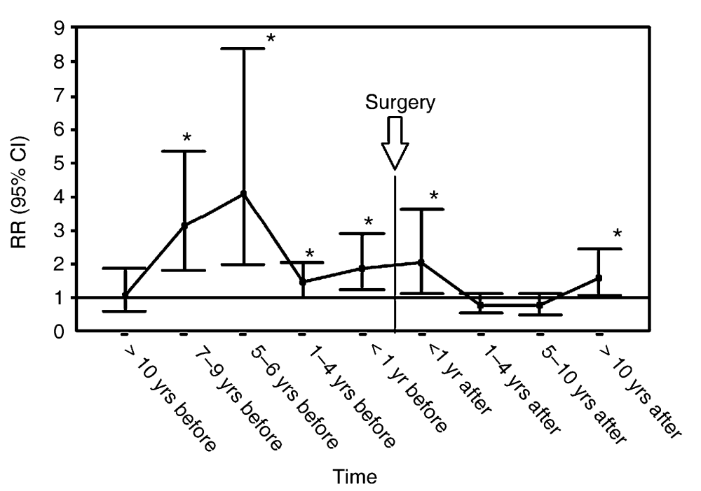
Fracture Incidence after PTX
Vestergaard et al. BMJ 2002
Notes:
Relative rates and 95% CI for risk of fracture in cases compared with matched controls stratified by time before and after surgery.

Slide 33
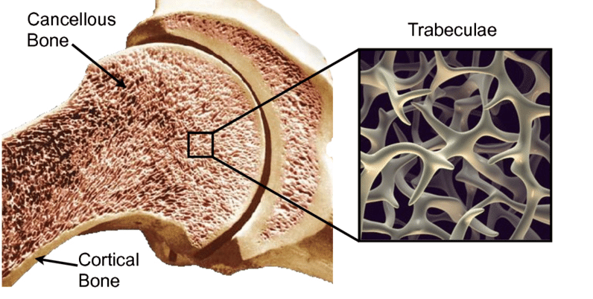
PTH effect on bone
PTH increases bone turnover
Resorption
Formation
Continuous PTH excess
Catabolic effect
Cortical bone

Slide 34
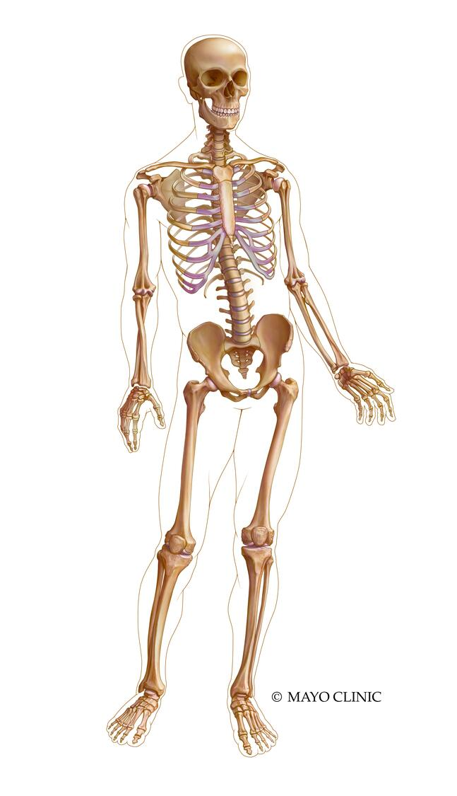
Spine:
75% Trabecular
25% Cortical
1/3 Radius:
>95% Cortical
Femur neck:
25% Trabecular
75% Cortical
Femur intertrochanteric:
50% Trabecular
50% Cortical

Slide 35
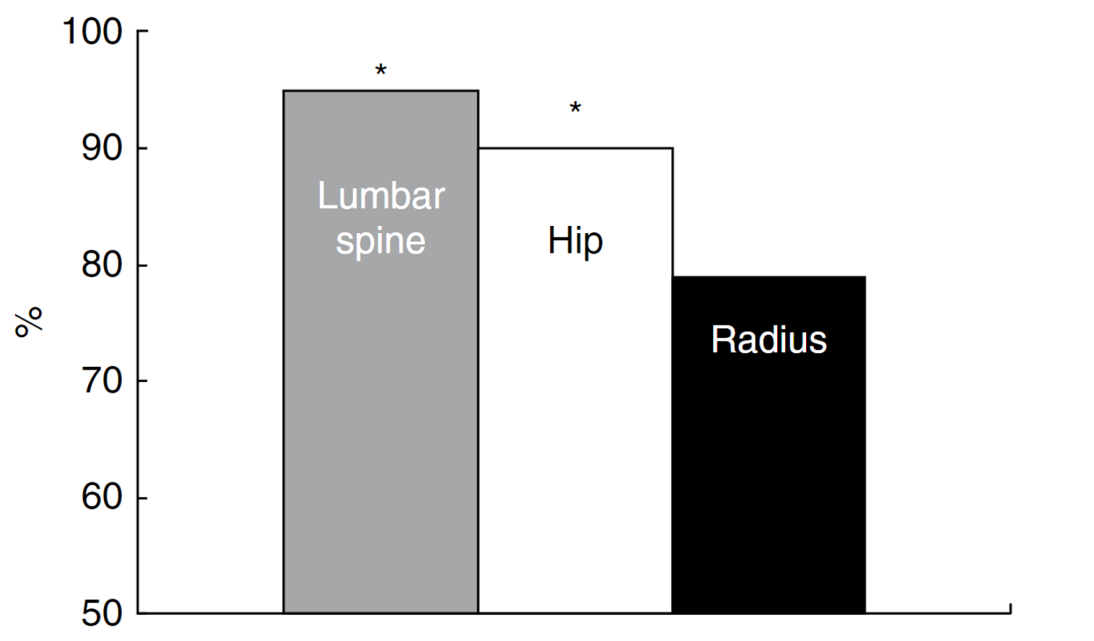
BMD in PHPT
(95% expected)
(89% expected)
(79% expected)
* Difference from radius p<0.05
Silverberg SJ et al. J Bone Miner Res 1989

Slide 36
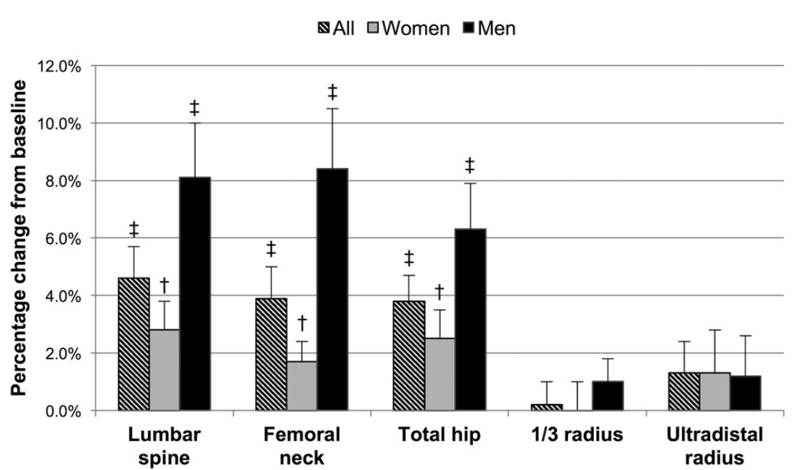
BMD after PTX
Cusano N et al. J Clin Endocrinol Metab 2017
Notes:
29 subjects with PHPT (21 women, 8 men) with BMD at baseline and 24 months postparathyroidectomy.

Slide 37
Nephrolithiasis in PHPT
Overt stone disease 9.7-20%
General population 1.6%
Higher risk in younger age and males
Post parathyroidectomy
Risk is decreased but not back to general population
Remains elevated for up to 10 years post-op
Most recurrence within 4 years
Reid LJ et al. J Clin Endocrinol Metab 2019
Cassibba S et al. Endocr Pract 2014
Elkoushy MA et al. Urology 2014
Mollerup CL et al. BMJ 2002

Slide 38
Kidney Function
eGFR <60 mL/min in approx. 16%
No clear association between mild PHPT and renal impairment
Parathyroidectomy prevents decline in renal function
Tassone at al. J Clin Endocrinol Metab 2015
Walker et al. J Clin Endocrinol Metab 2014

Slide 39
Non-Classical Manifestations
Neurocognitive and Cardiovascular
Need more evidence to determine relationship with PHPT and benefits of parathyroidectomy
GI
Only MEN1 and Zollinger Ellison syndrome are pathophysiological-linked
Bilezikian JP, Khan AA et al. J Bone Miner Res. 2022

Slide 40
Cardiovascular system
Association studies:
HTN, LVH, arterial stiffness, and impaired diastolic filling
Observational studies, small sample sizes
Co-existence of hypertension
No clear evidence for improvement in cardiovascular parameters following parathyroidectomy.
Risk of CV death in patients with PHPT is related to traditional risk factors but not serum calcium.
El-Hajj Fuleihan et al., J Bone Miner Res, 2022

Slide 41
Cardiovascular System
Pretorius et al., Annals of Int Med, 175:812-819, 2022
Notes:
No difference in CVS morbidity
Overall mortality was low (7.9%) and did not differ between groups
No difference in peripheral or vertebral fractures either with or without PTX
Limitation - withdrawal 23 patients in PTX and 27 in the observation group.

Slide 42
Evaluation of patients with PHPT
4

Slide 43
How Should Patients with PHPT be Evaluated?
Biochemical
25 hydroxyvitamin D
Creatinine clearance
Phosphorus
24-hr urine calcium and creatinine
Bilezikian JP, Khan AA et al. J Bone Miner Res. 2022

Slide 44
How Should Patients with PHPT be Evaluated?
Skeletal
3-site DXA (lumbar spine, hip, distal 1/3 radius)
Imaging for vertebral fractures
vertebral fracture assessment (VFA) or vertebral X-rays
Trabecular Bone Score (if available)
Bilezikian JP, Khan AA et al. J Bone Miner Res. 2022

Slide 45
How Should Patients with PHPT be Evaluated?
Renal
Creatinine clearance
24-hour urinary calcium
Imaging for nephrolithiasis/nephrocalcinosis
Bilezikian JP, Khan AA et al. J Bone Miner Res. 2022

Slide 46
How Should Patients with PHPT be Evaluated?
Non-classical manifestations
No data to support routine evaluation for these manifestations
Bilezikian JP, Khan AA et al. J Bone Miner Res. 2022

Slide 47
How Should Patients with PHPT be Evaluated?
Genetic
< 30 years of age
Multigland disease
Family history of hypercalcemia or a syndromic disease (MEN)
Bilezikian JP, Khan AA et al. J Bone Miner Res. 2022

Slide 48
Surgical Criteria for PHPT
5

Slide 49
Indications for Surgical Management
Surgery is recommended if any of the following is present (ungraded):
Serum calcium > 1 mg/dL (0.25 mmol/L) above the ULN
Age < 50 years
Skeletal involvement:
Fracture by VFA/Xray
BMD by T-score ≤ -2.5 at any site
Renal involvement:
eGFR or creatinine clearance <60 ml/min
Nephrocalcinosis or nephrolithiasis by X-ray, ultrasound, or other imaging modality
Hypercalciuria (> 250 mg/day in women; > 300 mg/day in men)
If no criterion is met, PTX is still an option with concurrence of the patient and physician, and if there are no contraindications
Bilezikian JP, Khan AA et al. J Bone Miner Res. 2022

Slide 50
QUESTIONS & ANSWERS
Sfeir.Jad@mayo.edu
@SfeirJad

