Slide 1
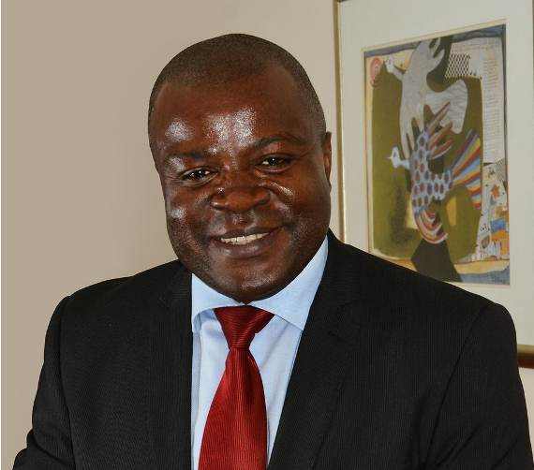
Professor Charles Shey Wiysonge
MD, MPhil, PhD
Director, Cochrane South Africa
South African Medical Research Council
Extraordinary Professor, Department of Global Health
Stellenbosch University
Honorary Professor, School of Public Health and Family Medicine
University of Cape Town
Prof. Charles Wiysonge has an MD from the University of Yaoundé I in Cameroon, an MPhil in Epidemiology from the University of Cambridge in the United Kingdom (UK), and a PhD in Vaccinology from the University of Cape Town in South Africa. He is also a Member of the Academy of Science of South Africa.
Prof. Wiysonge is the Director of the South African Cochrane Centre, a Professor of Global Health at Stellenbosch University in South Africa, and an Honorary Professor at the School of Public Health and Family Medicine at the University of Cape Town. He is a member of the World Health Organization (WHO) Working Group on Measuring Behavioural and Social Drivers of Covid-19 Vaccination; the Gavi Independent Review Committee; the African Regional Committee on Health Research and Development; the Advisory Board of the African Union Scientific, Research and Innovation Council; the South African National Immunisation Advisory Group; and numerous advisory committees on vaccination, research, and evidence-based policy. Prof. Wiysonge’s current research focuses on vaccine implementation issues in Africa.

