Slide 1
Introduction to Medication Safety: Background & Concepts
Dr. Anas Hamad, PhD, MSc, BSc, DMS, RPh
Director of Pharmacy Department, National Center for Cancer Care & Research (NCCCR)
Head of Medication Safety & Quality Center, Corporate Pharmacy, Hamad Medical Corporation (HMC)
Adjunct Assistant Professor of Clinical Pharmacy & Practice, Qatar University (QU)
Head of Standing Committee on Medication Services, Qatar Red Crescent Society (QRCS)
VP of Qatar Chapter, International Society of Health Economics & Outcomes Research (ISPOR Qatar)

Slide 2
Disclosure Statement
Speaker:
Dr. Anas Hamad
Has no relevant financial relationships to disclose
Will not be discussing unlabeled/unapproved use of drugs or products.

Slide 3
Objectives
Background and definitions
Where do medication errors happen?
Why do medication errors occur?
How common are medication errors?
How harmful are medication errors?

Slide 4
Introduction
Healthcare is one of the basic needs of any society
It helps to cure diseases, relieve suffering, and save lives
There has been a tremendous improvement in healthcare so that many previously fatal diseases have become easily treatable
HOWEVER, healthcare itself is still a source of patient distress and harm.
Vincent, 2011

Slide 5
Introduction

Slide 6
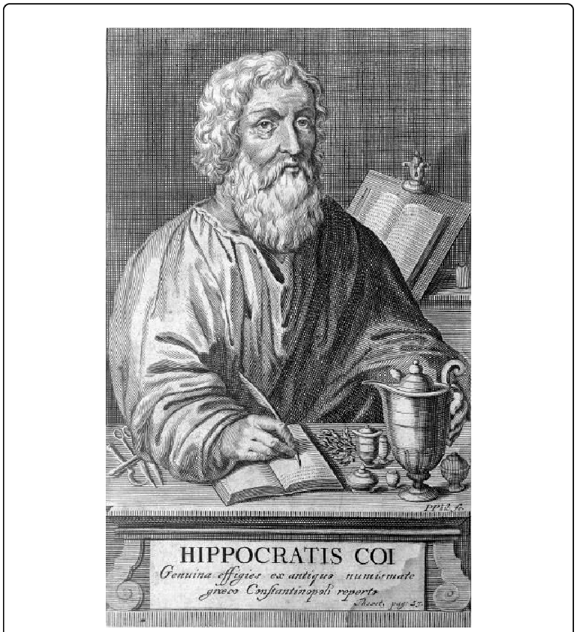
Background
There were mixed opinions about medicine in early times including the double idea of death and doctor riding together
In ancient Greece, Apollo was the god of physic and sender of diseases at the same time. ‘Pharmakos’ meant both remedy and poison and the words ‘kill’ and ‘cure’ were nearly indistinguishable
Hippocrates had a famous dictum that says ‘first, do no harm’.
Porter, 1999; Vincent, 2011

Slide 7
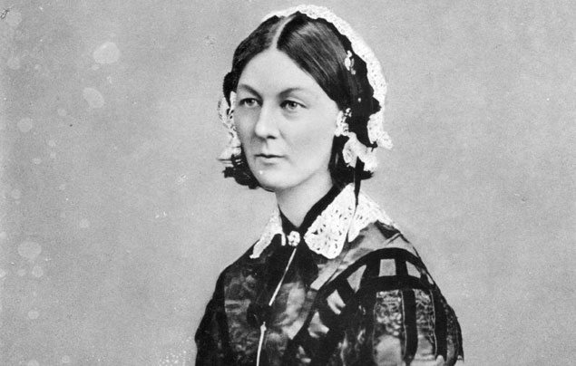
Background
In the context of modern medicine, Florence Nightingale was one of the first to address healthcare-associated risks. She introduced her book Notes on Hospitals with “It may seem a strange principle to enunciate as the very first requirement in a hospital that it should do the sick no harm.”
Nightingale, 1863

Slide 8
What is medication safety?
Medication safety is defined as freedom from preventable harm with medication use. Medication safety issues can impact health outcomes, length of stay in a healthcare facility, readmission rates, and overall costs to healthcare system.
ISMP Canada, 2007

Slide 9
Why focus on medications?
Medications are the most used intervention in healthcare.
Medication errors (MEs) are very common worldwide.
Medication-related harm is one of the most common harms in healthcare.
Medication optimization can keep people out of hospital and reduce readmissions.
Medications are a major expense in all hospitals. Proper management will help to reduce costs.

Slide 10
Why focus on medications?

Slide 11
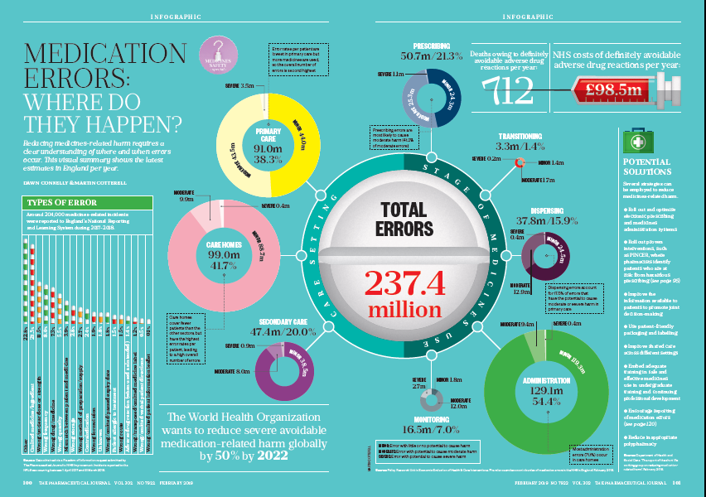

Slide 12
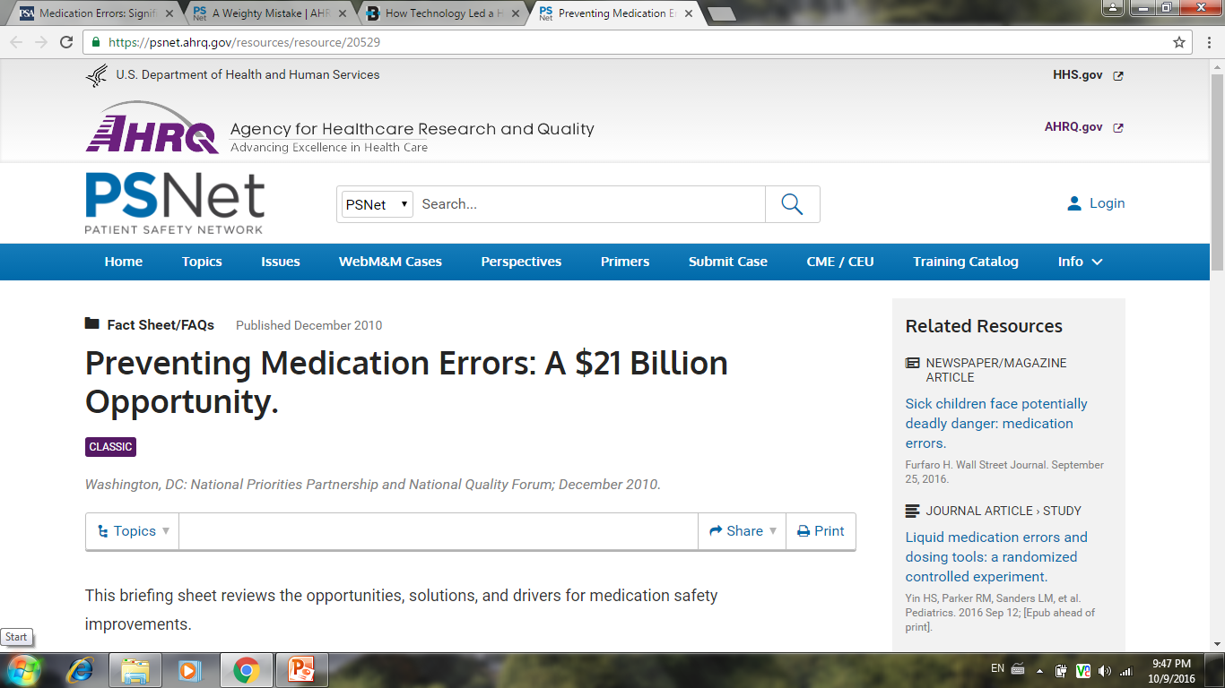
Why focus on medications?

Slide 13
Definitions
Harm
Impairment of the physical, emotional, or psychological function or structure of the body and/or pain resulting therefrom.
Medication Error
Any preventable event that may cause or lead to inappropriate medication use or patient harm while the medication is in the control of the health care professional, patient, or consumer.
Such events may be related to professional practice, health care products, procedures, and systems, prescribing, labeling, packaging, nomenclature, compounding, dispensing, distribution, administration, education, monitoring, and use.
Adverse Drug Event
Any untoward medical occurrence, unfavorable sign [e.g., abnormal labs], symptom, or disease, in a patient administered a drug. Adverse drug events include adverse drug reactions, and may be caused by medication errors.

Slide 14
Medication Errors and Harm
Preventable (First Target)
Errors
Harm
(ADE)
Non-preventable (ADR)
PADE
ADE: Adverse Drug Event
PADE: Potential Adverse Drug Event
ADR: Adverse Drug Reaction
Adapted from Bates et al, 1995

Slide 15
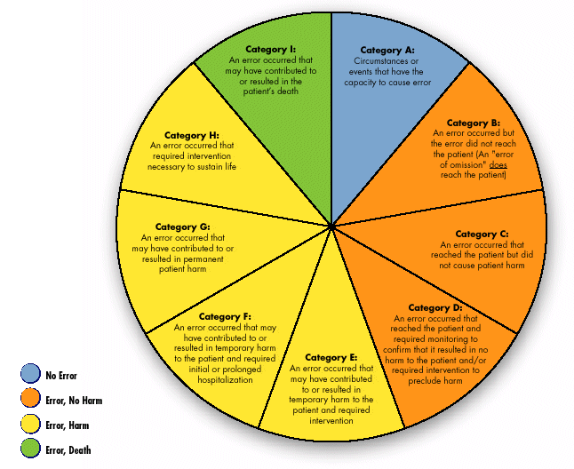

Slide 16
The unknown is even more!
Smith & Cavell, 2004

Slide 17
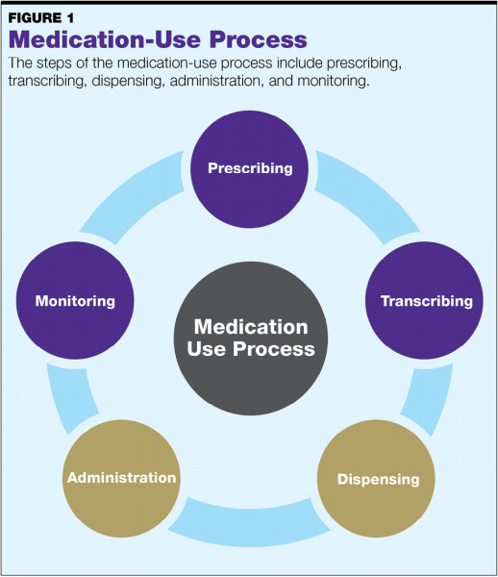
Where do medication errors happen?
Murray & Papillion, 2020
Notes:
We use this simple model to describe the Medication use process
Errors can happen at each stage pf the process.
Today we are focusing on those that directly affect you – ordering and monitoring
This way of categorizing medication errors over-simplifies the situation
Wherever they happen errors are almost never due to a single failure or single misunderstanding
This is an inter-connected process and your actions / lack of action can increase or decrease the risk of errors in other parts
e.g.
Oral drug therapy is less risky than intravenous drug therapy
if you do not switch a patient from IV therapy to an oral equivalent, you are increasing the risk of an error during dispensing and administration!

Slide 18
Where do medication errors happen?
Errors are not evenly distributed through the Medication Use Process
Out of every 100 inpatient medication errors
Medication ordering – 49%
Order Transcription – 11%
Dispensing – 14%
Administration of drugs – 26%
Leape et al , 1995
Notes:
Around half of all medication errors happen at the stage of ordering
Half of all errors are associated with the area that you are most closely involved with [ordering]
All errors will impact on your patients so you need to be vigilant
If you see a near miss – error almost happened – we need to know so that we can minimise the risk
When the unexpected happens to your patient THINK – could it be a medication error?

Slide 19
Why do medication errors occur?
Vincent, 2010
Accident causation model

Slide 20
Why do medication errors occur?
Patient Factors
Individual Factors
Team factors
Task Factors
Work Environment
System problems
Practicalities
Resources
Physical and mental well-being
Attitudes
Education and training
Causes of errors
Complex patients
Communication
Multidisciplinary working
Communication
Over-reliance on defences
Time pressure
Physical environment
Workload
Dean et al, 2002

Slide 21
Why do medication errors occur?
Reason, 1990

Slide 22
Why do medication errors occur?
Seshia et al, 2017

Slide 23
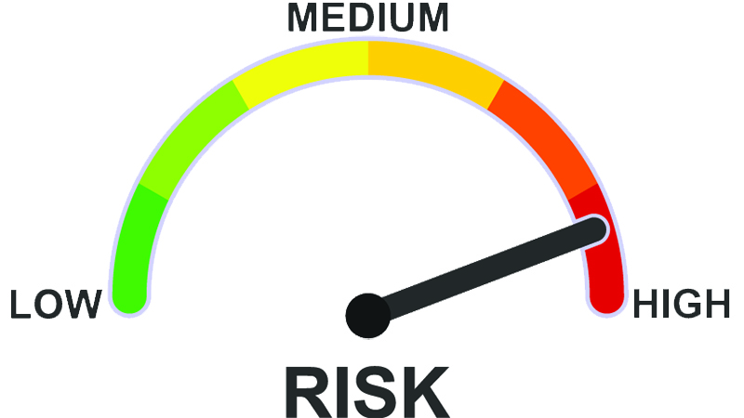
Known High Risks for Medication Errors
Poor hand-writing
Incomplete documentation
Confusing abbreviations
Dose calculations
Therapeutic duplications
Drug Interactions
“High-Alert” medications
“Look Alike – Sound Alike” drugs
Complex regimens
Polypharmacy.
Notes:
This slide lists the factors that have been shown to have a high association with serious medication errors
Poor hand writing, incomplete documentation and dangerous abbreviations are a major cause of serious medication errors. These will persist as long as we have hand written prescriptions and these will be here until June 2016 [and during “down-time” periods]
We have a workshop – later in 2015 – that studies these in depth and provides guidance on how to reduce the risk
“Death by Decimal point” is the most serious consequence of a calculation error; they can happen when prescribing, when dispensing and when administering
Therapeutic duplication and drug interactions are areas where eMRs and Pharmacists can help detect and avoid but rely on standard processes for prescription, checking and reconciliation
Some drugs have serious consequences if involved with errors and can be easily confused with other drugs; we try to highlight these where possible and put extra effort in to designing the drug use processes
These are all covered in the workshop

Slide 24
Role of Human Factors
Interactions of people with other people
Communication failures
Misunderstanding
Interactions with technology
Errors due to the interface with computers
Alert fatigue
Ignoring alerts
Interactions with the environment
Noise as a distraction
Uncomfortable workflow.

Slide 25
Thank You
“Medicine used to be simple, ineffective, and relatively safe. Now it is complex, effective, and potentially dangerous.”
Professor Sir Cyril Chantler

