Slide 1
Post-operative Nutritional Recommendations
Joyce Moawad, MSc.
Lecturer/ Clinical Coordinator
Human Nutrition Department
College of Health Sciences, QU HEALTH
Qatar University
Sep 2, 2023

Slide 2
Disclosure Statement
Ms. Joyce Moawad
Has no relevant financial relationships to disclose
Will not be discussing unlabeled/unapproved use of drugs or products
Notes:
I declare that I have no conflict of interest in providing this presentation. I have no financial, personal, or professional relationships that could conflict the content of this presentation or be perceived as a potential conflict.

Slide 3
Learning Outcomes
By the end of this presentation, participants will be able to:
Evaluate dietary strategies and food choices post-bariatric surgery
Develop personalized meal planning and behavior modification strategies
Analyze the impact of dietary habits and lifestyle factors on weight management and overall well-being post-bariatric surgery
Evaluate the importance of ongoing post-operative follow-up and support

Slide 4
Nutrition Care Process for Bariatric Surgery Patient
Diagnosis
Monitoring & Evaluation
Assessment
Intervention
Pre-bariatric surgery
Bariatric surgery
Post bariatric surgery

Slide 5
Nutrition Assessment for Bariatric Surgery Patient
Diet experience
Diet attempts
Food & nutrient intake
Eating environment
Use of supplements &/or alternative medicine
Patient’s nutrition knowledge
Patient’s beliefs & attitudes
Nutrient deficiency
Anthropometrics
Biochemical
NFPE
Pre-operative nutrition assessment
Post-operative nutrition assessment
All items in pre-operative period
Weight loss rate & BMI changes
Energy needs
Macronutrients & micronutrients needs
Fluid needs
Food intolerances
NFPE
Academy of Nutrition and Dietetics. (2020). Nutrition Care Manual: Bariatric Surgery (p. 102-145).

Slide 6
Nutrition Assessment and Diagnosis for Bariatric Surgery Patient
Post-operative nutrition assessment¹
Post-operative nutrition diagnosis
Weight loss rate & BMI changes
%weight loss = actual weight at time of surgery – actual weight postoperatively / actual weight at time of surgery × 100
Inadequate fluid, protein, vitamin or mineral intake
Undesirable food choices
Swallowing difficulty
Altered gastrointestinal function
Energy needs
Mifflin-St. Jeor Equation × AF
Macronutrients & micronutrients needs²
PTN: 60-80g, or 1.1 to 1.5g PTN/kg/IBW)
DRI for micronutrients
Fluid needs
1.5-2 L/day
¹Academy of Nutrition and Dietetics. (2020). Nutrition Care Manual: Bariatric Surgery (p. 102-145).
² Gasmi, A. et al., D.O., 2022. Micronutrients deficiences in patients after bariatric surgery. European journal of nutrition, 61(1), pp.55-67.

Slide 7
Nutrition Intervention for Bariatric Surgery Patient
Post-operative nutrition intervention
Early post-operative period
Diet stages based on progression in texture and volume of food specific to surgical procedure^{3,4}
Stage 1 & 2 diet: Hydration and liquids
Stage 3 diet: Soft solid foods
Stage 4 diet: Solid foods
Late post-operative period – long term diet and habit changes
Dietary intake depends on the type of the bariatric procedure performed⁴ Eating habits are influenced by patient’s motivation and willingness to adhere to a healthy dietary pattern.
¹Academy of Nutrition and Dietetics. (2020). Nutrition Care Manual: Bariatric Surgery (p. 102-145).
³ Clinical practice guidelines for the perioperative nutrition, metabolic, and nonsurgical support of patients undergoing bariatric procedures - 2019 update: cosponsored by American Association of Clinical Endocrinologists/American College of Endocrinology, The Obesity Society, American Society for Metabolic&Bariatric Surgery, Obesity Medicine Association, and American Society of Anesthesiologists.
⁴ Kushner, R., Cummings, S. and Herron, D., 2017. Bariatric surgery: postoperative nutritional management. UpToDate. Available online: https://www. uptodate. com/contents/bariatric-surgery-postoperative-nutritional-management.

Slide 8
Nutrition Intervention for Bariatric Surgery Patient
Nutrition intervention after Roux-en-Y gastric bypass & gastric sleeve procedures
Stage I: Clear liquids^{1,4}
Begin | Fluids/foods | Guidelines
Post-op days 1 & 2 | Clear liquids Clear, non-carbonated without calories, sugar, or caffeine | Sips of clear liquid may be started following swallow test
Goal:
Fluid goal before discharge from the hospital is 120-240mL over 2 hours
¹Academy of Nutrition and Dietetics. (2020). Nutrition Care Manual: Bariatric Surgery (p. 102-145).
⁴ Kushner, R., Cummings, S. and Herron, D., 2017. Bariatric surgery: postoperative nutritional management. UpToDate. Available online: https://www. uptodate. com/contents/bariatric-surgery-postoperative-nutritional-management.

Slide 9
Nutrition Intervention for Bariatric Surgery Patient
Nutrition intervention after Roux-en-Y gastric bypass & gastric sleeve procedures
Stage I: Clear Liquids - Sample
Foods Allowed
Clear favored broth Anise Algal Fresh fruit juice (purified well) Plain decaffeinated tea or tea (without milk or creamer) Sugar-free jello Sugar-free popsicles

Slide 10
Nutrition Intervention for Bariatric Surgery Patient
Nutrition intervention after Roux-en-Y gastric bypass & gastric sleeve procedures
Stage I: Clear Liquids
Recommendations
Sip & do not gulp Avoid using straws Drink slowly

Slide 11
Nutrition Intervention for Bariatric Surgery Patient
Nutrition intervention after Roux-en-Y gastric bypass & gastric sleeve procedures
Stage II: Full liquids
Begin | Fluid/foods | Guidelines
Post-op day 3 & continue until 10-14 days post-op (discharge diet) | GBP Clear liquids + GBP full liquids | Begin vitamin & mineral supplementation
Sugar: < 15g/serving
PTN: 25-30g/serving of added powders
Goals:
Fluid intake: 1-2L of total fluids each day^{1,4}
Protein intake : A minimal of 60g of PTN/d & up to 1.5kg/IBW/d^{1,4,5}
¹Academy of Nutrition and Dietetics. (2020). Nutrition Care Manual: Bariatric Surgery (p. 102-145).
⁴ Kushner, R., Cummings, S. and Herron, D., 2017. Bariatric surgery: postoperative nutritional management. UpToDate. Available online: https://www. uptodate. com/contents/bariatric-surgery-postoperative-nutritional-management
⁵ Bettini, S., Belligoli, A., Fabris, R. and Busetto, L., 2020. Diet approach before and after bariatric surgery. Reviews in Endocrine and Metabolic Disorders, 21, pp.297-306.

Slide 12
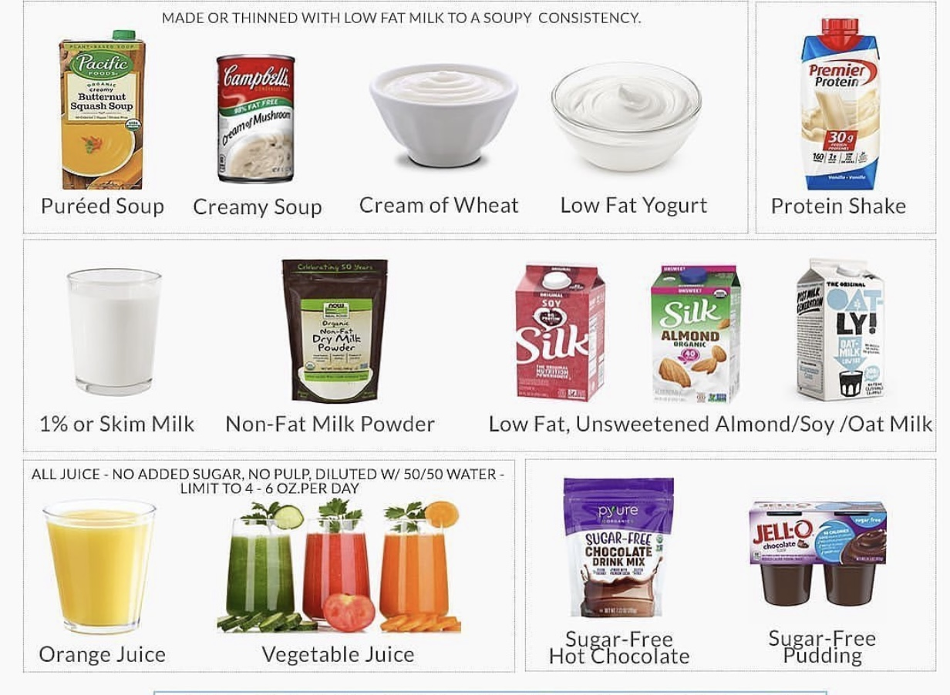
Nutrition Intervention for Bariatric Surgery Patient
Nutrition intervention after Roux-en-Y gastric bypass & gastric sleeve procedures
Stage II: Full Liquids - Sample
Foods Allowed
All of clear liquids diet Protein rich liquids Low-fat or fat-free milk mixed with whey, whey isolate or soy PTN Lactose-free milk or soy milk mixed with soy protein powder Diluted fruit juice Zero-fat or skimmed milk Low-fat/light yogurt (plain or flavored without fruit chunks - preferred Greek yogurt) Low fat or fat free cottage cheese Sugar-free, low fat pudding (Custard, “mhalabiyi”) Cream soup

Slide 13
Nutrition Intervention for Bariatric Surgery Patient
Nutrition intervention after Roux-en-Y gastric bypass & gastric sleeve procedures
Stage II: Full Liquids
Recommendations
Encourage patients to have salty fluids & solid liquids Drink 1.5 -2L of fluids each day 0.7-0.9L of clear liquids + 0.7-0.9L of full liquids Sip clear liquids often between meals Consume no solid food at this time Follow the “30-Minute Rule” to fluid intake: wait 30 minutes before and after your shake to drink other fluids

Slide 14
Nutrition Intervention for Bariatric Surgery Patient
Nutrition intervention after Roux-en-Y gastric bypass & gastric sleeve procedures
Stage II: Full Liquids
Notes³
Within several days of the surgery, the patient should be tolerating at least 1800 mL of fluid daily Typical daily calorie intake the 1st week post-op is 400kcal/d Advance to stage 3 once stage 2 is well tolerated (~2 weeks post-op) – to be assessed by clinical team Total quantity tolerated: no more than ½ cup total⁶
³Clinical practice guidelines for the perioperative nutrition, metabolic, and nonsurgical support of patients undergoing bariatric procedures - 2019 update: cosponsored by American Association of Clinical Endocrinologists/American College of Endocrinology, The Obesity Society, American Society for Metabolic & Bariatric Surgery, Obesity Medicine Association, and American Society of Anesthesiologists.
⁶ Soldavini, J., 2019. Krause's food & the nutrition care process. Journal of Nutrition Education and Behavior, 51(10), p.1225.

Slide 15
Nutrition Intervention for Bariatric Surgery Patient
Nutrition intervention after Roux-en-Y gastric bypass & gastric sleeve procedures
Stage III: Soft Solid Diet ^{1,6}
Post-op period* | Type of diet | Guidelines
Begin 10-14 days | Soft Solid Diet Pureed food diet | Priority on hydration and protein intake
Post-op 5 – 8 weeks | Soft Diet Advanced soft diet
*Stage 3 lasts for months as per patient’s tolerance
There is no standardization of diet stages.
Dietary advancement is based on nutritional needs & increasing tolerance for dietary texture¹
¹Academy of Nutrition and Dietetics. (2020). Nutrition Care Manual: Bariatric Surgery (p. 102-145).
⁶Barstad, L.H et al. 2023. Changes in dietary intake, food tolerance, hedonic hunger, binge eating problems, and gastrointestinal symptoms after sleeve gastrectomy compared with after gastric bypass; 1-year results from the Oseberg study—a randomized controlled trial. The American Journal of Clinical Nutrition, 117(3), pp.586-598.

Slide 16
Nutrition Intervention for Bariatric Surgery Patient
Nutrition intervention after Roux-en-Y gastric bypass & gastric sleeve procedures
Stage III: Soft Solid Diet – Pureed Diet⁶
Begin | Fluids/foods | Guidelines
Post-op days 10‐14 | Soft Solid Diet - Pureed food diet Foods blended or mashed to liquid/baby food consistency | Priority on hydration and protein intake
Goals:
Fluid intake: 1.8-2L of total fluids each day
Protein intake : 60-80g of PTN /day
⁶Barstad, L.H et al. 2023. Changes in dietary intake, food tolerance, hedonic hunger, binge eating problems, and gastrointestinal symptoms after sleeve gastrectomy compared with after gastric bypass; 1-year results from the Oseberg study—a randomized controlled trial. The American Journal of Clinical Nutrition, 117(3), pp.586-598.

Slide 17
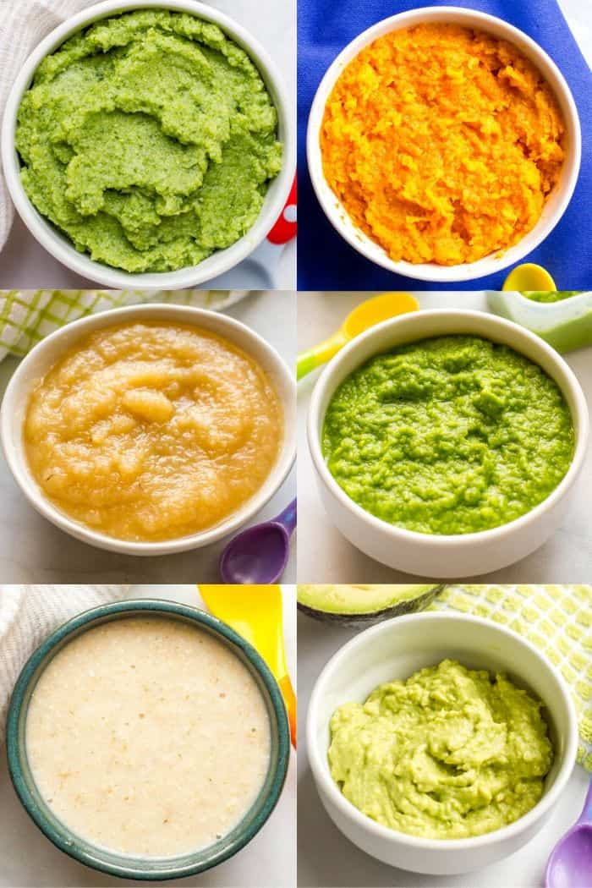
Nutrition Intervention for Bariatric Surgery Patient
Nutrition intervention after Roux-en-Y gastric bypass & gastric sleeve procedures
Stage III: Soft Solid Diet – Pureed Food
Foods Allowed | Avoid
All of clear & full liquids diet Blended lean meats, poultry, fish free of hard strains Low-fat soft cheeses, “labani” Soft Tofu Cooked & blended /mashed vegetables Cooked or canned fruits Mashed white or sweet potatoes Blended/mashed beans Soups Light mayonnaise to moisten | High fat and fried meals Peanut butter & other nut butters Hard cheeses Whole milk Raw vegetables and fruits (seeds, skins or hulls) Dried fruits Pasta; noodles; rice; bread & bread products All soda or other carbonated drinks Chocolate milk, sweetened condensed milk

Slide 18
Nutrition Intervention for Bariatric Surgery Patient
Nutrition intervention after Roux-en-Y gastric bypass & gastric sleeve procedures
Stage III: Soft Solid Diet – Pureed Food^{1,7}
Recommendations
Increased intake of GBP clear liquids Have ~ 2L of total liquids daily. Consume 3-6 small meals of PTN food per day Try only one new food at a meal Patients may be able to tolerate only 2 Tbsps at each meal or snack Avoid foods that are spicy, very hot, and/or very cold Aim to have protein food choices at 3‐6 small meals daily; patient may only be able to tolerate a couple of tablespoons at each meal/snack Avoid fluids during meals; wait ~30 minutes after each meal before having beverages Take multivitamin-mineral supplements on a daily basis
¹Academy of Nutrition and Dietetics. (2020). Nutrition Care Manual: Bariatric Surgery (p. 102-145).
⁷Barstad, L.H et al. 2023. Changes in dietary intake, food tolerance, hedonic hunger, binge eating problems, and gastrointestinal symptoms after sleeve gastrectomy compared with after gastric bypass; 1-year results from the Oseberg study—a randomized controlled trial. The American Journal of Clinical Nutrition, 117(3), pp.586-598.

Slide 19
Nutrition Intervention for Bariatric Surgery Patient
Nutrition intervention after Roux-en-Y gastric bypass & gastric sleeve procedures
Stage III: Soft Solid Diet
Notes
Typical daily energy intake progresses to 600-800 Kcal/d by week 3 & 4 post-op³. Total quantity: gradually increase from ½ cup to no more than ¾ cup total⁶
³Clinical practice guidelines for the perioperative nutrition, metabolic, and nonsurgical support of patients undergoing bariatric procedures - 2019 update: cosponsored by American Association of Clinical Endocrinologists/American College of Endocrinology, The Obesity Society, American Society for Metabolic & Bariatric Surgery, Obesity Medicine Association, and American Society of Anesthesiologists
⁶ Soldavini, J., 2019. Krause's food & the nutrition care process. Journal of Nutrition Education and Behavior, 51(10), p.1225..

Slide 20
Nutrition Intervention for Bariatric Surgery Patient
Nutrition intervention after Roux-en-Y gastric bypass & gastric sleeve procedures
Stage III: Soft Solid Diet - Advanced Soft Diet ⁷
Begin | Fluids/foods | Guidelines
Post-op 5-8 weeks | Soft Solid Diet – Advanced soft diet Amount and texture as tolerate | Priority on hydration and protein intake Advance as tolerated
Goals:
Fluid intake: 1.8-2L of total fluids each day
Protein intake : 60-80g of PTN /day
Mindful eating is essential
⁷Barstad, L.H et al. 2023. Changes in dietary intake, food tolerance, hedonic hunger, binge eating problems, and gastrointestinal symptoms after sleeve gastrectomy compared with after gastric bypass; 1-year results from the Oseberg study—a randomized controlled trial. The American Journal of Clinical Nutrition, 117(3), pp.586-598.

Slide 21
Nutrition Intervention for Bariatric Surgery Patient
Nutrition intervention after Roux-en-Y gastric bypass & gastric sleeve procedures
Stage III: Soft Solid Diet – Advanced Soft Diet^{1,7}
Recommendations
Add well‐cooked soft vegetables and soft and/or peeled fruit to meals/snacks Plan 5 to 6 small meals/snacks & adequate hydration Eat PTN foods first, followed by vegetables, fruits then grains All foods must be soft or cooked to a soft consistency. Chew all foods well. Include salads as tolerated Full liquids may be used for meak or snack replacement
¹Academy of Nutrition and Dietetics. (2020). Nutrition Care Manual: Bariatric Surgery (p. 102-145).
⁷Barstad, L.H et al. 2023. Changes in dietary intake, food tolerance, hedonic hunger, binge eating problems, and gastrointestinal symptoms after sleeve gastrectomy compared with after gastric bypass; 1-year results from the Oseberg study—a randomized controlled trial. The American Journal of Clinical Nutrition, 117(3), pp.586-598.

Slide 22
Nutrition Intervention for Bariatric Surgery Patient
Nutrition intervention after Roux-en-Y gastric bypass & gastric sleeve procedures
Stage III: Soft Solid Diet – Advanced Soft Diet^{1,7}
Recommendations
Avoid tough, stringy foods that can block the stoma (ex. raw celery, asparagus stalks) Avoid rice, bread, & pasta until patient is comfortable consuming 60g of PTN/day & 3-5 servings of fruits/vegetables per day (by post-op week 5). Starches should be limited to whole grain crackers with protein, potatoes, and/or dry low‐sugar cereals moistened with milk
¹Academy of Nutrition and Dietetics. (2020). Nutrition Care Manual: Bariatric Surgery (p. 102-145).
⁷Barstad, L.H et al. 2023. Changes in dietary intake, food tolerance, hedonic hunger, binge eating problems, and gastrointestinal symptoms after sleeve gastrectomy compared with after gastric bypass; 1-year results from the Oseberg study—a randomized controlled trial. The American Journal of Clinical Nutrition, 117(3), pp.586-598.

Slide 23
Nutrition Intervention for Bariatric Surgery Patient
Nutrition intervention after Roux-en-Y gastric bypass & gastric sleeve procedures
Stage III: Soft Solid Diet – Advanced Soft Diet^{1,7}
Recommendations
All foods must be soft or cooked to a soft consistency. Chew all foods well. Try only 1 new food at a meal to identify food tolerance Continue to advance diet as tolerated Take multivitamin-mineral supplements on a daily basis
¹Academy of Nutrition and Dietetics. (2020). Nutrition Care Manual: Bariatric Surgery (p. 102-145).
⁷Barstad, L.H et al. 2023. Changes in dietary intake, food tolerance, hedonic hunger, binge eating problems, and gastrointestinal symptoms after sleeve gastrectomy compared with after gastric bypass; 1-year results from the Oseberg study—a randomized controlled trial. The American Journal of Clinical Nutrition, 117(3), pp.586-598.

Slide 24
Nutrition Intervention for Bariatric Surgery Patient
Nutrition intervention after Roux-en-Y gastric bypass & gastric sleeve procedures
Stage III: Soft Solid Diet – Advanced Soft Diet
Notes³
Frequent nutrition follow-up is imperative Each patients should be encouraged to advance diet by texture and portion size at their pace Patients should consume 1200-1500 kcal/d Most patients consume ~ 1500-1800 kcal/d 6 months post-op Total quantity: meals should be from 3L4 cup to no more than 1 cup total⁶
³Clinical practice guidelines for the perioperative nutrition, metabolic, and nonsurgical support of patients undergoing bariatric procedures - 2019 update: cosponsored by American Association of Clinical Endocrinologists/American College of Endocrinology, The Obesity Society, American Society for Metabolic & Bariatric Surgery, Obesity Medicine Association, and American Society of Anesthesiologists.
⁶ Soldavini, J., 2019. Krause's food & the nutrition care process. Journal of Nutrition Education and Behavior, 51(10), p.1225.

Slide 25
Nutrition Intervention for Bariatric Surgery Patient
Nutrition intervention after Roux-en-Y gastric bypass & gastric sleeve procedures
Stage IV: Regular Diet^{1,7}
Begin | Fluids/foods | Guidelines
Post-op week 9 | Regular diet normal consistency for solid foods | Eat a healthy balanced diet consisting of adequate PTN, fruits, vegetables, & whole grains
Goals:
Fluid intake: 1.8-2L of total fluids each day
Protein intake : 60-80g of PTN /day
¹Academy of Nutrition and Dietetics. (2020). Nutrition Care Manual: Bariatric Surgery (p. 102-145).
⁷Barstad, L.H et al. 2023. Changes in dietary intake, food tolerance, hedonic hunger, binge eating problems, and gastrointestinal symptoms after sleeve gastrectomy compared with after gastric bypass; 1-year results from the Oseberg study—a randomized controlled trial. The American Journal of Clinical Nutrition, 117(3), pp.586-598.

Slide 26
Nutrition Intervention for Bariatric Surgery Patient
Nutrition intervention after Roux-en-Y gastric bypass & gastric sleeve procedures
Stage IV: Regular Diet⁷
Recommendations
Chew food thoroughly Add more raw vegetables (lettuce, carrots) Continue to avoid foods with tough skins & large seeds such as cucumbers Keep records of food tolerance and intake Try to add more variety of foods upon tolerance Take multivitamin-mineral supplements on a daily basis
⁷Barstad, L.H et al. 2023. Changes in dietary intake, food tolerance, hedonic hunger, binge eating problems, and gastrointestinal symptoms after sleeve gastrectomy compared with after gastric bypass; 1-year results from the Oseberg study—a randomized controlled trial. The American Journal of Clinical Nutrition, 117(3), pp.586-598.

Slide 27
Nutrition Intervention for Bariatric Surgery Patient
Nutrition intervention after Roux-en-Y gastric bypass & gastric sleeve procedures
Stage IV: Regular Diet
Notes³
Frequent nutrition follow-up is imperative Each patients should be encouraged to advance diet by texture and portion size at their pace The stomach may be sensitive for 3-6 months after surgery. Some types of food may be difficult to tolerate (problem foods). Several months after surgery, patients should consume 1200-1500 kcal/d, with most patients consuming ~ 1500-1800 kcal/d 6 months post-op. Energy needs are based on height, weight & age
³Clinical practice guidelines for the perioperative nutrition, metabolic, and nonsurgical support of patients undergoing bariatric procedures - 2019 update: cosponsored by American Association of Clinical Endocrinologists/American College of Endocrinology, The Obesity Society, American Society for Metabolic & Bariatric Surgery, Obesity Medicine Association, and American Society of Anesthesiologists.

Slide 28
Nutrition Intervention for Bariatric Surgery Patient
Nutrition intervention after Laparoscopic Adjustable Gastric Band (LAGB)^{1,4}
Diet Stage/Timing | Diet Stage Fluids/Foods Allowed | Guidelines
Stage 1 Post-op days 1&2 | LAGB clear liquids Non-carbonated; no calories | On the first day after surgery, give only sips of water and ice chips.
Stage 2 Begin on day 2 & 3 after surgery | LAGB Full liquids LAGB clear liquids + LAGB full liquids | Begin supplementation Drink 1.5 -2L of fluids each day 0.7-0.9L of clear liquids + 0.7-0.9L of full liquids
 |  | Increased hunger may be noted Add PTN at each meal
Stage 3 Week 1 Week 2 Week 3 | Soft Solid Diet Increase LAGB clear liquids + replace LAGB full liquids with soft, moist, diced, pureed foods Advance diet as tolerated Continue to consume PTN with some fruit or vegetable
 |  | Avoid high calorie soft foods
Stage 4 | Healthy solid food diet
PTN: 20g/serving
Fat: 3g/serving
¹Academy of Nutrition and Dietetics. (2020). Nutrition Care Manual: Bariatric Surgery (p. 102-145).
⁴ Kushner, R., Cummings, S. and Herron, D., 2017. Bariatric surgery: postoperative nutritional management. UpToDate. Available online: https://www. uptodate. com/contents/bariatric-surgery-postoperative-nutritional-management.

Slide 29
Nutrition Intervention for Bariatric Surgery Patient
Nutrition intervention after Laparoscopic Adjustable Gastric Band¹
Post-LAGB fill/adjustment
Diet progression 2 Days post-fill : Full liquid diet 4-5 days post-fill: Stage III
Key recommendation Chew food until liquid
Note:
Mindful eating is essential
¹Academy of Nutrition and Dietetics. (2020). Nutrition Care Manual: Bariatric Surgery (p. 102-145).
⁴ Kushner, R., Cummings, S. and Herron, D., 2017. Bariatric surgery: postoperative nutritional management. UpToDate. Available online: https://www. uptodate. com/contents/bariatric-surgery-postoperative-nutritional-management.

Slide 30
Nutrition Intervention for Bariatric Surgery Patient
Nutrition intervention post bariatric surgery
Micronutrient deficiencies⁵
⁵ Bettini, S., Belligoli, A., Fabris, R. and Busetto, L., 2020. Diet approach before and after bariatric surgery. Reviews in Endocrine and Metabolic Disorders, 21, pp.297-306.

Slide 31
Nutrition Intervention for Bariatric Surgery Patient
Nutrition intervention post bariatric surgery
Micronutrient supplementation^{1,8}
Patients are required to adhere of life-long vitamin & mineral supplementation and nutritional biochemical monitoring
Supplements:
Vitamins B1, B9, B12, A, D, E, K
Calcium, iron and zinc
¹Academy of Nutrition and Dietetics. (2020). Nutrition Care Manual: Bariatric Surgery (p. 102-145).
⁸Quilliot, D., M. Coupaye, C. Ciangura, S. Czernichow, A. Sallé, B. Gaborit, M. Alligier et al. "Recommendations for nutritional care after bariatric surgery: Recommendations for best practice and SOFFCO-MM/AFERO/SFNCM/expert consensus." Journal of Visceral Surgery 158, no. 1 (2021): 51-61.

Slide 32
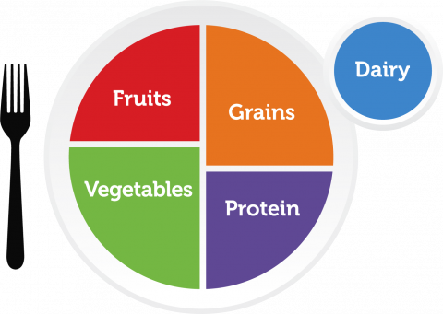
Nutrition Intervention for Bariatric Surgery Patient
Late post-operative nutrition intervention
Late post-operative period – long term diet and habit changes
Nutrition recommendations⁷: Work towards a balanced diet Control portion sizes Focus on mindful eating Have scheduled & structured eating times Track your food intake Take multivitamin/mineral supplements
⁷ Barstad, L.H., Johnson, L.K., Borgeraas, H., Hofsø, D., Svanevik, M., Småstuen, M.C., Hertel, J.K. and Hjelmesæth, J., 2023. Changes in dietary intake, food tolerance, hedonic hunger, binge eating problems, and gastrointestinal symptoms after sleeve gastrectomy compared with after gastric bypass; 1-year results from the Oseberg study—a randomized controlled trial. The American Journal of Clinical Nutrition, 117(3), pp.586-598.

Slide 33
Nutrition Intervention for Bariatric Surgery Patient
Nutrition intervention to consider
Possible problems | Nutrition recommendation
Nausea & vomiting | Take small bites & chew food thoroughly
Diarrhea | Follow lactose-free diet
Dumping syndrome | Avoid high fat & high sugar foods
Dehydration | Patients should strive 64 ounces (1.9L) of liquids per day
Constipation | Increase fluid intake and fibers, when possible
⁶⁷Barstad, L.H., Johnson, L.K., Borgeraas, H., Hofsø, D., Svanevik, M., Småstuen, M.C., Hertel, J.K. and Hjelmesæth, J., 2023. Changes in dietary intake, food tolerance, hedonic hunger, binge eating problems, and gastrointestinal symptoms after sleeve gastrectomy compared with after gastric bypass; 1-year results from the Oseberg study—a randomized controlled trial. The American Journal of Clinical Nutrition, 117(3), pp.586-598.

Slide 34
Nutrition Monitoring for Bariatric Surgery Patient
Nutrition monitoring and evaluation
Monitor adherence to nutrition recommendations
Suggested timeline for post-bariatric MNT visits¹:
2 weeks
6 & 9 weeks
12 weeks
4 to 9 months
1 year
Annually after 1 year
¹Academy of Nutrition and Dietetics. (2020). Nutrition Care Manual: Bariatric Surgery (p. 102-145).

Slide 35
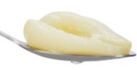
Case Study
Ms. AA
Age | 28
 | Weight (kg) | BMI (kg/m²⁾
Pre-surgery | 99 | 38.6
At surgery | 105 | 41
3 weeks post-op | 98
Fat
PTN foods
REE = 1679 kcal/day (Mifflin-St.Jeor equation)
PA = 1 (sedentary)
TEE = 1679 kcal/day
Non-PTN foods
1 egg
1 Tbsp of canned pear
1 Tbsp avocado
Goals:
Fluid : 1.5-2L/d
PTN: 60g/d

Slide 36
Thank you
Joyce Moawad, MSc.
Lecturer/ Clinical Coordinator
Human Nutrition Department
College of Health Sciences, QU HEALTH
Qatar University
Sep 2, 2023

Slide 37
References
Academy of Nutrition and Dietetics. (2020). Nutrition Care Manual: Bariatric Surgery (p. 102-145).
Gasmi, A., Bjørklund, G., Mujawdiya, P.K., Semenova, Y., Peana, M., Dosa, A., Piscopo, S., Gasmi Benahmed, A. and Costea, D.O., 2022. Micronutrients deficiences in patients after bariatric surgery. European journal of nutrition, 61(1), pp.55-67.
Clinical practice guidelines for the perioperative nutrition, metabolic, and nonsurgical support of patients undergoing bariatric procedures - 2019 update: cosponsored by American Association of Clinical Endocrinologists/American College of Endocrinology, The Obesity Society, American Society for Metabolic&Bariatric Surgery, Obesity Medicine Association, and American Society of Anesthesiologists.
Kushner, R., Cummings, S. and Herron, D., 2017. Bariatric surgery: postoperative nutritional management. UpToDate. Available online: https://www. uptodate. com/contents/bariatric-surgery-postoperative-nutritional-management.
Bettini, S., Belligoli, A., Fabris, R. and Busetto, L., 2020. Diet approach before and after bariatric surgery. Reviews in Endocrine and Metabolic Disorders, 21, pp.297-306.
Soldavini, J., 2019. Krause's food & the nutrition care process. Journal of Nutrition Education and Behavior, 51(10), p.1225.
Barstad, L.H., Johnson, L.K., Borgeraas, H., Hofsø, D., Svanevik, M., Småstuen, M.C., Hertel, J.K. and Hjelmesæth, J., 2023. Changes in dietary intake, food tolerance, hedonic hunger, binge eating problems, and gastrointestinal symptoms after sleeve gastrectomy compared with after gastric bypass; 1-year results from the Oseberg study—a randomized controlled trial. The American Journal of Clinical Nutrition, 117(3), pp.586-598.
Quilliot, D., M. Coupaye, C. Ciangura, S. Czernichow, A. Sallé, B. Gaborit, M. Alligier et al. "Recommendations for nutritional care after bariatric surgery: Recommendations for best practice and SOFFCO-MM/AFERO/SFNCM/expert consensus." Journal of Visceral Surgery 158, no. 1 (2021): 51-61.
Boniecka, I., Czerwonogrodzka-Senczyna, A., Jeznach-Steinhagen, A., Paśnik, K., Szostak-Węgierek, D. and Zeair, S., 2023. Nutritional Status, Selected Nutrients Intake, and Metabolic Disorders in Bariatric Surgery Patients. Nutrients, 15(11), p.2479.

