Slide 1
Disclosure Statement
Speaker:
Prof. Hiba Bawadi
Has no relevant financial relationships to disclose
Will not be discussing unlabeled/unapproved use of drugs or products

Slide 2
When you don’t listen to MOM

Slide 4
Beyond Weight Loss: Weight Maintenance and Long-Term Success
Prof. Hiba Bawadi, PhD
Director of Clinical Education – Qatar University

Slide 5
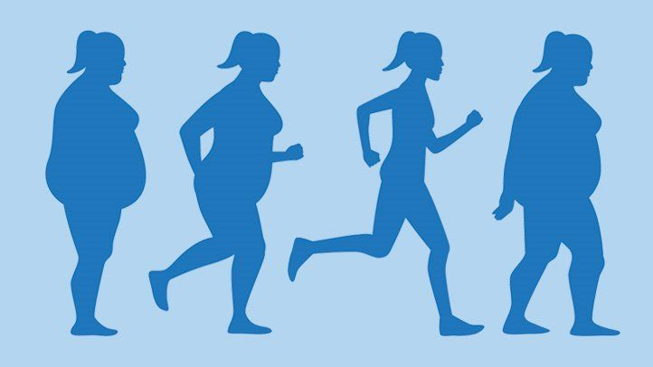
What is the hardest part about weight loss?

Slide 6
The vicious cycle of weight loss
Metabolism slow-down
Normal eating
Weight gain
Diet
End of diet
Why is it dangerous?

Slide 7
A Lifetime Intervention
OBESITY IS A CHRONIC DISEASE SO LET US TREAT IT AS SUCH

Slide 8
Definition
95% of those who try to lose weight , succeed
Only 5% of those are able to maintain the lost weight after the first year

Slide 9
Definition
Let us agree on a definition
losing at least 10% of initial body weight and keeping it off for at least 1 year.
20% of overweight/obese persons able to achieve success.

Slide 10
Challenges of weight loss maintenance
Physiological
Metabolic Adaptation: Very low BMR after prolonged, severe caloric restriction
Yo-yo dieting
Psychological
Emotional triggers, stress

Slide 11
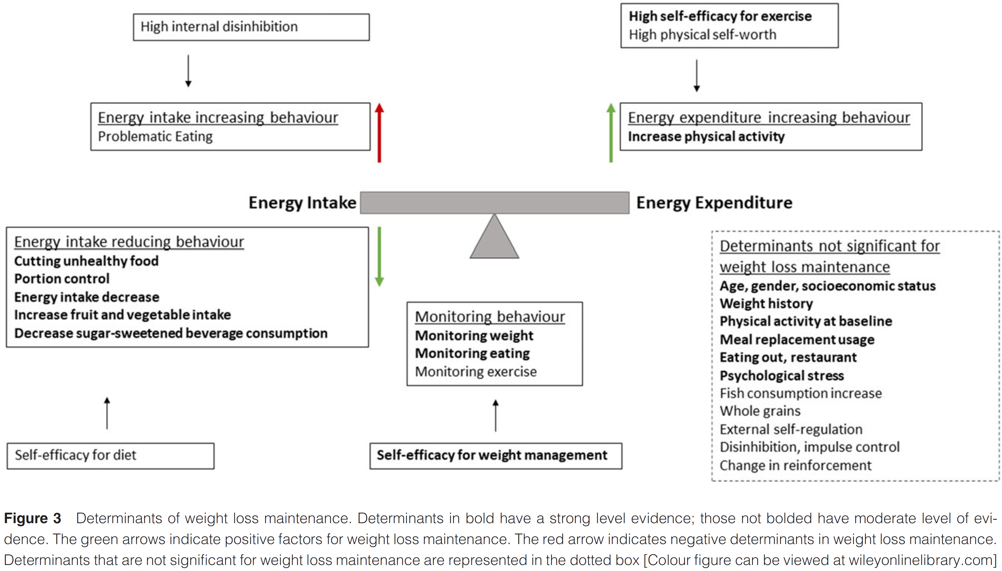

Slide 12
Let us learn from those who succeeded in maintaining their weight loss

Slide 13
Individuals who were successful in weight loss maintenance were
Able to correct weight regain quickly
Self-sufficient & Autonomous
Suffered less from psychological and emotional instability
Suffered less from binge eating and weight cycling.

Slide 14
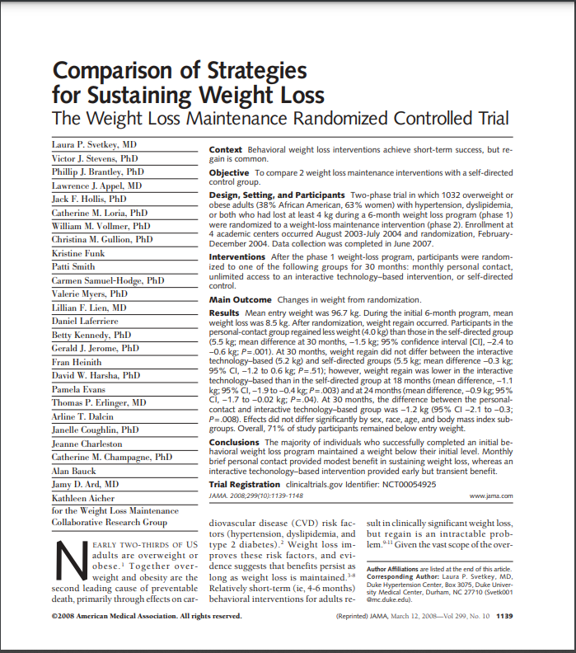
Strategies for successful weight loss maintenance

Slide 15
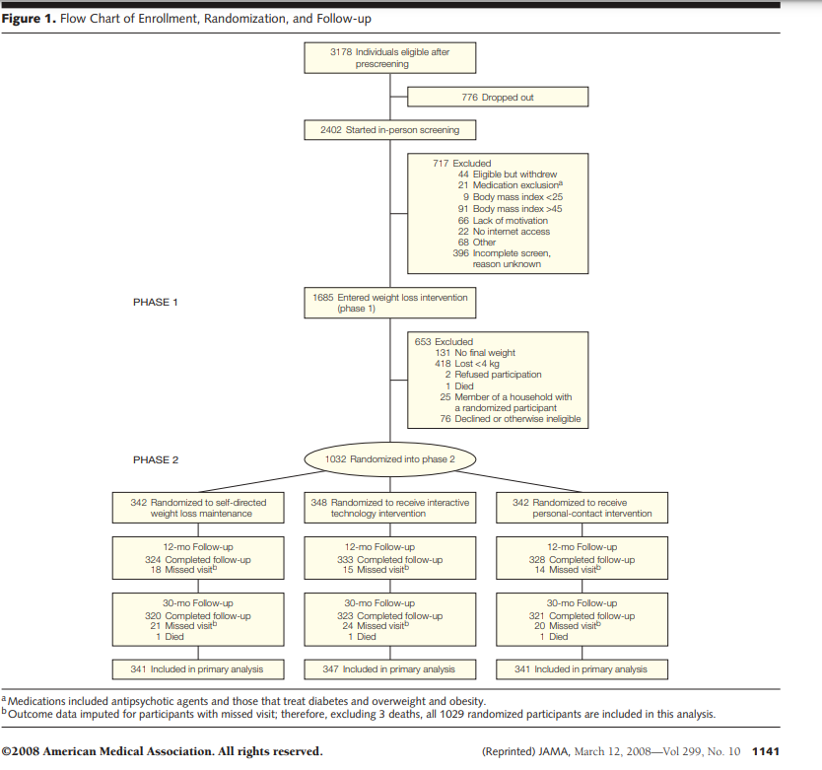
Notes:
self-directed comparison condition in which participants received minimal intervention
Both personal-contact and interactive technology–based interventions reinforced the key theoretical constructs (motivation, support, problem solving, and relapse prevention)
The interactive technology–based intervention included unlimited access to a Web site designed to support weight loss maintenance.²⁵ Interactive features allowed participants to set personal goals and action plans for the next week and to graph personal data over time. Modules addressed problem solving and motivation,
monthly person-to-person guidance and support.

Slide 16
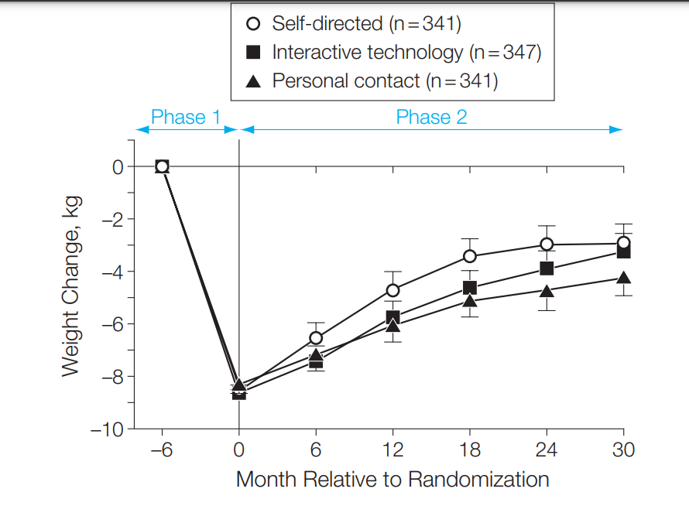

Slide 17
Strategies for successful weight loss maintenance
Before weight loss starts
Make your patient aware that weight loss is not the endpoint

Slide 18
Strategies for successful weight loss maintenance
During weight loss journey
Ensure gradual changes for sustainability.

Slide 19
Strategies for successful weight loss maintenance
After weight loss is achieved
Continue to monitor weight – one visit every 4 months
Work with your patients to develop a strong support system that includes friends, family, or support groups.
Develop healthy coping mechanisms for stress and emotional triggers.

Slide 20
The intervention should be similarly complex!
Assess the energy intake and nutrient content of the diet.
Set Realistic Goals: 5% to 10% within 6 months is recommended (3% to 5% that is maintained can produce clinically relevant health improvements).
Rating: Strong, Imperative
Assess motivation, readiness, and self-efficacy for weight management based on behavior change theories and models (such as cognitive behavioral therapy, transtheoretical model, and social cognitive theory/social learning theory). Rating: Fair, Imperative

Slide 21
The intervention should be similarly complex!
An individualized diet (preferences and health status, nutrient adequacy, and reduce caloric intake).
Select a diet that works for the person on the long-term & is Affordable.
At least 14 MNT encounters (either individual or group) over a period of at least 6 months. Rating: Strong, Imperative
For weight maintenance at least monthly MNT encounters over a period of at least 1 year. Rating: Strong, Imperative

Slide 22
SUMMARY
Weight loss that ensures behavioral change
Reaching the target weight is not the end of the story
Continuous weight maintenance follow up sessions are necessary

Slide 23
CASE STUDY

Slide 24
THANKS

